Slide 1
Psychological issues in the van driver community
Rebecca Posner
Behavioral Psychologist
Transport Research Laboratory

Slide 3
Mental health
1 in 6
State of well-being in which every individual realises their own potential, can cope with the normal stresses of life, can work productively and fruitfully and is able to make a contribution to their community.
(WHO, 2016)
Being mentally healthy is not just the absence of mental health diagnosis, but it is being able to learn, express and manage a range of emotions, form and maintain good relationships and can cope and manage change and uncertainty
(Mental health foundation, 2017)

Slide 4
Mental health at work
48% of people experienced a mental health problem in their current job
Stress and mental health problems account for 70 million days of work absence every year
32% of men attribute poor mental health to their job
Presentism costs UK business up to £15.1 billion p.a
Staff turnover due to mental health problems costs £2.4 billion each year
30% of work-related illnesses within transport and logistics due to stress, depression and/or anxiety

Slide 5
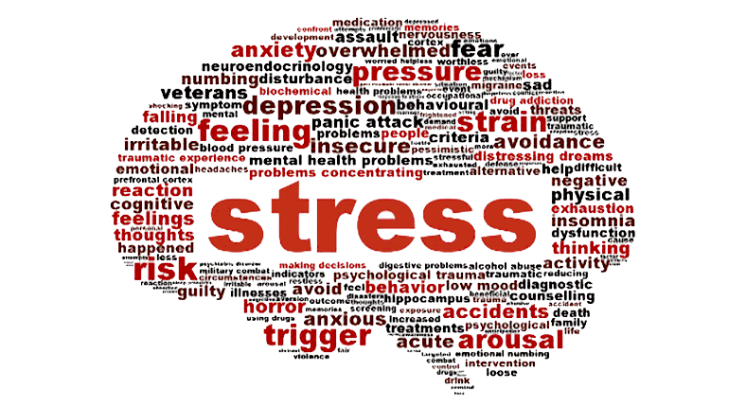

Slide 6
Stress
The adverse reaction people have to excessive pressures or other types of demand placed on them
Six areas of work design that affect stress levels:
Demand
Control
Support
Relationships
Role
Change

Slide 7
Mental health at work
Working environment and driver mental health
High competitiveness and increased company scrutiny
Working environment on driver mental health
Long hours, pressure of just in time deliveries, irregular shift work
High demands for continuous mental altertness
Low job control and high insecurity
High work-life conflict and chronic social isolation

Slide 8
Mental health at work
Working environment and driver mental health
Higher levels of poor mental health
Higher prevalence rate of depression, anxiety and stress
Working environment on driver mental health
High prevalence rates of sleep problems and chronic fatigue
Higher levels of social dysfunction and loneliness
Fewer seeking professional support

Slide 9
Stress and driving behaviour
Increased self-reported crash involvement
Increased cognitive lapses
Increased driving errors
Increased traffic violations
Stress is the result of a dynamic relationship between the individual and the environment
Stress

Slide 10
Mental health and driving behaviour
Anxiety
Post-traumatic stress disorder (PTSD)
Mental Health
Overall wellbeing
Attention Deficit Hyperactivity Disorder (ADHD)
Driver behaviour
Obsessive compulsive disorder (OCD)
Depression
Sleep disorders
Panic disorders
Psychological traits e.g. psychopathic
Stress
Substance abuse

Slide 11
Those with higher levels of positive wellbeing and appraisal demonstrated more positive driving behaviour.
Engaging in less violations, such as indicating hostility to other others and missing warning signs.
Wellbeing and driver behaviour
Those with higher levels of negative wellbeing and appraisal reported higher propensity to commit violations.

Slide 12
Mental health and fleet safety
Higher levels of anxiety
Higher levels of insomnia
Traffic offenders
Higher levels of depression
Higher levels of social dysfunction

Slide 13
Perception vs Reality
Depression
Anxiety
26.9%
14.5%
Rated their overall mental health as good, very good or excellent
89.7%
Sleep problems
20.6%
Past or current feelings of loneliness
27.9%

Slide 14
Questions?
Rebecca Posner
Psychologist
rposner@trl.co.uk
+44 [0]1344 770 431
TRL | Crowthorne House | Nine Mile Ride | Wokingham
Berkshire | RG40 3GA | United Kingdom

