Slide 1
Fatigue
Marcus de Guingard
Managing Director
The 3rd Pillar of Health

Slide 2

Fatigue
FTA Van Excellence
March 2019
Twitter: @3rdPillarHealth
© Third Pillar of Health Ltd 2019

Slide 3
Introduction
“Tiredness reduces reaction time, vigilance, alertness and concentration so the ability to perform attention-based activities (such as driving) is impaired. The speed at which information is processed is also reduced by tiredness and the quality of decision making may also be affected.”
RoSPA
Twitter: @3rdPillarHealth
© Third Pillar of Health Ltd 2019

Slide 4
Why is sleep important?
Twitter: @3rdPillarHealth
© Third Pillar of Health Ltd 2019

Slide 5
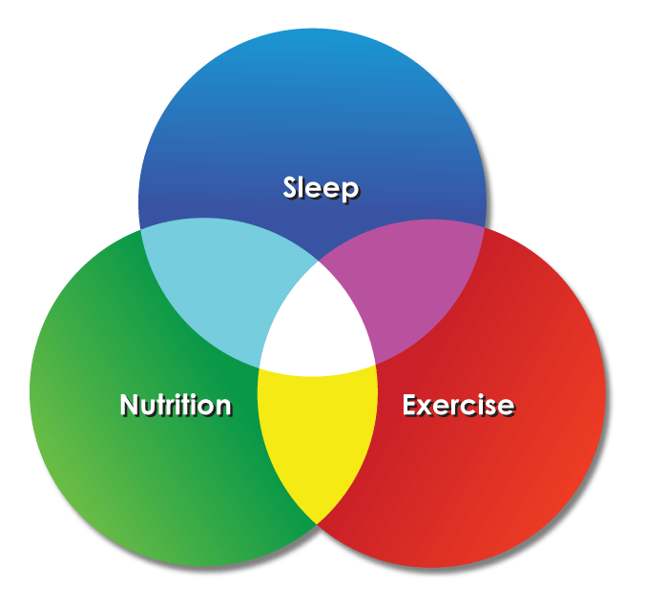
Sleep is the third pillar of health
Twitter: @3rdPillarHealth
© Third Pillar of Health Ltd 2019

Slide 6
Effects of sleep deprivation
What happens if you don’t get enough sleep?
Daytime drowsiness to microsleeps and ‘sleep seizures’
Stress, mood shifts, irritability & strained relationships
Physiological issues including reduced immunity and weight gain
Reduced energy, alertness, vigilance and productivity
Reduced vocabulary and poor communication skills.
Twitter: @3rdPillarHealth
© Third Pillar of Health Ltd 2019

Slide 7
Are we getting enough sleep?
Twitter: @3rdPillarHealth
© Third Pillar of Health Ltd 2019

Slide 8
The incidence of sleep deprivation
[CDC] Tiredness and poor sleep is America’s greatest ‘public health issue’
Between 1999 and 2010 those sleeping less < 7 hours rose from 34% to 46% [1]
At any one time 20% of people in developed and 17% in developing countries are suffering sleep problems [2]
35% of Americans get inadequate sleep. Sleep disorders are on the rise.
Sleep deprivation is widespread. No organisation is unaffected!
[1] National Sleep Foundation
[2] Warwick University
Twitter: @3rdPillarHealth
© Third Pillar of Health Ltd 2019

Slide 9
What we’ve found
Twitter: @3rdPillarHealth
© Third Pillar of Health Ltd 2019

Slide 10
Key findings from UK working populations
Twitter: @3rdPillarHealth
© Third Pillar of Health Ltd 2019

Slide 11
Implications of poor sleep to the individual
Twitter: @3rdPillarHealth
© Third Pillar of Health Ltd 2019

Slide 12
Impact of fatigue on health
Increased risk of obesity in short sleepers (between 23% & 73%) [1]
Significant increased risk of diabetes (up to 2.5x) [2]
Increased risk of dying of heart disease (up to double) [3]
Much more likely to catch a cold or flu virus (up to 4 times) [4]
Sleep disturbance linked to cancerous tumor growth in animals [5]
[1] US National Health & Examination Survey
[2] Boston University School of Medicine
[3] UCL & Warwick Universities
[4] Archives of Internal Medicine, 2009
[5] Chicago and Louisville Universities
Twitter: @3rdPillarHealth
© Third Pillar of Health Ltd 2019

Slide 13
Impact of fatigue on performance & safety
Sleeping 4 to 5 hours a night for a week impairs performance to the same extent as being legally drunk [1]
6 hour sleepers are 11x more likely to make mistakes after 14 days of sleep restriction. This rises to 14x for 4 hour sleepers [2]
Sleepiness accounts for c. 20% of accidents on UK roads [3]
Sleep deprivation affects the flow of blood to 3 areas of the brain which paly a crucial role in: decision making, attention span and the speed at which we adopt new information [4]
[1] Harvard Business Review
[2] Pennsylvania University
[3] Department of Transport & www.sign.ac.uk
[4] Dr Sara Mednick “Take a Nap! Change your life” (Workman Publishing, 2006)
Twitter: @3rdPillarHealth
© Third Pillar of Health Ltd 2019

Slide 14
Fatigue danger zone
1
2
3
4
5
6
7
8
Fatigue Danger Zone
Twitter: @3rdPillarHealth
© Third Pillar of Health Ltd 2019
Notes:
The main cause of fatigue is getting insufficient quality sleep.
Most people need 7 to 8 hours of good quality sleep in order to maintain their energy levels during the day.
Studies have also shown that on any given night, if you get less than six hours of sleep puts you in the danger zone of reduced alertness the following day. So, if you know you’ve gotten too little sleep the previous night, you need to be especially mindful of your ability to function the following day.

Slide 15
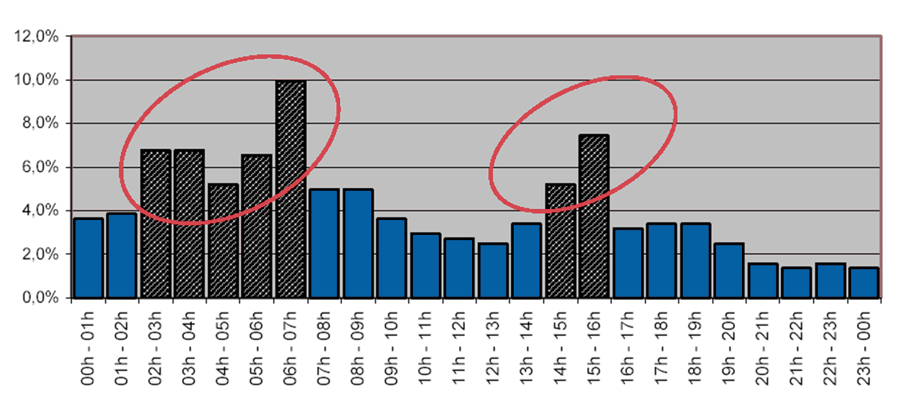
Hourly breakdown of fatal RT accidents
AAAA
50% of fatal accidents happen at night (for 20% of traffic)
Risk of drowsiness exists at every hour and on all trips.
2h – 7h
14h – 16h
Source : Sommeil, attention, vigilance : Recherche française et européenne, 06/05/2008, Jacques Boussuge, ASFA
Twitter: @3rdPillarHealth
© Third Pillar of Health Ltd 2019

Slide 16
Relationship between sleep and drowsy driving
The quantity and quality of sleep we obtain is intrinsically linked to our alertness
The general consensus is that we need 7 to 9 hours of quality sleep to function at our best the next day
Our in-built biomechanical mechanism sends signals to the brain that we need sleep – which causes sleepiness
Total time awake makes a difference. 18 straight hours is equivalent to BAC of 0.05 and 24 hours to 0.1 BAC
There is an increase in the incidence of sleep disorders – particularly insomnia and sleep apnoea.
Twitter: @3rdPillarHealth
© Third Pillar of Health Ltd 2019

Slide 17
Driver fatigue
Twitter: @3rdPillarHealth
© Third Pillar of Health Ltd 2019

Slide 18
General statistics on fatigue and driving
Fatigue accounts for c. 20% of accidents on UK roads [1] and 30% of fatal accidents [2]
Drivers awake for 24 hrs are 7x more likely to have an accident [3]
Fatigue-related accidents tend to be more serious due to lack of corrective action [4]
Each crash costs £800 in repair costs with vehicle off the road for 7 days. [5]
[1] UK Department for Transport (DFT)
[2] US Department of Transport
[3] Adelaide Sleep Research Centre
[4] DFT Fatigue & Road Safety Analysis (February 2011)
[5] DFT – Driving for Work
Twitter: @3rdPillarHealth
© Third Pillar of Health Ltd 2019

Slide 19
Tired driving – attitudes and incidence
78% of people think it is unacceptable and 66% totally unacceptable to drive when tired
However 40% of car, van and lorry drivers said they have carried on driving when too tired
60% of the population have driven whilst drowsy in the past year
25% of the population drive whilst drowsy to or from work a least a few days each month (36% of shift workers) [1]
4.2% of drivers admitted to falling asleep at the wheel at least once in past 30 days (11% in the past year). [2]
[1] National Sleep Foundation
[2] US Centres for Disease Control & NHTSA
Twitter: @3rdPillarHealth
© Third Pillar of Health Ltd 2019

Slide 20
Statistics – Driving and work
10% of people who own a vehicle for work admitted falling asleep at the wheel in last 12m [1]
25% of road deaths involve someone driving for work [2]
Increased risk of a sleep-related crash for those:
  Taking drowsy medicine 6.22x
  Sleeping less than 5 hours 4.60x
  Sleeping 5 to 5.9 hours 3.50x
  Working irregular patterns 2.24x
  Sleeping 6 to 6.9 hours 1.95x
[1] Brake & Green Flag, 2008
[2] Department of Transport, 2008
Twitter: @3rdPillarHealth
© Third Pillar of Health Ltd 2019

Slide 21
Drowsy driving – costs to the company
Sick leave resulting from road traffic accident
Lost working time due to car being off the road for repairs
Car repair bill
Medical expenses
Increased insurance premiums where cover is provided for
  Car insurance
  Medical insurance
  Any kind of death in service payment (in the event of a fatal accident)
Recruitment expenses (for new or temporary staff).
Twitter: @3rdPillarHealth
© Third Pillar of Health Ltd 2019

Slide 22
Tell-tale signs of drowsy driving
Frequent yawning and Eyelids drooping
Straining your eyes to focus on the road
Memory lapses or frequently hitting the rumble strips
If you experience any of these signs you are at risk of a microsleep
  A microsleep can last from fractions of a second up to 2 seconds and result in a total loss of alertness
  At 56 miles per hour (90 Km / hr) a vehicle will travel 25 metres per second
  The good news is tiredness does not suddenly come upon us. As indicated there are warning signs
Twitter: @3rdPillarHealth
© Third Pillar of Health Ltd 2019

Slide 23
Strategies to avoid drowsy driving
Common but ineffective countermeasures include:
Winding down the window
Turning up the music
Stopping to take a quick walk
Talking to a passenger
Stopping to splash cold water on your face
Adjusting the seat so it is uncomfortable
Changing lanes more frequently.
In laboratory tests NONE of these countermeasures were shown to reduce drowsiness and increase alertness.
Twitter: @3rdPillarHealth
© Third Pillar of Health Ltd 2019

Slide 24
Effective countermeasures
Obtain adequate sleep before a journey
Take a nap before a journey
Avoid driving in the early morning
Pull over to a roadside hotel to sleep
Drink a caffeinated drink and immediately take a 15 to 20 minute nap
Change drivers (providing the new driver is alert).
Twitter: @3rdPillarHealth
© Third Pillar of Health Ltd 2019

Slide 25
Why WTRs and HOS rules are not enough
Working Time Regulations and Hours of Service rules are not in themselves
enough to protect your staff because:
The fail to take into account undiagnosed sleep disorders
They fail to take account of poor sleep habits (widespread across society)
The fail to take into account the consequences of rotating shifts patterns
They fail to take into account parents with young children who suffer from frequent sleep disruption
They often fail to take into account commuting times, which do not allow for sufficient rest between shifts.
Twitter: @3rdPillarHealth
© Third Pillar of Health Ltd 2019

Slide 26
How you can address this issue?
Twitter: @3rdPillarHealth
© Third Pillar of Health Ltd 2019

Slide 27
Best practice approach to addressing the problem
We believe that there are 4 key elements to a programme which tackles common issues in respect of fatigue.
Awareness
Policies and procedures review
Train-the-trainer
Interventions.
Twitter: @3rdPillarHealth
© Third Pillar of Health Ltd 2019

Slide 28
Possible staff interventions
Company | Cultural | Free / Regulatory | Technological | Other
Policies & procedures | “Just” culture | Hours of service & WTD | Fatigue forecasting models | Education
Occupational Health | Alter tasks | HSE Fatigue & Risk Index | Light therapy | Napping / controlled rest
Employee Assistance (EAP) | Enable staff to voice concerns | Epworth, PSQI, Karolinska | Driving tech | Train-the-trainer
Accident investigation forms | Educate managers | Need for recovery (NFR) | Wearable tech | Cognitive tests
Twitter: @3rdPillarHealth
© Third Pillar of Health Ltd 2019

Slide 29
Contact details
Marcus de Guingand
Managing Director, Third Pillar of Health
Connect with me on LinkedIn: https://uk.linkedin.com/in/marcusdeguingand
Email: marcus@thirdpillarofhealth.com
Office: +44 (0)845 686 0022
Website: www.thirdpillarofhealth.com
Twitter: @3rdPillarHealth
Twitter: @3rdPillarHealth
© Third Pillar of Health Ltd 2019

