Slide 1
Blast of Innovation
Liz Horsey
Divisional Marketing Manager
Bott Ltd

Slide 2


ENHANCING PERFORMANCE
IN
‘INDUSTRIAL ATHLETES’
Notes:
Good morning / afternoon

Slide 3

Functionality
Durability
Van Operative Performance + Wellbeing
Weight
VoRs
Cost
Notes:
At Bott, we recognise that for any investment, there is a balance to be had between functionality, durability and cost
+ for vans, we could also include considerations as such as weight, time lost due to VoRs and also, the performance and wellbeing of the van operatives themselves.

Slide 4
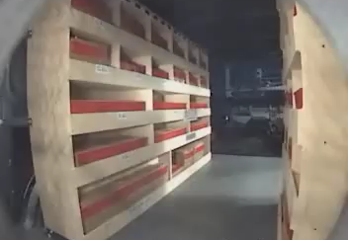
Will this support outstanding performance by your industrial athletes??
Wooden racking crash test example
Notes:
Here is an example of some wooden racking. It looks functional, but keep watching to see how it performed in a crash test simulation.

Slide 5
5 conversion areas that drive efficiencies
Notes:
That was an extreme example of equipment failure, but at Bott we are committed to helping fleet managers find cost effective, durable and compliant solutions which drive genuine efficiencies day in, day out – and can also help reduce operative stress levels.

Slide 6









5 conversion areas that drive efficiencies
Workspace Organisation
Save time daily through efficient tools and stock storage
Fit For Purpose Equipment
Minimise downtime & inefficient working with kit that delivers over the long term
Load Planning
Enable quicker, compliant stowing of kit
+ vehicle right-sizing
Optimised power solutions
Efficiently and safely get the job done with the right power and lighting solutions
Safer Storage
Reduce time and tool losses with
enhanced security options
Notes:
From simply getting more organised, reducing time-wasting finding parts and tools,, to ergonomic layouts and equipment that make it quicker and safer loading the van, which and can reduce incidents from overstretching, poor weight dispersal or movement in transit.
Fully understanding daily tasks can also help ‘right size’ the base vehicle required. Through this, we’ve recently assisted a number of customers actually move to smaller vans, cutting upfront and running costs
Finally, assessing any additional security needs and identifying fit-for-purpose equipment and power solutions can make a big different to operative performance, helping get the job done more efficiently and minimising downtime from breakdowns.
Our remote data-logging service can help to determine what is the best solution for your needs, from high power inverters, to low noise, low emission ‘engine off’ alternatives.

Slide 7

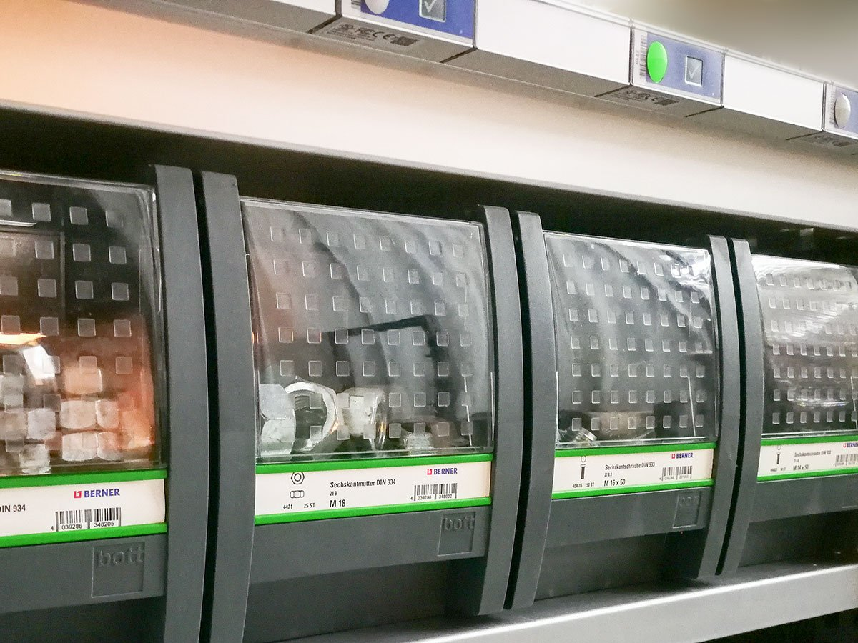


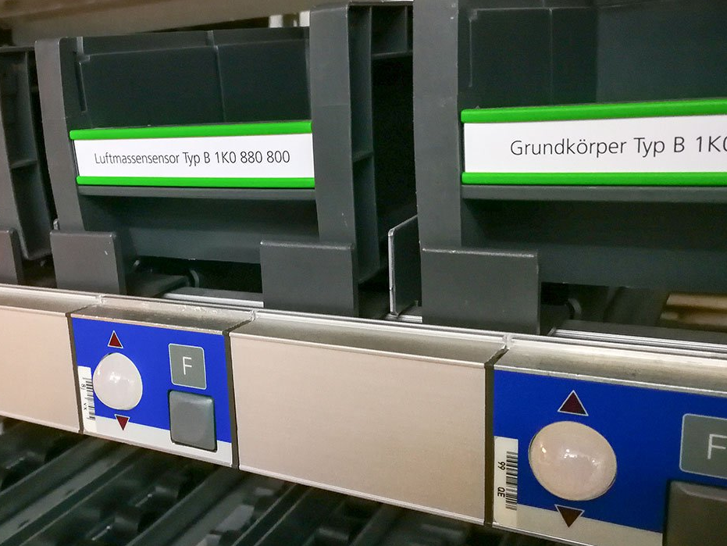
NEW – Pick-to-Light Solution
Saves valuable time & builds operational efficiency
Enhanced by software linked to:
  Stock management system – enabling auto re-ordering of used items
  Automated job billing
Ideal for overnight stock replenishment or easy pre-ordered stock collection from depot
Notes:
We are here today however, to talk about innovation. One solution Bott have recently launched is our ‘pick-to-light’ system. Simply scan a barcode and this lights a storage location in the van.
This can quickly build operational efficiency, with valuable minutes adding up over the week.
This can also be linked to stock management software, enabling automated reordering of items used and easy inclusion in job billing.
Ideal for service engineers and Housing Associations, ‘pick to light’ helps quick stock replenishment, either remotely by separate personnel, or pre-ordered and collected from depot
– this solution will directly help reduce pressure and increase the performance of your industrial athletes.

Slide 8

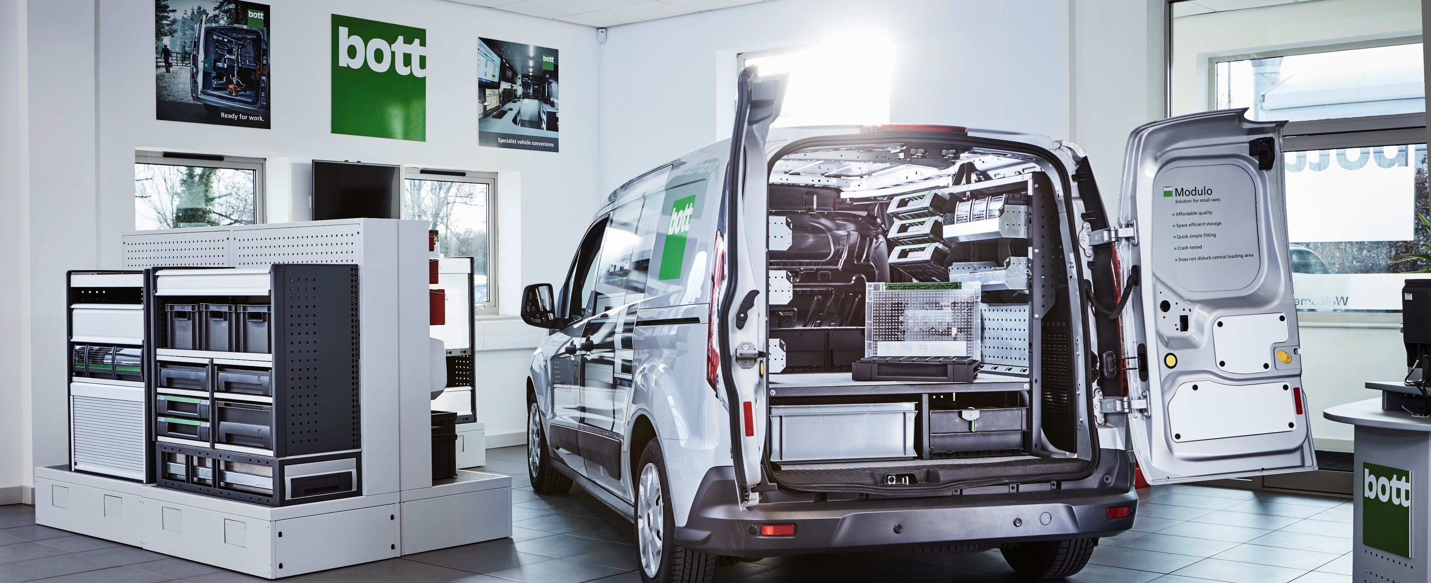
Notes:
Please come and talk to the team today if you would like to learn more about our pick-to-light system, or how Bott can support you in running a safe and compliant fleet.

