Slide 1
Resilience and Mind set
Andy Neale
Founder & Managing Director
NFE Group

Slide 2
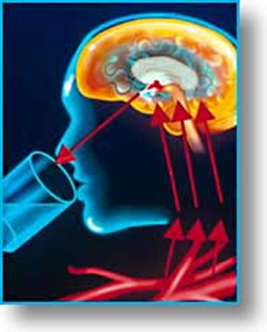
Driving Health, Wellbeing & Resiliency By Andy Neale

Slide 3

Driving Health, Wellbeing & Resiliency
Health & Wellbeing?
We all know what it is and how to achieve it; let’s test that theory!
We’ll start with some group exercise!
Lets play ‘Heads & Tails’

Slide 4
Driving Health, Wellbeing & Resiliency
Q1. If I eat more calories than I burn on a daily basis I will gain weight?
Heads - Agree
Tails - Disagree
Q2. Eating foods high in salt is healthy for my heart?
Heads - Agree
Tails - Disagree

Slide 5
Driving Health, Wellbeing & Resiliency
Q3. Drinking lots of alcohol is good for my liver?
Heads - Agree
Tails - Disagree
Q4. Drinking caffeine after 1pm day will help me sleep well?
Heads - Agree
Tails - Disagree

Slide 6
Driving Health, Wellbeing & Resiliency
Q5. Regular exercise is good for me?
Heads - Agree
Tails - Disagree
Q6. Staying hydrated by drinking 2l of water a day is healthy?
Heads - Agree
Tails - Disagree

Slide 7
Driving Health, Wellbeing & Resiliency
Q7. Smoking is healthy for me and for those around me?
Heads - Agree
Tails - Disagree
So there we have it everyone still stood up can now leave!
So why don’t we lead that life?
This is about us taking responsibility for our own Health

Slide 8
Driving Health, Wellbeing & Resiliency
What can we do corporately to help those around us?
Firstly create a culture whereby healthy living is discussed and expected
Then give our colleagues the tools for the job – training through knowledge
Training is about encouraging others to learn and reinforcing messaging
High profile and ongoing – reward and encourage
Culture change – nothing grows in the shade!
Corporate Wellbeing will follow

Slide 9
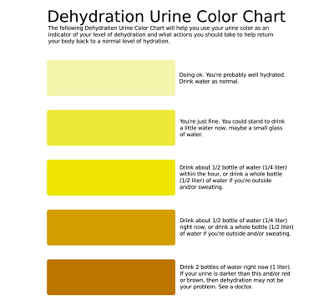
Put up posters in all toilets

Slide 10
Driving Health, Wellbeing & Resiliency
What is Resiliency?
The ability to Cope with Stress
The ability to Recover from stuff!
Bouncebackability!

Slide 11
Driving Health, Wellbeing & Resiliency
So who has had any training in how to cope!
Last year we covered some basics that are free to use
  Breathing
  Hydration
Heart Rate Variability – The Heart rules the Head – Literally

Slide 12
Key Brain Circuits
Thinking Centres
Hippocampus
Hormonal
Centres
Emotional
Centres
Pituitary
Amygdala
Autonomic
Centres
Notes:
22
22
Purpose: The effect of different signals on brain.
Incoherent signal sent from heart to brain inhibits all centres.
Coherent signal enhances all centres.
This is why these techniques improve:
Blood pressure (autonomic centres)
Emotional maturity, balance (emotional centres - amygdala, hippocampus)
Cortisol:DHEA balance (hormonal centres)
Thinking, Planning, Decision Making, Creativity. (cognitive centres)
Cortical Facilitation & Cortical Inhibition.
Body generates both signals already, but today we mainly generate the chaos.
Chaotic signal did have survival importance:
sabre-toothed tiger story, stop to evaluate, or be smart - leads to death.
We live in chaos, rarely see coherence (holidays, hot shower, bubble bath).
Techniques teach us how to flip the switch at will.
Important implications for safety.

Slide 13
Driving Wellbeing & Resiliency
Cortical inhibition
Bad decisions
Driven by emotion and not the brain

Slide 14

Notes:
7.6 secs to 35 seconds

Slide 15

Notes:
7.6 secs to 35 seconds

Slide 16
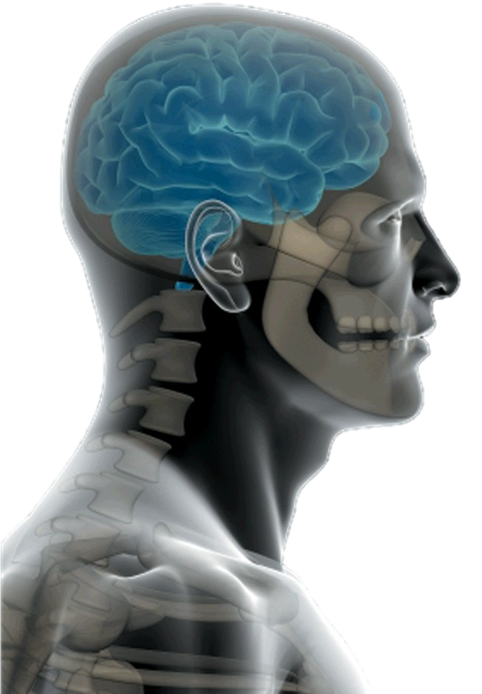
The Power of the Brain
How good are you at multitasking?
TOP TIPS for BRAIN HEALTH
Drink 2 Litres of Water per day
Control Stress
Sleep for at least 4 cycles every day
Only 2% body weight
Uses 20% energy
73% is water
100 billion nerve cells
Notes:
22
22
Purpose: The effect of different signals on brain.
Slide 6 - Run through key brain facts. What makes it not work probably is Stress, chimp brain and pressure. Here's some top tips to help it.
Drink water - 2% Dehydration causes issues
Cortisol the stress hormone destroys brain cells. You know how to control cortisol, breathe!
4 Cycles of Sleep. We will talk about this a little later
Incoherent signal sent from heart to brain inhibits all centres.
Coherent signal enhances all centres.
This is why these techniques improve:
Blood pressure (autonomic centres)
Emotional maturity, balance (emotional centres - amygdala, hippocampus)
Cortisol:DHEA balance (hormonal centres)
Thinking, Planning, Decision Making, Creativity. (cognitive centres)
Cortical Facilitation & Cortical Inhibition.
Body generates both signals already, but today we mainly generate the chaos.
Chaotic signal did have survival importance:
sabre-toothed tiger story, stop to evaluate, or be smart - leads to death.
We live in chaos, rarely see coherence (holidays, hot shower, bubble bath).
Techniques teach us how to flip the switch at will.
Important implications for safety.
Use the standing on one leg etc. before moving on to next slide

Slide 17

30 seconds to remember these words
Vase
Tiger
Book
Piano
Hat
Teapot
Camera
Ice cream
Spade
House
Notes:
Slide -7 Exercise- You have 30 seconds to look at these 10 words with a view to remembering them. After 30 seconds, tell them to write down as many as they can remember.
- Ask how they did? Why can't we remember? Yes, other stuff in your head. How can we control this? Breathing!!
EXERCISE: Can we multi-task? Get them to stand on one leg, raise right arm and draw a rectangle using your index finger, then raise left arm and draw the number 6 at the same time.
We can multitask, but the max is 3 and even then it's hard.

Slide 18
Write down as many of the words as you can remember
Vase
Tiger
Book
Piano
Hat
Teapot
Camera
Ice cream
Spade
House
Now read this next slide out aloud as a group
Notes:
Slide -7 Exercise- You have 30 seconds to look at these 10 words with a view to remembering them. After 30 seconds, tell them to write down as many as they can remember.
- Ask how they did? Why can't we remember? Yes, other stuff in your head. How can we control this? Breathing!!
EXERCISE: Can we multi-task? Get them to stand on one leg, raise right arm and draw a rectangle using your index finger, then raise left arm and draw the number 6 at the same time.
We can multitask, but the max is 3 and even then it's hard.

Slide 19
I cnduo’t bvleiee taht I culod aulacity uesdtannrd waht I was rdnaieg. Unisg the icndeblire pweor of the hmuan mnid. Aocdcrnig to rseecrah at Cmabrigde Uinervtisy, it dseno’t mttaer in waht oderr the lterets in a wrod are, the olny irpoamtnt tihng is taht the frsit and lsat ltteer be in the rhgit pclae.
Notes:
Slide -8 The brain's power to predict! What the brain needs to do is stay in control so it can predict what will happen to keep us safe. Read the following sentence. How good is your brain! However, it needs to relax and not be stressing to do this.

Slide 20

SLEEP
Sleep is one of the most basic human functions but a third of us struggle to get enough. Some simple changes can make a big difference.
Sleep loss = fluctuations in blood pressure, heart rhythms & digestion
Insomniacs are 4 x more likely to experience relationship problems
Know your sleep cycle and prepare for a good sleep
Recharge
Notes:
Slides -9-11. Run through sleep and it's importance. The sleep cycle and tips. We are asking people you struggles with sleep. We tell them we have put together a PDF with some top tips on how to get better sleep, including tips for night shift workers. Just give us your email and we'll send it to you.

Slide 21
Sleep cycles repeat every 1.5h

Slide 22
Driving Wellbeing & Resiliency
How do we know who needs help?
  £1 per person per month - £12 per employee per year!
How do they know they need help?
  Because we encourage them to learn, high profile programme
How do they know help is available?
  We provide a culture that tells them and normalises
  Wearable tech?

Slide 23
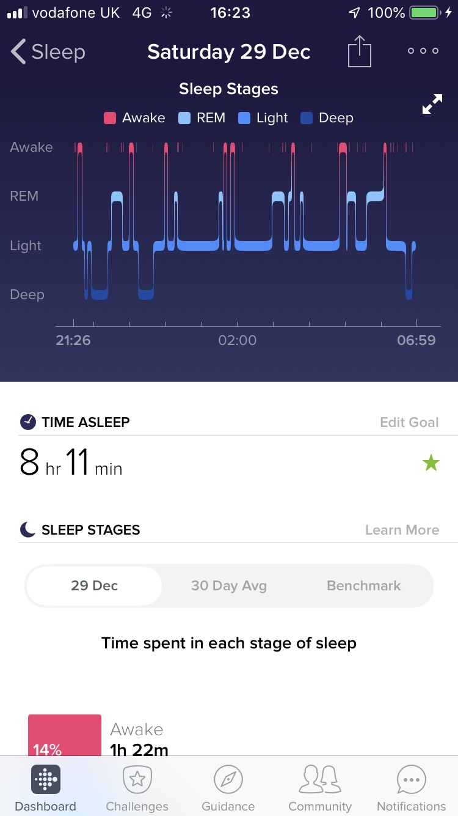
Real life example from Fitbit watch

Slide 24
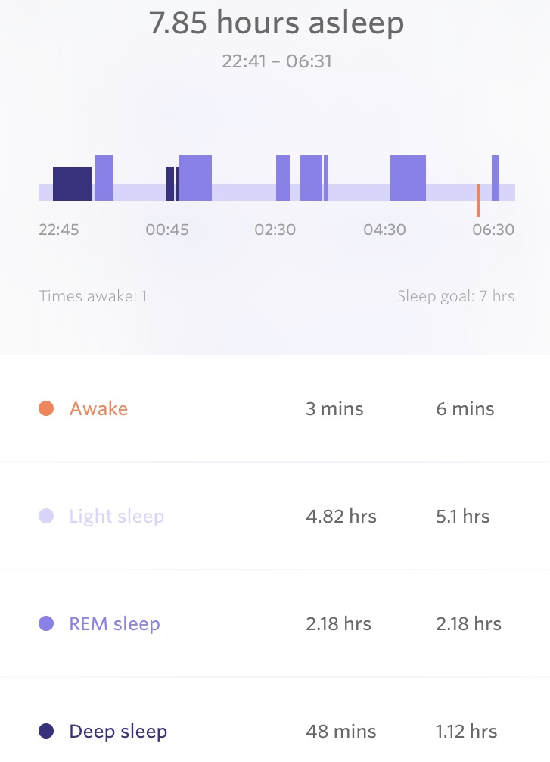
Real life example from Spire Health tag
Notes:
Currently running a small trial with this ‘wearable tech’ on L&SE route

Slide 25
Driving Wellbeing & Resiliency – “Driving like Grandma”
Practical Driver Training for all drivers!
Saves fuel and saves CO2 and creates more time
Data analysis as audited by EST from Jan-May 2018 – 450 drivers across multiple fleets and vehicle types
  Average fuel saving of 11.92%
  Average journey time reduction of 3.5%
  40 hour week = 1 ¼ hours
  Better mental skills, more constant speed, reducing braking, acceleration & gear changes. More space and time = Less stress

Slide 26
Driving Wellbeing & Resiliency – “Driving like Grandma”
The savings pay for the training!
They will also pay for the Wellbeing Programme!
Last year free water and free breathing this year free driver training and a free Driver Wellbeing programme

Slide 27



Thank You!
Follow us
@automotional1
@Perfondemand

