Slide 1
EU workers and the future of Immigration Policy
Sally Gilson
Head of Skills Campaigns
FTA

Slide 2
Logistics and EU Workers
13% 43,000
19% 113,000
11% 29,000
Notes:
Currently a HGV driver shortage of 52,000. Add to this the number of EU nationals we are currently reliant on and across logistics we have a potential problem.
19% of warehouse workers and 11% of van drivers
However, the 11% for Van driver will be substantially higher due to the way that job roles are classified, therefore our exposure around these jobs will be much higher.

Slide 3
Brexit: Current State of Play
EU27 agrees to Article 50 extension until 22nd May if Withdrawal Agreement approved
If Withdrawal Bill not agreed then extension to 12th April
Before the 12th April, UK will need to decide whether to ask for longer extension or leave with no deal
FTA Brexit advice is still to prepare for a No Deal
Notes:
It’s almost impossible to predict exactly how Brexit will play out
However as it stands, these are the current important dates
Theresa May requested an extension to Article 50, this was granted until 22nd May but only if the Withdrawal Agreement was approved which would then give UK parliament time to put through the necessary legislation
However if the Withdrawal Bill is not agreed then the extension will end on 12th April
At this point the UK could request a further extension but would need a specific reason for this and would need to take part in the European Elections.
If no further extension is requested then we will leave the EU without a deal on 12th April at 11pm
There are many ways this could play out and it is constantly evolving. As of now, we are expecting a number of indicative votes that are not legally binding to take place to indicate what kind of deal, if any would be passed by parliament.
Our advice to members remains to prepare for No Deal

Slide 4
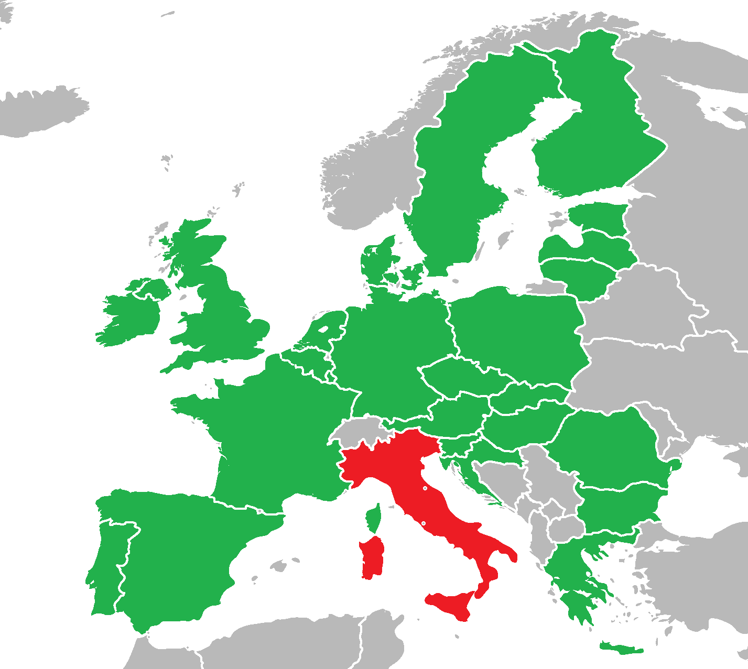
Transport of goods by motor vehicles whose Total Permissible Laden Weight (TPLW), including trailers, does not exceed 3.5 tonnes
Permit not required
ECMT permit (or bilateral permit) required
Italy
Notes:
In all EU countries except Italy:
Van transport is liberalised; no ECMT permit is required; there are no specific restrictions.
In Italy (even if the journey only includes transit through Italy):
The rules and restrictions described in the table apply. If a given transport operation fits in one of the blue boxes (ie. ECMT permit required), Italian authorities will look at the whole journey and will apply all ECMT rules (eg. 3 cross trade operations maximum).

Slide 5
Status of EU/EEA Citizens - Transition
Settled Status
5 years or more continuous residency
Pre-Settled Status
Under 5 years continuous residency
Post 12th April 2019
Free movement will continue throughout the transition period - 31/12/20
Applications open fully from March 2019
Apply for pre-settled status until 5 years completed
Applications can be made during this time for Pre-Settled Status
Irish citizens
Irish citizens can continue to work and live in UK as part of the Common Travel Area
Notes:
Just a quick explanation of the system for EU/EEA Citizens to apply to stay post Brexit
For any EU/EEA Citizen that has been in the UK for 5 years or more and that means live in the UK for 6 months or more in a year. They will be invited to apply for settled status. This was opened to EU citizens in February and will be open to all EU/EEA citizens by the end of this month
For anyone who has been here for less than 5 years, they can apply for pre settled status and then once the 5 years are completed they can apply for settled status
In the case of a transition period, freedom of movement will continue and anyone arriving during this time can apply for pre settled status
Irish Citizens have a separate agreement via the Common Travel Area and will be able to live and work across the UK whatever the scenario

Slide 6
Status of EU/EEA Citizens: No Deal
Settled Status
5 years or more continuous residency
Pre-Settled Status
Under 5 years continuous residency
Post 12th April 2019
EU nationals wanting to stay longer than 3mths can apply for European Temporary Leave to Remain for max 36mths, open until end 2020.
Applications open fully from March 2019 until Dec 2020 (March 2021 if transition)
Apply for pre-settled status until 5 years completed, then settled status will be granted
Irish citizens
Irish citizens can continue to work and live in UK as part of the Common Travel Area
Can then apply to stay via new Immigration scheme
EU Nationals allowed to stay for up to 3mths without a visa
There will be a fee for the European Temporary Leave to Remain, cost not yet confirmed
Notes:
In the case of a no deal; any EU/EEA citizens already living here will continue to apply for settled or pre settled status as before.
However, Freedom of Movement will end, therefore any EU/EEA citizen arriving after the 12th April will be able to stay for up to 3 months for travel, tourism and business but if they want to stay longer then they will have to apply for a European Temporary Leave to Remain.
There are no salary or qualification restrictions to this however they will have to pay for this visa.
This will allow them to stay for up to 36mths, once the time has expired they would have to leave or apply via the new Skills Based Immigration System. If they don’t fit this criteria then they will have to leave immediately
Again, Irish Citizens in the UK and UK citizens in Ireland will continue to have freedom of movement via the Common Travel Area
It’s worth noting that only 5% have so far applied so there are many people to process and get the message out to!

Slide 7
New employers’ duties – if ‘No Deal’
Until 2021:
EU citizens will continue to be able to evidence their rights to work and to rent property using a passport or national identity card. Employers, landlords etc won’t have to distinguish between EU nationals resident before or after Brexit day
From 1 January 2021:
Once the new Immigration System is introduced, Home Office will require employers to distinguish between EU citizens who were resident before Brexit, and post-Brexit arrivals.
Employers and others will need to check EU citizens’ status using the Home Office’s Digital Status Checker2 system, but not retrospectively.
Notes:
It is important to understand what employers will be expected to do with regards to right to work checks
In the case of a transition period – as freedom of movement continues there will be no additional checks for employers regarding EU/EEA citizens.
In the case of a no deal until 2021, EU and EEA citizens will be able to evidence their right to work using a passport or national identity card.
However, once the new Skills Based Immigration System is on place then employers will need to distinguish between EU citizens who were resident before Brexit and post Brexit arrivals.
Employers will need to check via the Home Office’s Digital Status Checker2 system

Slide 8
No Deal – UK Nationals in EU and EFTA
UK cannot act unilaterally to protect rights of UK nationals in EU – withdrawal agreement only way to guarantee
Continue to call on EU and member states to uphold commitments to citizens and protect rights of UK nationals including benefits and services
UK Nationals that return due to no deal would have access to NHS
UK Nationals in some EU countries are not guaranteed free healthcare in their country of residence in the case of no deal
UK seeking arrangements with EFTA states – EFTA states confirmed UK nationals living in those states will be able to stay
Recommend looking at https://www.gov.uk/uk-nationals-living-eu as every country has different application processes for residency
Notes:
Systems for UK National in the EU differ per country
UK can’t unilaterally agree their rights within the EU as every country has there own immigration policy
Those UK citizens who are legally residing in members states will continue to be considered as legally residing
Some member states have said that certain benefits may not continue in the case of a no deal
UK Nationals will be able to return to the UK for access to the NHS if this was the case
As freedom of movement for UK Nationals in EU ends it’s important to remember that this will restrict those already living in one member state from freely moving to another member state
Full information for each country is on the Gov.uk website

Slide 9
Proposed New Skills Based Immigration System
Focus on higher skilled
No preference for EU citizens
Abolish cap on number of skilled migrants
Extend to RQF level 3 or above
Retain minimum salary of £30,000
Avoid lower skilled sectoral schemes besides agriculture
Notes:
Government released the White Paper for future immigration in December last year.
The focus is on higher skilled workers
There will be no preferential treatment for EU/EEA citizens, therefore there will be recruitment from countries across the world
There will no longer be a cap on the number of skilled immigrants coming to the UK to work
Currently you must be level 6 (Degree) or above, this is proposed to be lowered to level 3 (A level)
However they are retaining a min salary of £30k
There will be no special lower skilled worker schemes accept for agricultural

Slide 10
White Paper Future Immigration – New Skills Based System
£30k Salary will be put out for consultation – will engage with businesses and employers as to what salary threshold should be set
Propose a transitional measure, time limited route for short term workers – up to 12 months
“The MAC did not recommend a route specifically for low skilled workers and we intend to accept that recommendation
Notes:
Government have announced that the £30k salary will go out for consultation, however we don’t yet have a date for that
They have suggested a transitional measure which would allow workers to come here for up to 12 months, however this is not a long term policy
Government took the advice of the Migration Advisory committee and focused on higher skilled workers.

Slide 11
How the logistics sector would fare under recommendations
90% of logistics workers are below RQF level 2
88% earn below £30k
Minimum £30,000 salary restrictive – especially for Northern Ireland, Scotland and Wales where average wages are lower
No long term provision for seasonal workers beyond Youth Mobility Scheme
Notes:
With 90% of logistics workers RQF level 2 or below and 88% earning less than £30k, the proposed new Skills Based Immigration System would have a detrimental effect on our ability to recruit from outside of the UK
The salary restrictions are felt harder in Northern Ireland, Scotand Wales where average wages are lower.
Without a long term solution for seasonal workers, this will be even harder during our seasonal peaks, especially within the courier sector

Slide 12
How can we train new staff
Brexit will create further skills gaps through skills shortages and new regulations/ procedures
Freight Forwarders and Customs Experts – can utilise apprenticeships and additional money from Government in the form of customs training grants
HGV and Van Drivers – Apprenticeships currently only funded route, occasionally DWP training programmes but money limited
Notes:
The pressure will build to train home grown talent as UK businesses will no longer be able to guarantee access to labour outside of the UK below a salary of £30k or a qualification level lower than 3.
Therefore we need to focus on what funding is available.
There have been grants made available to help cope post Brexit, these have been made available from both UK and devolved governments.
However, the main funding is through apprenticeships.

Slide 13
Logistics Apprenticeships
Level | Apprenticeship Standard
2 | LGV Driver, Metal Recycling General Operative, Passenger Transport Driver, Supply Chain Operator, Supply Chain Warehouse Operative, Express Delivery Operative, Autocare Technician
3 | International Freight Forwarding Specialist, Transport and Warehousing Operative*, Heavy Vehicle Service and Maintenance Technician, Bus and Coach Engineering Technician, Accident and Repair Technician
4 | Passenger Transport Operations Manager, Automation and Controls Engineering Technician*, Road Transport Engineering Manager
5 | Transport and Warehousing Supervisor*
6 | Express Delivery Manager*
Notes:
Logistics specific apprenticeships are limited but there are some van based standards for courier available and in development

Slide 14
What is FTA campaigning for
Continued access to lower skilled workers
Amendment to Shortage Occupation List and Future Immigration White Paper to reduce salary and qualification restrictions
Unused Apprenticeship Levy funds to be utilised for emergency Brexit training
Ultimately convert to Training Levy to include all vocational training
Notes:
The skills agenda will continue to be a priority area for FTA.
Logistics will need continued access to lower skilled workers – therefore we will keep pushing for a lower salary and qualification threshold
It will also be key to get our main skills shortages listed on the Shortage Occupation Lists in Scotland and the rest of the UK.
As logistics have had limited access to make use of levy funds, we’re asking for emergency Brexit funds to be made available for other vocational training
Ultimately we want the Apprenticeship Levy to become a Training levy, paying for all quality vocational training. Apprenticeships are excellent and to be encouraged but training is not one size fits all so we need greater funding for a range of training options.
Ultimately FTA will be keeping logistics skills shortages on the government agendas, ensuring they are seen as a priority.

