Slide 1
Psychological issues in the van driver community
Rebecca Posner
Behavioral Psychologist
Transport Research Laboratory

Slide 2
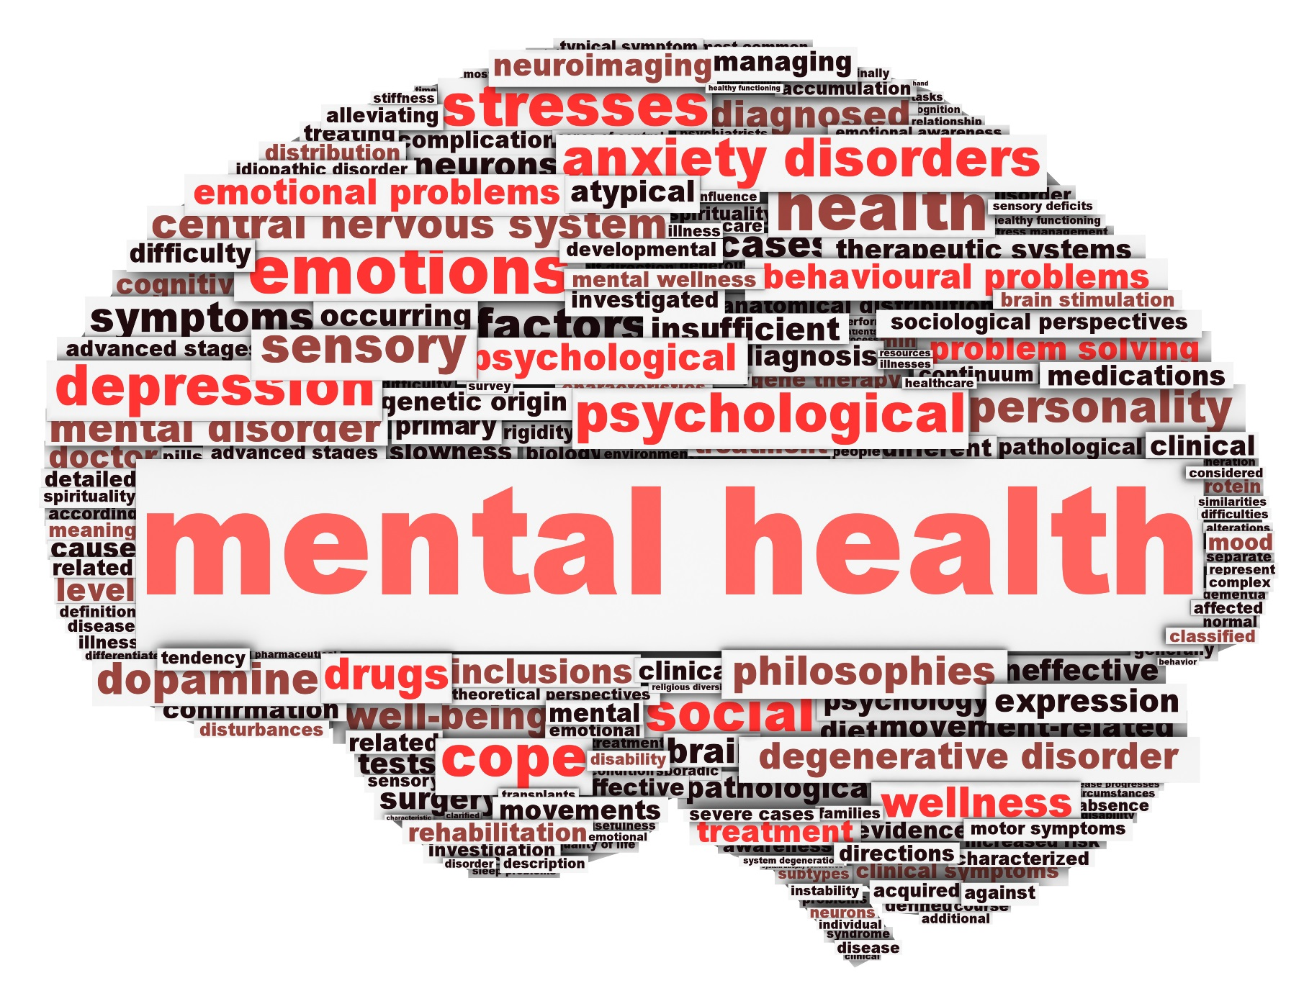
Notes:
So today I am here to talk to you about mental health, and more specificially the impact of mental health and wellbeing on driving
As I said not your usual topic.

Slide 3
Mental health
1 in 6
State of well-being in which every individual realises their own potential, can cope with the normal stresses of life, can work productively and fruitfully and is able to make a contribution to their community.
(WHO, 2016)
Being mentally healthy is not just the absence of mental health diagnosis, but it is being able to learn, express and manage a range of emotions, form and maintain good relationships and can cope and manage change and uncertainty
(Mental health foundation, 2017)
Notes:
Mental health has been defined in many ways but I’ve just put two up. Mental health is not just the absence of mental health difficulties, everyone has a mental health and it is the ability to realise their own potential, to learn, express and manage a range of emotions, form and maintain good relationship, cope and manage change and uncertainty.
Some of you might have already seen these numbers : according to the latest statistics 1 in 6 adults in England over the age of 16 reported experiencing symptoms of common mental health disorders in any given week. And while this figure is high, we expect it to be an underestimation.
Common mental health disorders include depression, generalised anxiety disorder, panic disorder, phobias, obsessive compulsive disorders and other not otherwise specified.
So TRL’s focus has always been around improving road safety, through improving our infrastructure, improving the vehicles that are on our roads are particularly by changing road user behaviour to make it safer and healthier.
I’ve always had a very strong interest in mental health and how it interacts with day to day life, but three years ago when I started looking at this topic in more detail The literature explored in which urban design can influence mental health, but the research stopped there and didn’t explore how mental health and transport more generally may interact.
With at least 1 in 6 people in the UK experiencing mental health difficulties every day we realised the need to understand this relationship more clearly.

Slide 4
Mental health at work
48% of people experienced a mental health problem in their current job
Stress and mental health problems account for 70 million days of work absence every year
32% of men attribute poor mental health to their job
Presentism costs UK business up to £15.1 billion p.a
Staff turnover due to mental health problems costs £2.4 billion each year
30% of work-related illnesses within transport and logistics due to stress, depression and/or anxiety
Notes:
Now when we look at mental health health at work – there has been a lot of work done over the last year to raise awarness of the importance of mental health at work, and the imapct of mental health on our work.
Here are just a few of many numbers that I think I highly relevant.
of work on our mental health as well as how our mental health can affect 48% of a survey of 44,000 employees – study carreid out by Mind in early 2018
Compared to 17% of them who attribute their mental health to personal

Slide 5
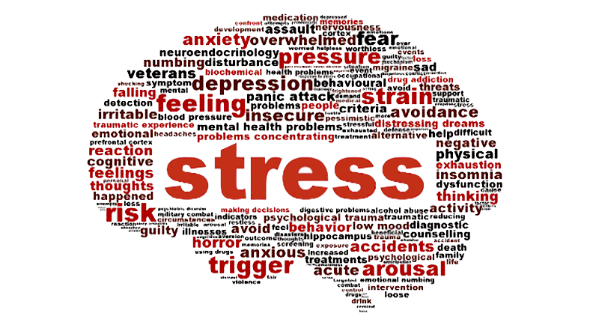
Notes:
I am going to go for a bit of interaction again: please put your hand up if you have ever experienced stress?
That’s what I thought – almost everyone there days has experienced stress in some capacity, whether that be at work or in their personal lives.
There is no exact definition of stress which can make it very difficult to identify but in the broadest sense stress is the feeling of being under abnormal pressure. And figures from a recent study carried out by the Mental Health foundation as part of mental heath awareness found that of 4,619 people surveyed 74% reported that in the past year that had felt so stressed that they have been overwhlemed or unable to cope.

Slide 6
Stress
The adverse reaction people have to excessive pressures or other types of demand placed on them
Six areas of work design that affect stress levels:
Demand
Control
Support
Relationships
Role
Change
Notes:
Stress, and particularly work related stress is now recognised by the HSE which means that employers now have a legal duty to protect their employees from stress at work. The HSE define stress as the adverse reaction people have to excessive pressures or other types of demand that are placed on them.
Stress affects everyone differently, what stresses one person may not affect another – but HSE highlighted 6 areas of work design that can affect stress levels.
Now I’m sure you’ll agree with me that a number of these factors are highly relevant to the fleet industry.

Slide 7
Mental health at work
Working environment and driver mental health
High competitiveness and increased company scrutiny
Working environment on driver mental health
Long hours, pressure of just in time deliveries, irregular shift work
High demands for continuous mental altertness
Low job control and high insecurity
High work-life conflict and chronic social isolation
Notes:
As part of our work we have been carrying out reviews of the literature to understand the relationships between mental health and transport. One of the key findings from our research was the impact of the working environment within the industry on the mental health and wellbeing of commercial vehicle drivers. As the published research showed, and our own engagement with the industry in the UK highlighted the industry. They described as these drivers working in a highly competitive environment with increased company scrutitny, working long hours, dealing gwith the increased just in time deliveries and irregular shift work as well as low job control, job insecurity and high work-life conflict.
But what does this actually mean on mental health? Well

Slide 8
Mental health at work
Working environment and driver mental health
Higher levels of poor mental health
Higher prevalence rate of depression, anxiety and stress
Working environment on driver mental health
High prevalence rates of sleep problems and chronic fatigue
Higher levels of social dysfunction and loneliness
Fewer seeking professional support
Notes:
Higher levels of poor mental health
Some studies in the US have compared the prevalence rates and have found that the prevalence rates for the general population were 4.8 compared to 26.9% for HGV drivers
A study in Australia that engaged with 1324 drivers found that 17.3% had experienced mild symptoms of either depression, anxiety or stress.
They also found higher prevalence rates of sleep problems, chronic fatigue, social dysfunction and loneliness.
But in addition, they found that fewer were seeking professional support to manage their mental health.
Now I’m sure that you are aware of the impact that the industry has on your drivers, recent work that we’ve been conducting shows that operators know about the pressures that drivers are under but what I want to highlight today is the role that mental health has on driver behaviour.

Slide 9
Stress and driving behaviour
Increased self-reported crash involvement
Increased cognitive lapses
Increased driving errors
Increased traffic violations
Stress is the result of a dynamic relationship between the individual and the environment
Stress
Notes:
Now let’s go back to stress – as you saw HGV drivers are more likely to experience stress, partly due to their work environment and less likely to seek support.
One of your top priorities I am sure is road safety – ensuring that your drivers get from A to B safely and securely.
Well stress can affect road safety as a result of the impact that it has on driver behaviour
Now stress is dynamic – and what I mean by that is that stress from different sources interact with each other. So stress can be transferred from one environment to another. For example, increased work related stress as a result of the increased demand on drivers can be combined with personal life. As I’m sure many of you know stress doesn’t just dissapear so this stress will then be taken ‘into the cab’ and these can be transferred to the driving task. And as I am sure we can all agree the driving task and the driving environment is not stress free.
But what this actually means in terms of road safety is increased self-repoted crash involvement, increased cognitive lapses , increased driving errors and increased traffic violations

Slide 10
Mental health and driving behaviour
Anxiety
Post-traumatic stress disorder (PTSD)
Mental Health
Overall wellbeing
Attention Deficit Hyperactivity Disorder (ADHD)
Driver behaviour
Obsessive compulsive disorder (OCD)
Depression
Sleep disorders
Panic disorders
Psychological traits e.g. psychopathic
Stress
Substance abuse
Notes:
And that was just stress – these are the factors that have been found to influence driver behaviour.
Now I’m going to give you a second to think about that. If stress can lead to increased self-reported crash involvement, increased cognitive lapses , increased driving errors and increased traffic violations think about the impact of mental health more widely.

Slide 11
Those with higher levels of positive wellbeing and appraisal demonstrated more positive driving behaviour.
Engaging in less violations, such as indicating hostility to other others and missing warning signs.
Wellbeing and driver behaviour
Those with higher levels of negative wellbeing and appraisal reported higher propensity to commit violations.
Notes:
So not only does positive wellbeing, and by that we mean positive affect, life satisfaction and happiness (predicted by positive well-being: high self-efficay, self-esteem and optimisim)
Negtive well-being: high stressor, conscientiousness, coping and stress scores and low social support and positive personality scores
Negative outcomes: anxiety, depression, perceived stress predicted Negative appraisals: fatigue, perceived stress
Positive appraisal: life satisfaction

Slide 12
Mental health and fleet safety
Higher levels of anxiety
Higher levels of insomnia
Traffic offenders
Higher levels of depression
Higher levels of social dysfunction
Notes:
Now just to highlight what I mean by that. Studies have compared traffic offenders to non-traffic offenders and have found that offenders have poorer mental health and poorer driving behaviour – with anxiety, depression, insomnia and social dysfunction associated with poorer driving behaviour.

Slide 13
Perception vs Reality
Depression
Anxiety
26.9%
14.5%
Rated their overall mental health as good, very good or excellent
89.7%
Sleep problems
20.6%
Past or current feelings of loneliness
27.9%
Notes:
One study in the US asked drivers to rate how they perceived their mental health 89.7% rated their overall mental health as good, very good or excellent– they then administered a common mental health questionnaire and found that in fact 26.9% were showing signs of depression; 14.5% signs of anxiety. 20.6% signs of sleep problems; 18.9% chronic fatigue and 27.9% feelings of loneliness
Recent stat in the UK: 95% of employees calling in sick with stress give a different reason

Slide 14
Questions?
Rebecca Posner
Psychologist
rposner@trl.co.uk
+44 [0]1344 770 431
TRL | Crowthorne House | Nine Mile Ride | Wokingham
Berkshire | RG40 3GA | United Kingdom

