Slide 1
Pulling it all together
Dr Paul Jackson
Head of Impairment Research
Transport Research Laboratory

Slide 2



Pulling it all together:
Developing a Driver Wellbeing Programme
Dr Paul Jackson CPsychol
Head of Impairment Research

Slide 3
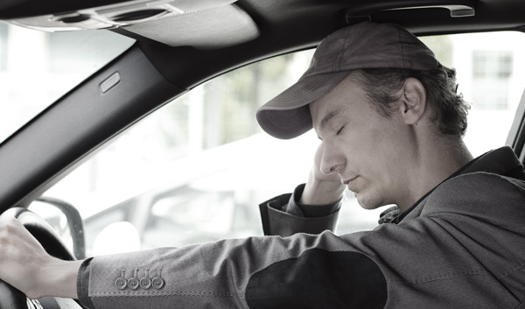
Overview
Professionalism and responsibilities
Components of wellbeing
Contributors to poor driver wellbeing
Costs of not managing wellbeing
Solutions
Summary

Slide 4

How does driving for a living affect wellbeing?
What impact do drivers’ schedules have on family life?
Do work patterns allow drivers to engage in social activities?
Do work practices increase stress and anxiety?
What opportunities for physical exercise exist?
Do pay rates / pay structure encourage fatigue?
What support services are available for drivers?
Do company and individual values align?

Slide 5
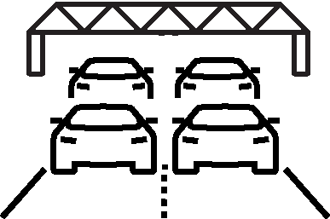
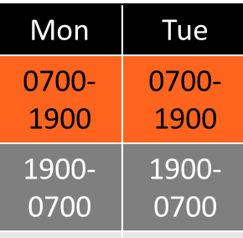

Contributors to driver mental wellbeing issues
Operational, roster and lifestyle contributors combine to increase driver stress, fatigue and affect mental wellbeing
OPERATIONAL CONTRIBUTORS
Customer-driven KPIs
Delivery slots
Unrealistic delivery schedules
Road conditions
Pay rates/structure
Difficult customers
ROSTER CONTRIBUTORS
Early starts, late finishes
Sleeping during day = poor sleep
Use of caffeine to stay awake
Long hours
Overtime
Working on rest days etc.
LIFESTYLE CONTRIBUTORS
Isolation
Diet & Hydration
Work-related health issues
Opportunities for exercise
Sleep disorders
Access to health care
Male bravado
Notes:
Stress and mental health problems account for 70 million days of work absence every year
Staff turnover due to mental health problems costs £2.4 billion each year
Reduced productivity costs UK business up to £15.1 billion per year

Slide 6

Effects of poor wellbeing on driver performance
Incidents/Crashes
Poor customer service
Poor morale
Anxiety
Fuel consumption
Increased
costs
Depression
Bent metal costs
Sickness
Insurance claims
Absenteeism
Attrition
Recruitment
Vehicles out of service
Company
reputation
Training

Slide 7
Elements of
DRIVER WELLBEING
Diet and Hydration British Diatetic Association
Fatigue
Marcus de Guingand, 3rd Pillar of Health
Quality of Life
Andrew Brown, CALM
Resilience & Mindset
Andy Neale,
NFE Group
Mental Health
Rebecca Posner, TRL
DRIVERS
Professionalism
Van Driver as Athlete
Formalise in a
Driver Wellbeing Programme
SHARED responsibility
COMPANY
availability of good quality food, water
protect/ maximise sleep opportunities
impact of operational practices
reporting mechanisms
awareness of mental health

Slide 8
Components of a driver wellbeing programme
Phase 1: Assessment
Phase 2: Development
Phase 3: Improvement
Gap analysis against best practice: what policies and procedures are in place/need to be added?
Gap Analysis
Company Standard
Check compliance
against
Company Standard
Analysis of rosters
Scientific analysis of rosters to identify fatigue hotspots: where is fatigue risk elevated?
Development of procedures
Surveys/focus groups
How do people’s experiences compare with what the science says?
Integration of data streams: quantify costs
Stakeholder
Engagement
Workshop
Management
Site Audits
Transport Office
Benchmarking
Implementation
Plan and Cost Benefit Analysis
Drivers
Refinement
of system
Measure wellbeing
(Baseline)
Families
Training
Measure wellbeing
Months 1-3
Months 4-6
Month 6 onwards

Slide 9


Examples of tools for managing driver wellbeing
Example of Survey Output
Example of Roster Analysis Output
Example of Compliance Audit
Example of Fatigue Training Scenario

Slide 10
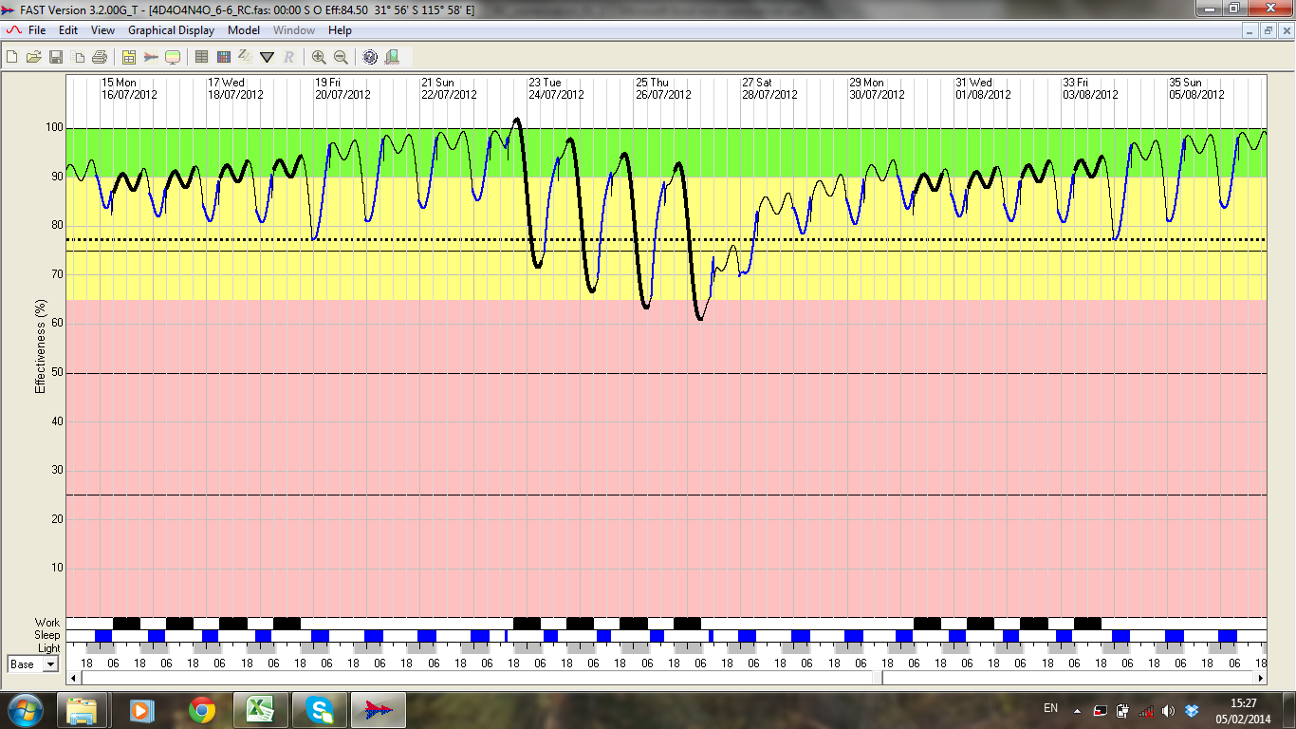
Roster analysis to identify fatigue hotspots
(4D 4O 4N 4O (0600-1800 / 1800-0600))

Slide 11
Examples of tools for managing driver wellbeing
Example of Survey Output
Example of Roster Analysis Output
Example of Compliance Audit
Example of Fatigue Training Scenario

Slide 12
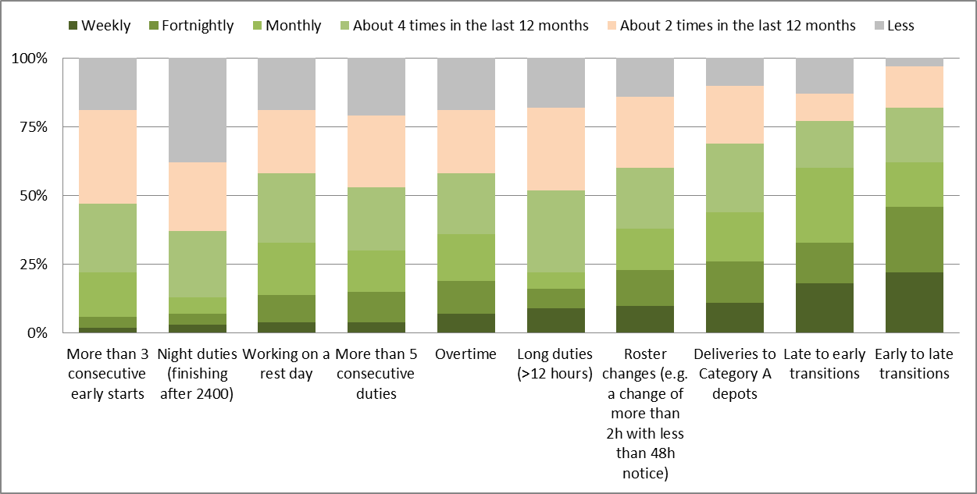
Survey results to highlight specific issues

Slide 13
Examples of tools for managing driver wellbeing
Example of Survey Output
Example of Roster Analysis Output
Example of Compliance Audit
Example of Fatigue Training Scenario

Slide 14
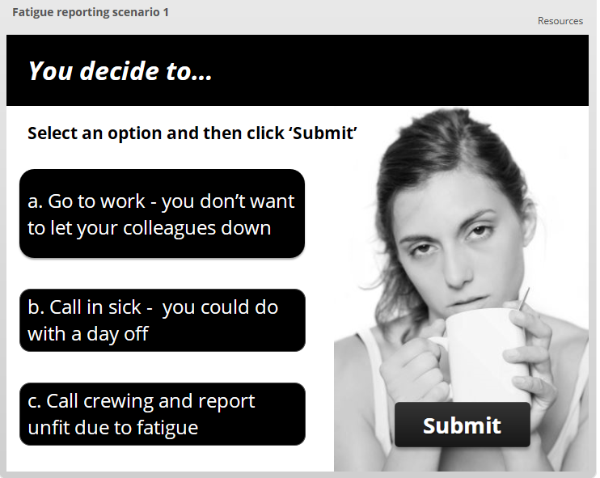

Slide 15
Examples of tools for managing driver wellbeing
Example of Survey Output
Example of Roster Analysis Output
Example of Compliance Audit
Example of Fatigue Training Scenario

Slide 16
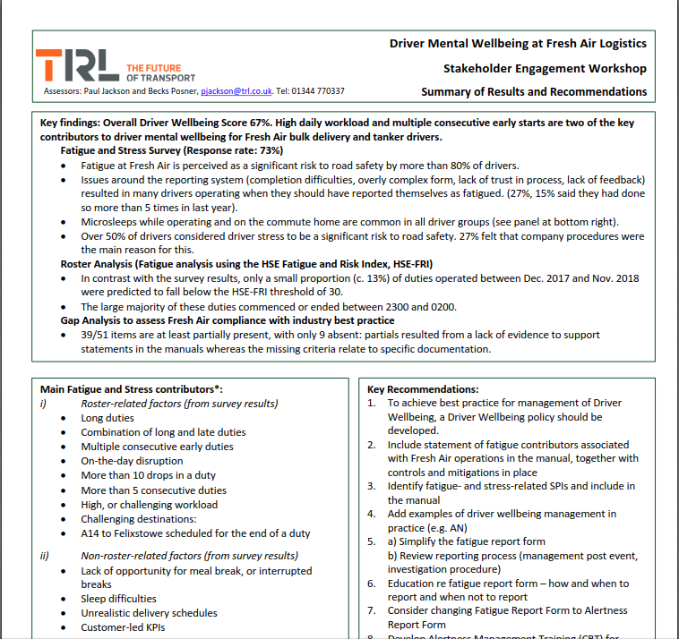
Checking compliance against company standard
Sites

Slide 17
Summary
Poor driver wellbeing affects customer service, performance, leads to increased risk of incidents, crashes and a range of operational costs
Many common fleet management practices inadvertently impact on driver wellbeing
Effective management of driver wellbeing needs a Shared Responsibility approach
Solutions include identifying the true costs of operational practices, data collection and analysis, effective policies and procedures, training on fatigue, stress and mental wellbeing.
A well-designed driver wellbeing programme can not only save money (by reducing operational costs), but also make money (e.g. improved productivity).

Slide 18


Thank you for your attention
Dr Paul Jackson
Head of Impairment Research
pjackson@trl.co.uk
+44 [0]1344 770337 | +44 [0]7870 917939
TRL | Crowthorne House | Nine Mile Ride | Wokingham
Berkshire | RG40 3GA | United Kingdom
Notes:
What are the main contributors to fatigue and stress in your operation?
How do you know this?
How are you managing these?

