Slide 1
FTA Blast of Information
Barrie Wilson
Regional Manager, Vans
Freight Transport Association

Slide 2
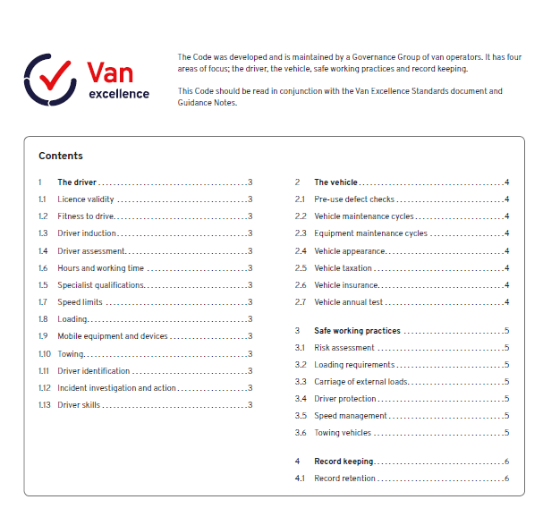
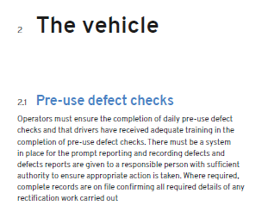
Van Excellence Pre Use Check App

Slide 3
Van Excellence Pre Use Check App

Slide 4
Van Excellence Pre Use Check App

Slide 5
Van Excellence Pre Use Check App

Slide 6
Van Excellence Pre Use Check App

Slide 7
Van Excellence Pre Use Check App

Slide 8
Van Excellence Pre Use Check App

Slide 9
Van Excellence Pre Use Check App
info@vanexcellence.co.uk

