Slide 1
FTA Blast of Information
Barrie Wilson
Regional Manager, Vans
Freight Transport Association

Slide 2
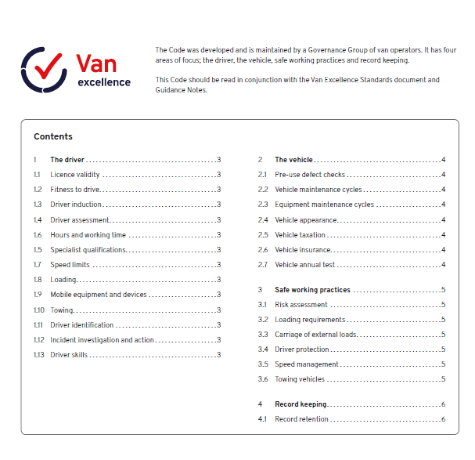

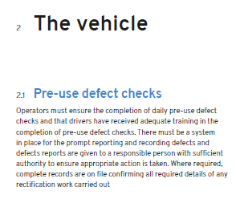
Van Excellence Pre Use Check App

Slide 3
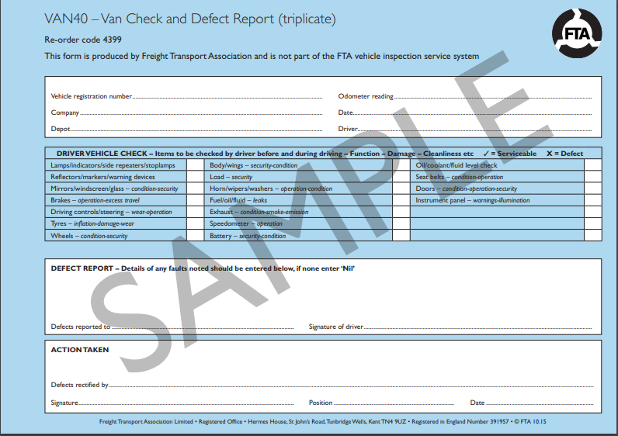
Van Excellence Pre Use Check App

Slide 4
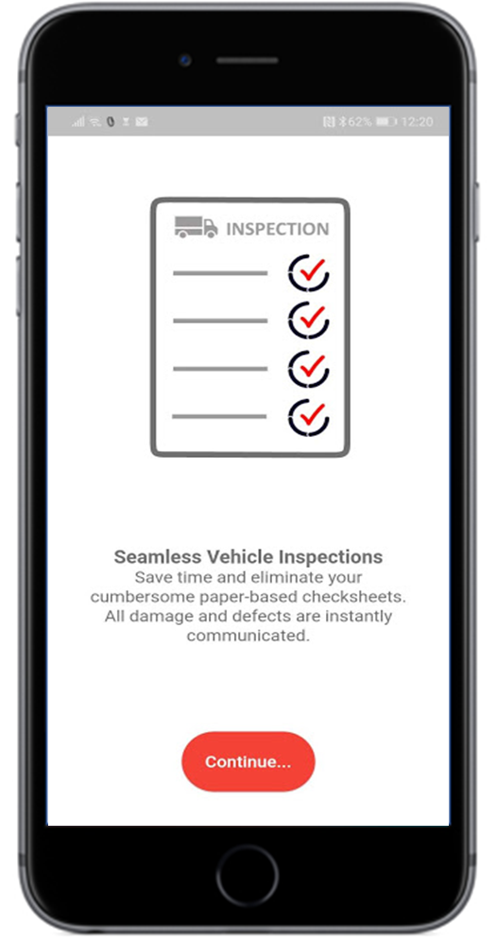
Van Excellence Pre Use Check App

Slide 5
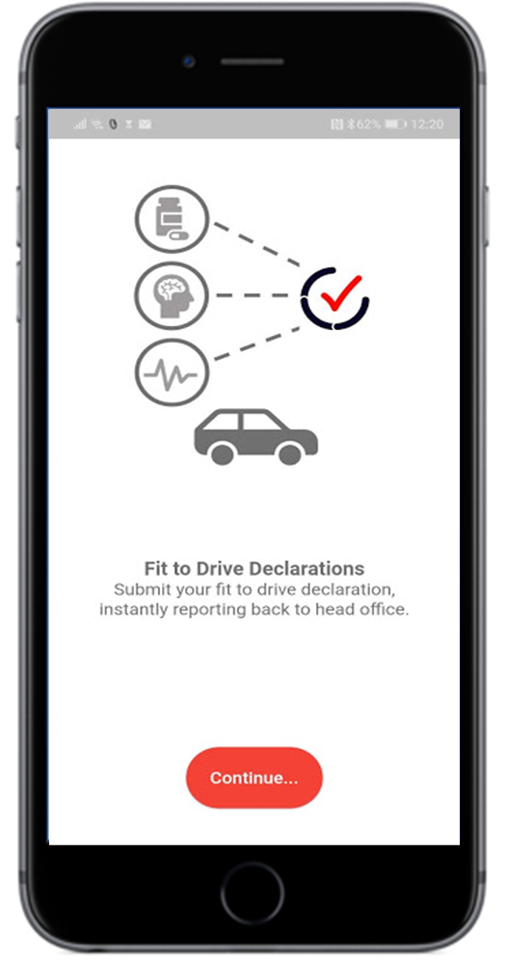
Van Excellence Pre Use Check App

Slide 6
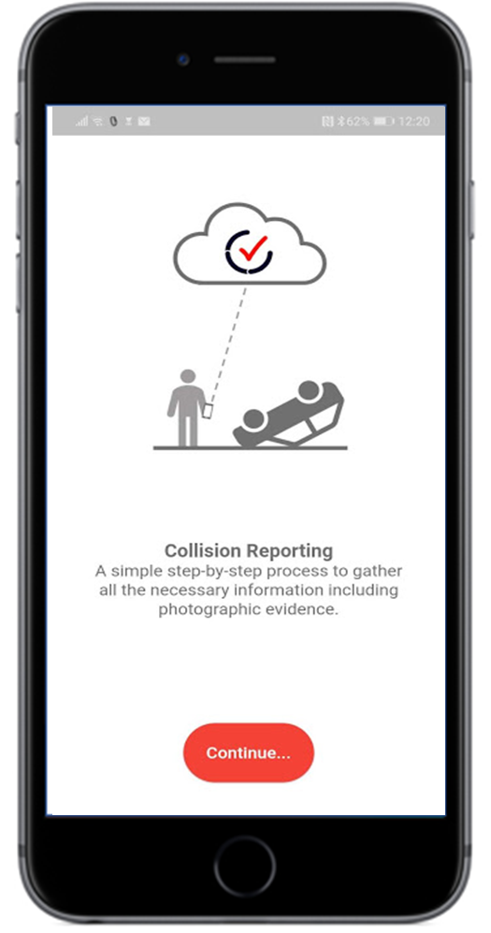
Van Excellence Pre Use Check App

Slide 7
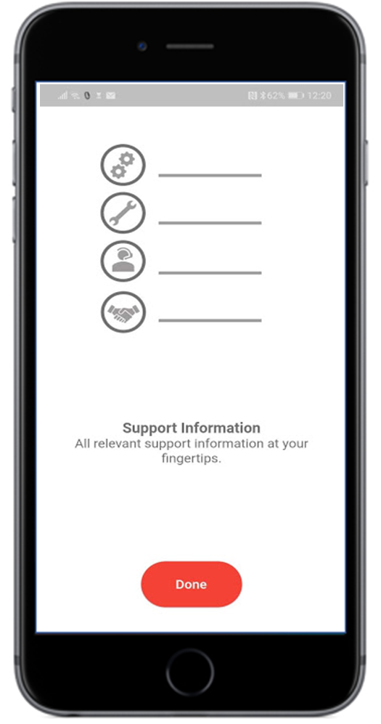
Van Excellence Pre Use Check App

Slide 8
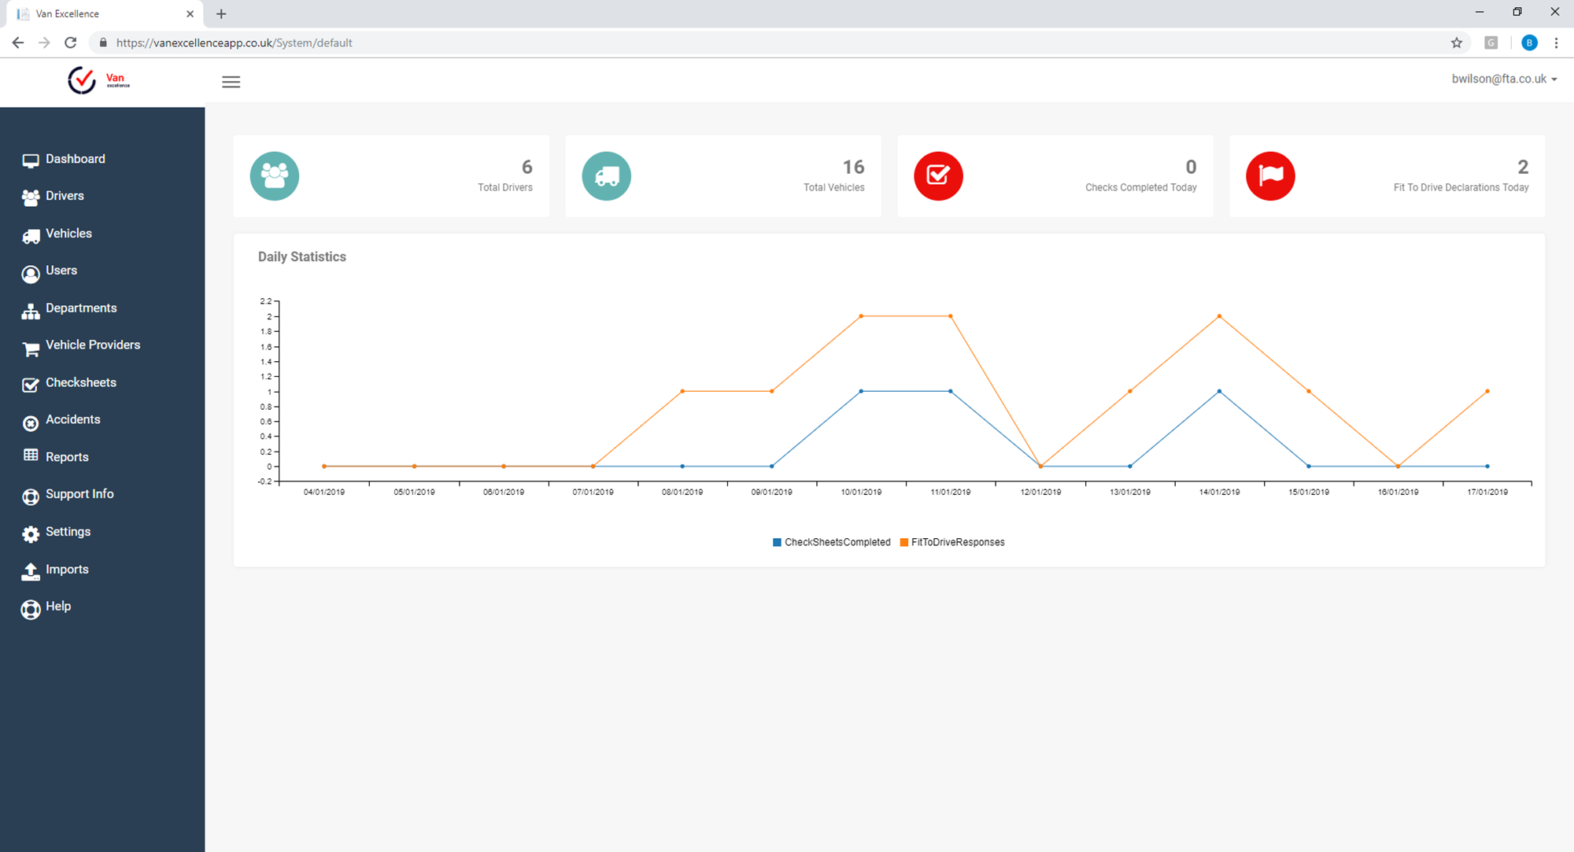
Van Excellence Pre Use Check App

Slide 9
Van Excellence Pre Use Check App
    info@vanexcellence.co.uk

