Slide 1
Blast of Innovation
Andy Edwards
Regional Sales Manager (North)
Quartix

Slide 2
Andy Edwards, Regional Sales Manager
‘Blast of Innovation’
Safe Speed Database
Driver Engagement Report

Slide 3

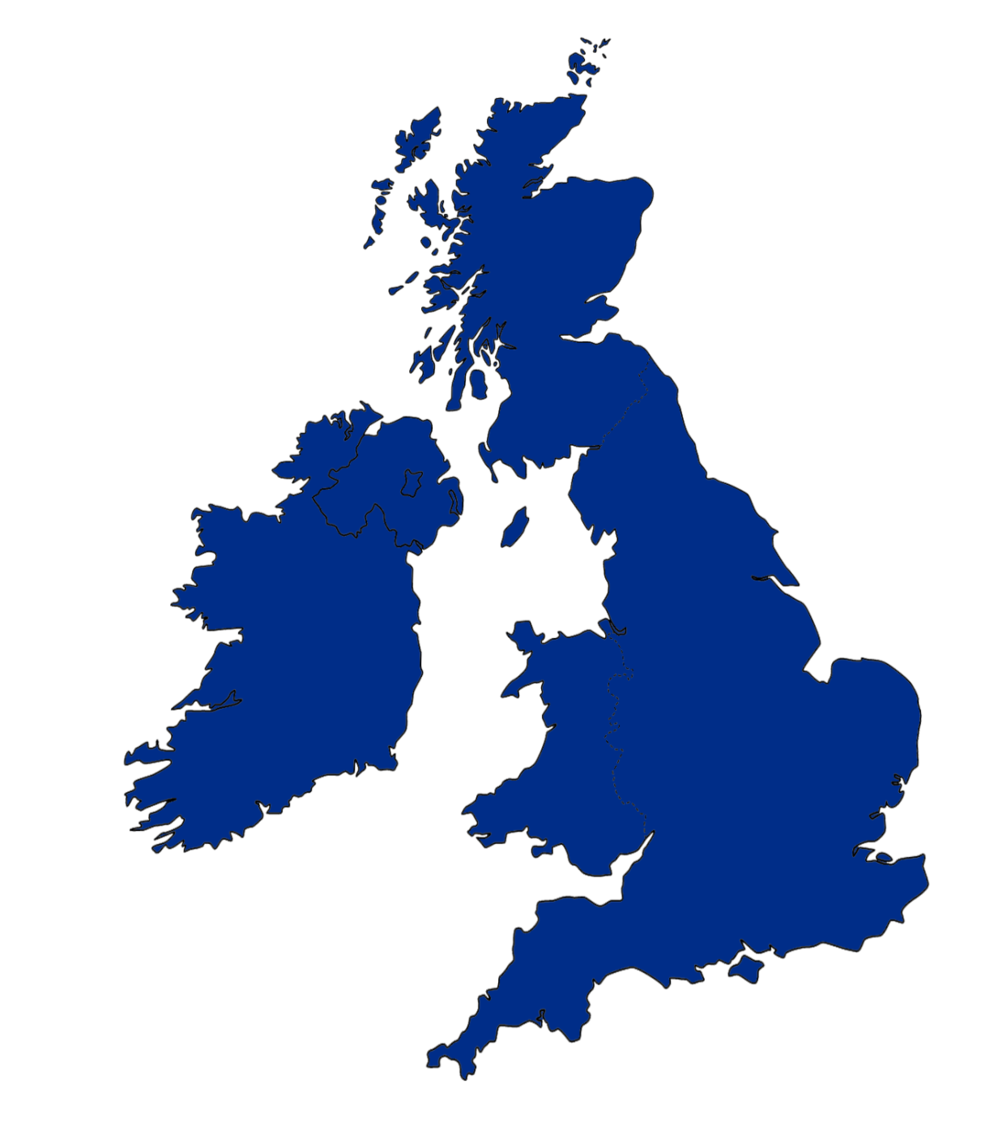






Background
Established in 2001, Quartix is one of the UK’s leading suppliers of subscription based vehicle tracking systems, software and services
Strong growth in revenue, profitability and cash generation, financial strength to fund further growth in both the UK and selected overseas markets
13,000 clients, installing an average of 6,000 units per month in 2018
All technology developed, owned and managed in-house
System is renowned for its ease of use, reliability and exceptional after sales service
Operating across six locations
in three territories
Telematics
www.quartix.co.uk
www.quartix.net
www.quartix.fr
www.quartix.eu
www.quartix.com
www.quartix.us
Database & Systems
Applications
3

Slide 4

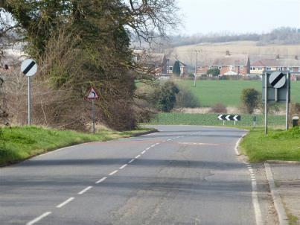
The Safe Speed Database
Unique database developed by Quartix in partnership with insurance partners to help save lives and reduce loss ratios
More than 30 million data points collated each day from vehicles tracked by Quartix, each data point on every journey is assessed against both speed limit and relative speed distribution
Encourages a change in driver behaviour to maintain appropriate speeds in the context of each road which is often well below the road speed limit
Watch
video
(02:44)
4

Slide 5
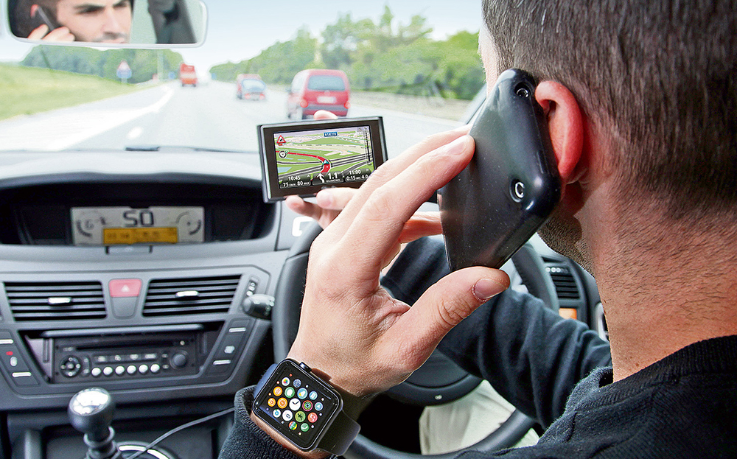
Driver Engagement Report
Driver behaviour feedback without an in cab distraction
Manage risk by identifying dangerous drivers
Modify behaviour in helping drivers understand their own performance to improve safety
5

Slide 6
Thank you for your time and please visit our stand for more information

