Slide 1
Blast of Innovation
Tony Bowen
LCV and Projects Manager
Brigade Electronics

Slide 2
Blast of Innovation
Tony Bowen
FTA Van Excellence Operational Briefings

Slide 3

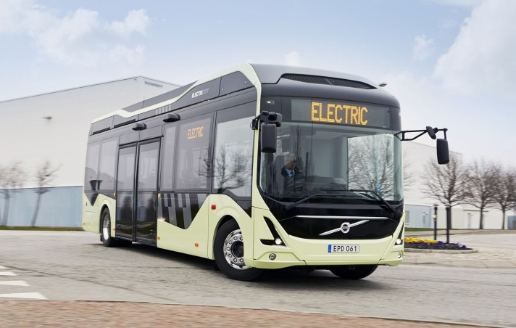
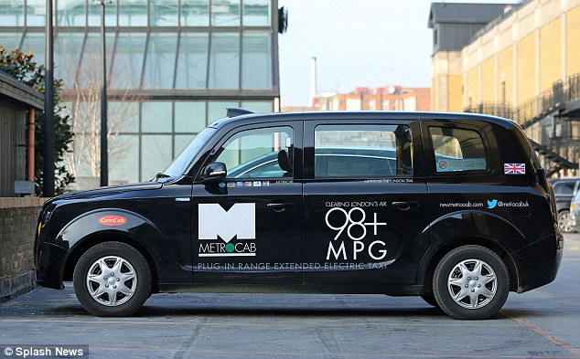
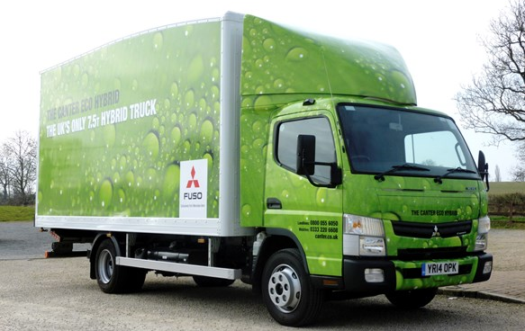
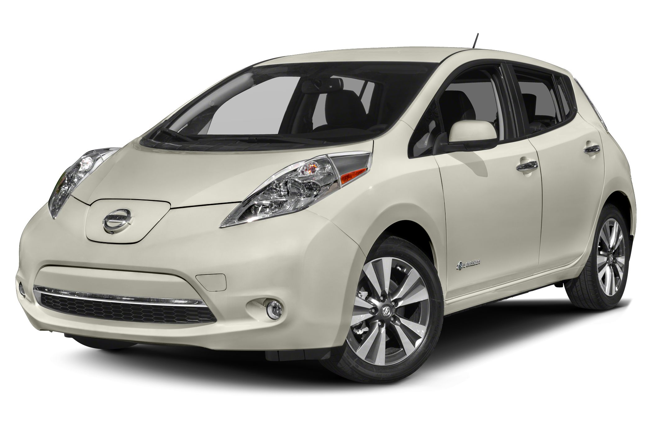
Electric & Hybrid Vehicles
What are the facts?

Slide 4
Facts
Increased risk of accidents between EV’s & Hybrids and pedestrians compared with an ICE type vehicle
Turning manoeuvres – 80%
Reversing, moving off, entering/leaving a parking space – 100%
Collisions in speed limit areas 30mph and under – 50%
Supermarket/Retail Car Parks – x7
What have the regulators been doing?

Slide 5
Regulation UNECE-R138
United Nations Economic Commission for Europe
Acoustic Vehicle Alerting System - AVAS
September 2019
All NEW MODEL vehicle registrations
September 2021
All NEW VEHICLE registrations
What has Brigade Electronics been doing?

Slide 6

Marketing Animation

Slide 7
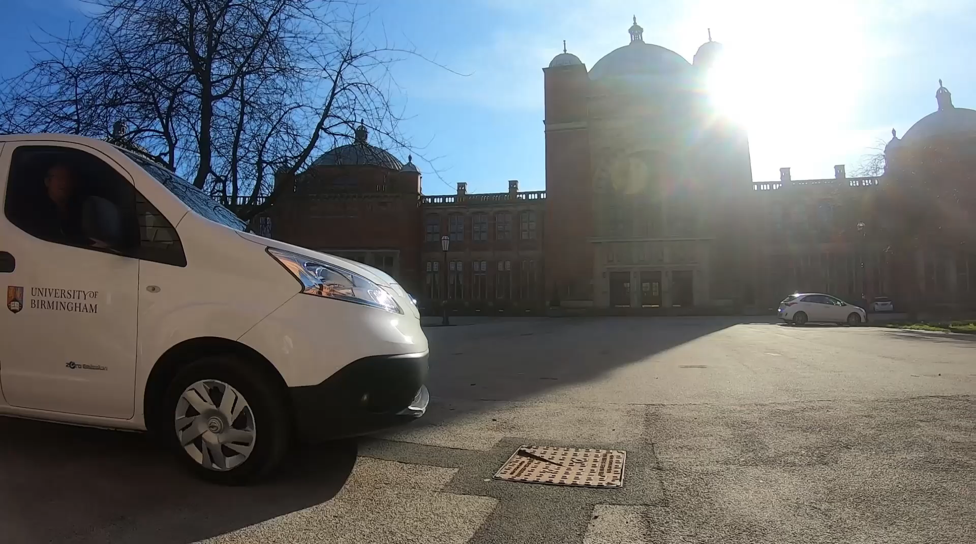
University of Birmingham

Slide 8

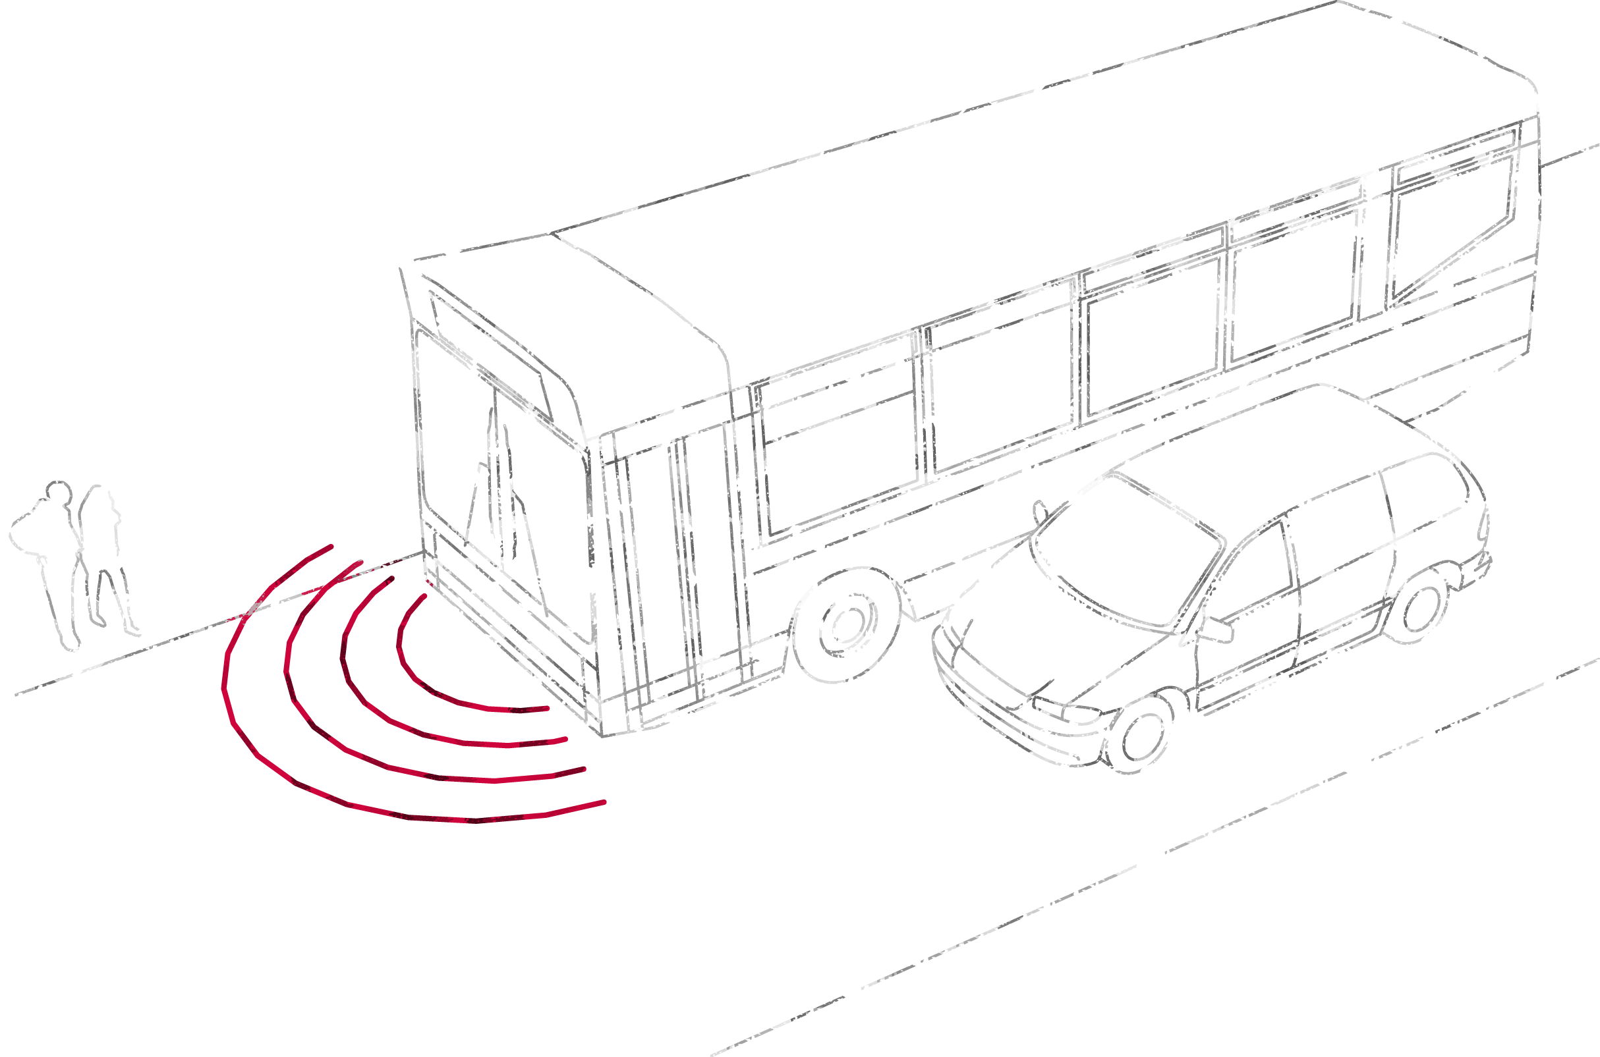

Solving the problem of quiet vehicles
Quiet Vehicle Sounder

