Slide 1
Mercedes Benz Vans: sponsors address
Andy Eccles
Head of Fleet
Mercedes-Benz Vans UK Ltd

Slide 2

ANDY ECCLES, HEAD OF FLEET
MERCEDES-BENZ VANS UK LTD
ANDREW.ECCLES@DAIMLER.COM, 07899 891972
Notes:
Introduction and explanation that I’m not here as part of a sales pitch – far from it – we know that running a business or a fleet of vans is hard enough

Slide 3



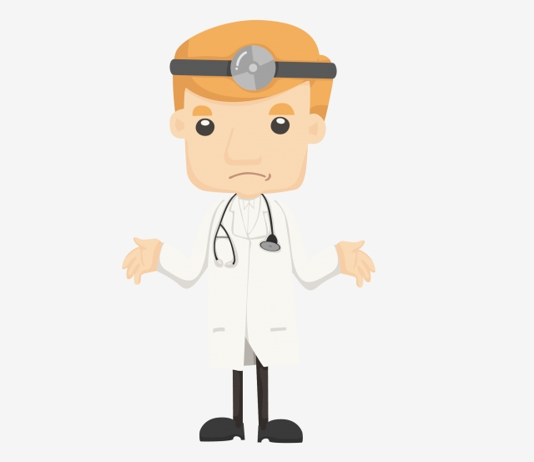
ALMOST A FIFTH ARE LIFTING LARGER PACKAGES MORE THAN 10 TIMES A DAY
20% OF UK VAN DRIVERS WALK UP AND DOWN STAIRS OVER 10 TIMES A DAY
49% RATE THEIR SLEEP AS AVERAGE TO VERY BAD
40% HAVE ONLY BEEN TO THE DOCTORS ONCE, IF NOT AT ALL, IN THE PAST YEAR
20% SAY THEY HAVEN’T BEEN TO A DOCTOR IN THE PAST 12 MONTHS
Notes:
I’m here today to provide a bit of an overview to the day. We have undertaken a survey of 2,000 UK van drivers, owners and operators as part of our Business Barometer study, which you may have heard of, and I wanted to share some of the stats with you that I’m sure you will all relate to. We know that there are 4.3 million vans on the UK roads today, but only 420,000 people list their profession as van drivers, so the other 4.1 million simply drive a van to enable them to do their job – they are a service engineer or work in facilities management perhaps for example. Therefore they probably don’t see themselves as the industrial athletes that they are, doing hard, physical work while also dealing with the stresses and pressures that come from their jobs, which we highlighted last year if you remember.
ALMOST A FIFTH OF UK VAN DRIVERS ARE LIFTING LARGER PACKAGES MORE THAN 10 TIMES THROUGHOUT THE DAY
20% OF UK VAN DRIVERS WALK UP AND DOWN STAIRS OVER 10 TIMES A DAY
49% OF UK VAN DRIVES RATE THEIR SLEEP AS AVERAGE TO VERY BAD
40% OF UK VAN DRIVERS, OWNERS AND OPERATORS HAVE ONLY BEEN TO THE DOCTORS ONCE, IF NOT AT ALL, IN THE PAST YEAR
20% OF UK VAN DRIVERS SAY THEY HAVEN’T BEEN TO A DOCTOR IN THE PAST 12 MONTHS
It is also highlighted by the lack of decent sleep… For me though, the most worrying stat on here is the lack of visits to the doctors – now either you’re all superhuman, or you’re not taking proper care of yourselves…

Slide 4




THE VAN COMMUNITY WOULD LIKE TO SEE HEALTHIER FOOD OPTIONS AVAILABLE AT SERVICE STATIONS IN THE UK (95%)
MORE THAN A QUARTER (28%) BELIEVE HEALTHY FOOD OPTIONS AT MOTORWAY SERVICE STATIONS ARE POOR OR VERY POOR
THE MAIN REASON VAN DRIVERS ARE PUT OFF EATING HEALTHIER LUNCHES BECAUSE IT IS TOO EXPENSIVE TO DO SO (41%)
94% EXPERIENCE A DIP IN ENERGY AFTER EATING
Notes:
But I’m sure that the health & safety bods in your companies will ensure that manual handling and all that fun stuff is taken care of, so I don’t want to focus on that. I want to instead focus on how well we take care of ourselves and sow some seeds to think about as today unfolds. Our Business Barometer research shows that potentially, we are making ourselves feel worse when we’re out on the road thanks to a lack of healthy options when out driving. If we think about this in the context of van drivers as ‘industrial athletes’, quite simply, we’re not fuelling our body for the task ahead. The British Dietetic Association is here to help advise on how we can help fuel ourselves better so that we don’t experience a dip in energy, which again, as ‘athletes’, we just can’t afford to have.

Slide 5



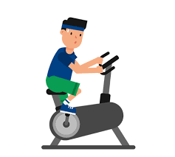
GO TO THE DOCTOR – ASK FOR A CHECK UP, HAVE BLOODS CHECKED, DON’T BRUSH OFF HEALTH NIGGLES
CONSIDER A PACKED LUNCH IF POSSIBLE, OR IF NOT, LOOK AT SIMPLE FOOD SWAPS
MONITOR YOUR SLEEP PATTERN, EITHER BY WEARING A SLEEP TRACKER, OR KEEPING A SLEEP DIARY
SEE WHAT THE WELLBEING POLICY IS FOR YOUR WORKPLACE, OR IF YOU’RE SELF-EMPLOYED, SEE WHAT PARTNERSHIPS YOU CAN SET UP WITH LOCAL HEALTH CLUBS TO GET FAVOURABLE RATES
Notes:
Not going to the doctors isn’t something to be proud of I’m afraid, especially amongst the men out there who are statistically much less likely to go to the doctor. This week, if you do one thing, phone the doctor for a health check, especially if you’ve been ignoring a health niggle. Please.
Now I’m not going to steal the thunder of the fab team from the British Dietetic Association, but they can explain how it’s not about cutting the foods you like out, but its worth seeing if simple food swaps can help, particularly with energy levels. For example, swapping crisps in a meal deal with some nuts instead. And if you’re eating right, there is a strong correlation with sleep right too, but certainly try keeping track of this, either through a fitbit type device, or simply by making a note of your bed and wake time, how you feel when you’ve just woken up, if you’ve had to rely on an alarm to wake up etc. I’m no doctor of course so if you have serious sleep issues, do speak to your doctor. And lastly, speak to your HR folk and see what they’re doing about wellbeing – if the office has a healthy canteen policy, but you’re out on the road eating rubbish, can they perhaps provide you with a lunch allowance which makes buying healtier food more affordable? And if you’re self-employed or you own the company, have a discussion with local health clubs and see if you can set up a partnership to enable more favourable rates – if you don’t ask, you don’t get. Right?!

Slide 6
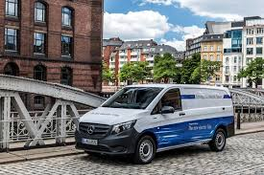
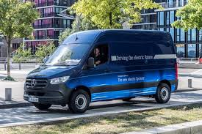
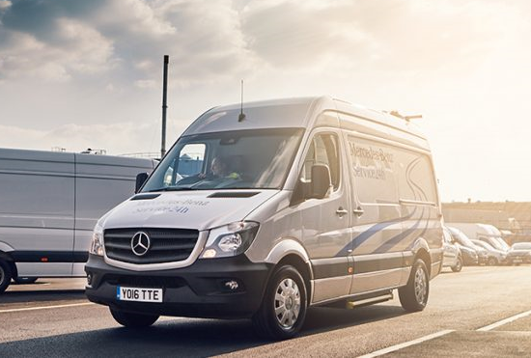
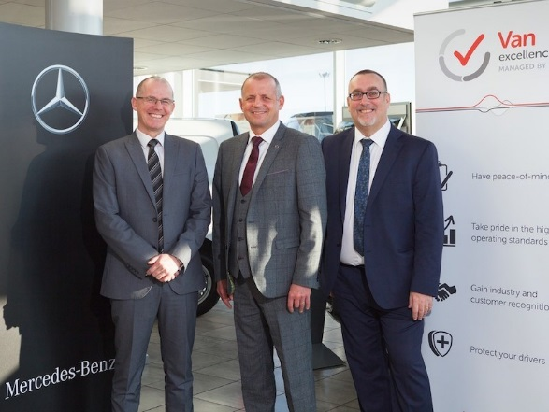
GO GREEN – NEW EVITO COMING SOON TO THE UK – CONSIDER HOW AN ELECTRIC VAN COULD SUIT, ESPECIALLY IF YOU’RE NEAR A LOW-EMISSION ZONE
OR FOR LARGER LOADS, THE ESPRINTER WILL BE AVAILABLE FROM 2020 TO HELP FLEETS DEAL WITH ENVIRONMENTAL CHALLENGES
24 HOUR, 365 SUPPORT MEANS ONE LESS WORRY FOR BUSINESSES – FREE ROADSIDE RECOVERY WITH MOBILOVAN AND OUT-OF-HOURS DEALER NETWORK
SEE HOW WE WORK IN PARTNERSHIP WITH THE FTA VAN EXCELLENCE TO SUPPORT YOU IN UNDERSTANDING HOW TO ENSURE YOUR FLEET AND DRIVERS ARE SAFE AND COMPLIANT
Notes:
So what can we do to help? Well, in addition to our Citan, Vito, Sprinter and X-Class models, we are also offering our eDrive range, starting with the eVito this year and offering the eSprinter next – electric vehicles might not be for everyone, but if you think they might be for you, have a chat with us so that we can see how they could work for your business. We also offer with every vehicle a free, round-the-clock roadside recovery service with our trained technicians to fix your van and keep you moving – we don’t just lift and shift you to a garage. Our dealers offer an out-of-hours service too so that you don’t need to interrupt your working day to service your vans. We are also now in our 6th year of working in partnership with the FTA Van Excellence programme and are very proud to be Platinum Partner. We genuinely do work in partnership with these guys and our customers, so if you run or are thinking of running our vans, have a chat with us to see how we can support you through the van excellence programme.

Slide 7
ANDY ECCLES, HEAD OF FLEET
MERCEDES-BENZ VANS UK LTD
ANDREW.ECCLES@DAIMLER.COM, 07899 891972
Notes:
And that’s me done! Thank you very much for listening.

