Slide 1
CALM and the CALMVan Initiative
Andrew Brown
Director of Corporate Partnerships
CALM

Slide 2


Slide 3
WHAT’S CHANGED?

Slide 4
AROUND 6,000 PEOPLE DIE FROM SUICIDE EVERY YEAR IN THE UK

Slide 5
75% MALE
1 MAN EVERY 2 HOURS
BIGGEST KILLER OF MEN UNDER 45

Slide 6
135 PEOPLE ARE DIRECTLY AFFECTED BY EACH SUICIDE

Slide 7
CALM IS STILL HERE TO HELP

Slide 8
PRACTICAL SUPPORT AND POSITIVE CHANGE
1 We run a helpline, 7 hours a day, 7 days a week, to catch you if you fall
2 We affect social change so that most people don’t ever need to call a helpline: awareness & behaviour
3 We work with partners, brands and groups to spread positivity and behaviour change, through campaigns with sport, comedy, music and culture

Slide 9
PRACTICAL SUPPORT AND POSITIVE CHANGE
1 We run a helpline, 7 hours a day, 7 days a week, to catch you if you fall
2 We affect social change so that most people don’t ever need to call a helpline: awareness & behaviour
3 We work with partners, brands and groups to spread positivity and behaviour change, through campaigns with sport, comedy, music and culture

Slide 10
A CALM SOCIETY
Tolerance, Kindness, Community,
Emotional Openness
Notes:
Not worthy, clinical or them and us

Slide 11
Key Pillars
It’s OK to talk about your emotions & seek help when you need to
We can all be a better friend, RELATIVE, colleague

Slide 12
BUT SOME THINGS ARE CHANGING…
CALM awareness now 25-30% under 35
Issue awareness closing in on 50%
Helpline:
Seats: 31% increase
Total contacts: 48% increase
Strike rate: 1% decrease
Suicides prevented: 66% increase – 675 in 2018
Changed the Govt…
Notes:
2017-2019

Slide 13
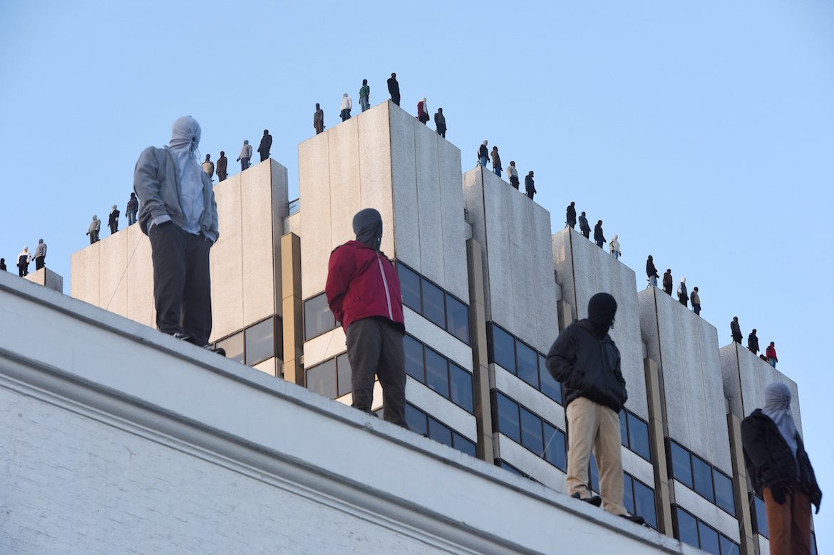

Notes:
And impactful

Slide 14
PRACTICAL SUPPORT AND POSITIVE CHANGE
1 We run a helpline, 7 hours a day, 7 days a week, to catch you if you fall
2 We affect social change so that most people don’t ever need to call a helpline: awareness & behaviour
3 We work with partners, brands and groups to spread positivity and behaviour change, through campaigns with sport, comedy, music and culture
Notes:
More on this later

Slide 15
WHAT’S NEW?

Slide 16
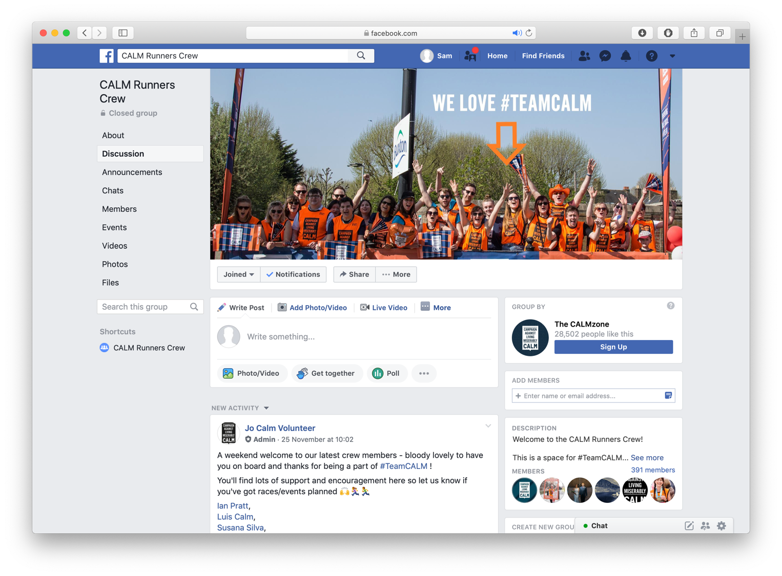

Slide 17


Slide 18


Slide 19

#MARK
YOUR
MAN
JUNE 2018
Notes:
Mark your man – look after mates better – leveraging football theme around World Cup
T shirts sold and proceeds to CALM

Slide 20


Slide 21


Slide 22


Slide 23
MOVING FORWARD

Slide 24





PARTNERSHIPS
Notes:
Wide range of partners
Different degrees of activation – support provision, funding, campaigns

Slide 25


CALM x FTA
Long-term partnership, supporting drivers
Combination of:
Awareness: In-van
Support: Digital and helpline
With CALM engagement and expertise
Coming soon…

Slide 26
THANK YOU

