Slide 1

Van Drivers: the road to good health
Nutrition and hydration for optimal performance
British Dietetic Association Work Ready

Slide 2
Who we are
Corporate nutrition health and wellbeing programme
Work Ready dietitians trained to specialise in workplace health interventions
Dietitians are qualified and regulated healthcare professionals

Slide 3
Nutrition and Hydration
Why is it important?
What we eat & drink affects :
  Our health
  How we think, feel & behave: including functioning at work
Up to 60% eating & drinking takes place in the van
  Huge potential impact
  Both at work & home
Notes:
Nutrition has impacts beyond physical health
Reference
BDA (2015) Supporting healthier working lives through dietitian-led wellness initiatives
http://www.bdaworkready.co.uk/

Slide 4
We asked van drivers about their habits whilst on shift …
56% considered themselves overweight
March 2019 survey: 59 respondents
Notes:
*top results featured
Survey specifically for this conference
We know that as larger bodies become normalised in the UK, many people who are overweight or obese don’t recognise it in themselves, so this self-reported figure is likely to be an under-estimate.
Population average in men 40% overweight + 26% obese; women 30% overweight + 27%
Data for van drivers does not exist but a recent study showed 84 percent of HGV drivers were overweight or obese https://www.nihr.ac.uk/news/new-research-to-help-truck-drivers-get-their-health-back-on-the-road/7652
Note of caution: studies usually use weight or BMI as a benchmark but in practice most employee based programmes are best accepted when focussed on a healthy lifestyle rather than weight.

Slide 5
95% say healthy eating is important to them
Notes:
*top results featured
Survey specifically for this conference
This is really positive and overcoming intention to change removes a key barrier to adopting healthier habits

Slide 6
76% take a lunch break
But
…41% eat in their vehicles
Notes:
*top results featured
Survey specifically for this conference
That means a quarter are regularly skipping lunch breaks, which is found in other work settings too.
We hope by the end of this presentation you’ll be convinced that taking breaks is important for concentration (safety). It’s also a vital way to keep healthy (loo breaks, topping up hydration, getting some sunshine, having a meal).
Ideally we should have lunch away from our work station to get all these benefits.

Slide 7
37% eat 1 portion of fruit or veg whilst on shift
Notes:
We’ve all heard the 5 a day message. We will see later how fruit and veg keep us healthy at work, and it will be harder to achieve the recommended intake if only one serving is eaten during a shift.
Intro to next slide: Given the demands of the work, it’s easy to see why drivers and their employers would need to make a specific effort to ensure they maintain healthy habits…

Slide 8
Characteristics of driving work
Long and variable working hours
Sedentary, but some roles more active e.g. multi-drop delivery
Tight schedules
Working environment provides limited opportunities for a healthy lifestyle

Slide 9


You have much in common with athletes..
Skill based role
Focus / concentration
Repetitive movements
Travel
Eating on the road
Notes:
All of these can lead to losing valuable employees due to poor health or may reduce performance on the job.
There are some key strategies which drivers and their employers can adopt to support healthier lifestyles in these roles – we will cover some nutrition related points later in this session to assist with: boosting mood through food choices, habits which support the maintenance of a healthy weight and good hydration which aids concentration and prevents headaches.

Slide 10
Health impacts of driving work
High stress related to being on the road and tight schedules
Physical issues such as back pain from poor posture or lifting
Higher than average rates of overweight, obesity, diabetes and high blood pressure
Adequate hydration likely to be limited by lack of access to toilets
Notes:
All of these can lead to losing valuable employees due to poor health or may reduce performance on the job.
There are some key strategies which drivers and their employers can adopt to support healthier lifestyles in these roles – we will cover some nutrition related points later in this session to assist with: boosting mood through food choices, habits which support the maintenance of a healthy weight and good hydration which aids concentration and prevents headaches.

Slide 11
Key nutrition tips for wellbeing in driving jobs
Get a good routine
Put the right fuel in
Focus on hydration
Notes:
Routine: Some studies have shown that people in driving jobs have irregular working patterns and their days (and meals) lack structure. Safe Food IOI Lorry Driver interventions 2013 http://2013.wsmconference.co.uk/2011/downloads/11S3S14%20Sinead%20Duane.pdf
Right fuel: Choosing foods which are high in useful nutrients such as protein, quality carbs, fruit and vegetables means we are giving our brain and body what’s needed for the tasks ahead – plus prioritising this can be an easy way to reduce intakes of saturated fats, salt and sugar
Hydration – this is essential for safety but difficult for people who are out and about for long periods. We will show later why it’s so important.
BDA Food Fact Sheet
https://www.bda.uk.com/foodfacts/HealthyEating.pdf
https://www.bda.uk.com/foodfacts/food_fact_sheet_information_sources/healthyeatinginfo

Slide 12
Get a good routine

Slide 13
Breakfast: a win-win
Tops up energy stores used up in overnight fasting for morning activities
Prioritise time for breakfast at home or at work
↑ working memory for individuals who consume breakfast¹
↓ body mass index and ↓ risk of being overweight or obese²
↑ likelihood to meet recommendations for grains, fruit, dairy and vegetables³
Notes:
1. Galioto & Spitznagel (2016) The Effects of Breakfast and Breakfast Composition on Cognition in Adults . Adv Nutr 16:576S-589S
2. Williams (2014) The benefits of breakfast cereal consumption: a systematic review of the evidence base. Adv Nutr 5:636S-673S
3. Fayet-Moore et al. (2019) Breakfast Choice Is Associated with Nutrient, Food Group and Discretionary Intakes in Australian Adults at Both Breakfast and Rest of the Day. Nutrients 11:175.

Slide 14


Lunch
76% take a lunchbreak
  41% eating in their vehicles
  Other locations included: outside, café, depots

Slide 15
Lunch Break Benefits
A chance to refresh, stay alert, focused & perform at your best
Refuel energy levels & top up on nutrients
  Shorter lunch breaks associated with less healthy food choices
Research shows breaks can: improve well being, reduce stress & fatigue & improve performance
  especially if involving nature / light /relaxation

Slide 16
Put the right fuel in
Notes:
Audience question: who agrees that what we eat can affect our mood and performance at work?

Slide 17
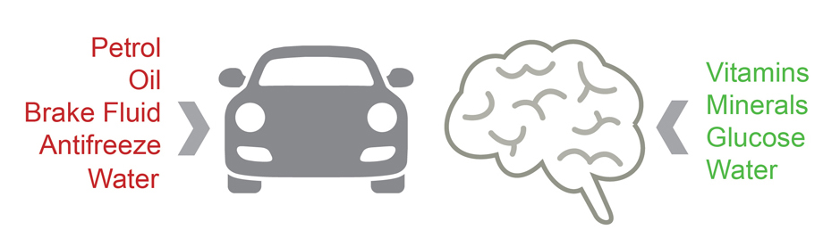
Optimising nutrient intake
The brain needs variety of nutrients work at its best
Uses 20% of daily energy or calories
In particular requires vitamins (B group) minerals (iron, zinc & iodine) & omega-3 fats
Notes:
Reference
EFSA (2015) Scientific Opinion on the substantiation of health claims related to glycaemic carbohydrates and maintenance of normal brain function pursuant to Article 13(5) of Regulation (EC) No 1924/2006 . EFSA Journal 13: 4026
http://onlinelibrary.wiley.com/doi/10.2903/j.efsa.2015.4026/pdf
Swaminathan (2008) Why Does the Brain Need So Much Power? Scientific americanhttp://www.scientificamerican.com/article/why-does-the-brain-need-s/

Slide 18
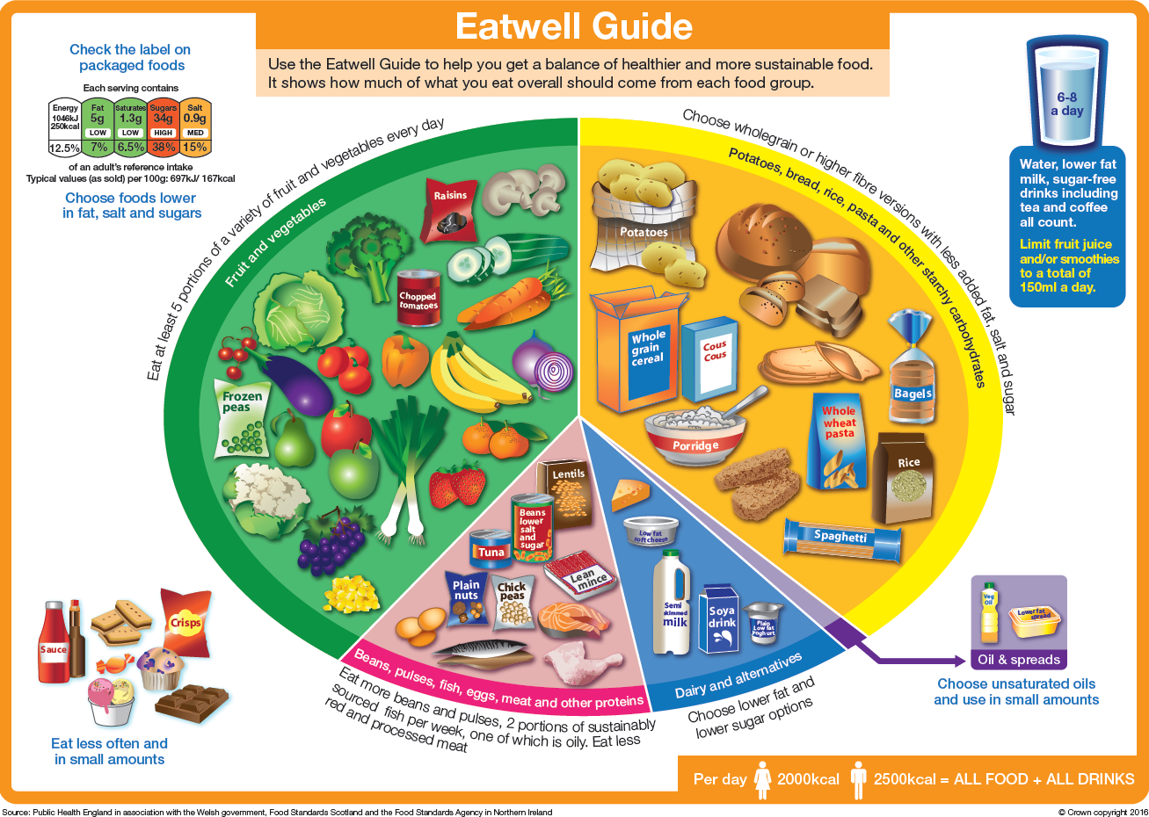
Key food groups for a good mood
Iron
Polyphenols Magnesium Vitamin A
B vitamins
Glucose
Selenium
B vitamins
Iron
Amino acids
Zinc
Magnesium
Vitamin A
Selenium
B vitamins
Iron
Vitamin D
Vitamin A
Omega 3’s
Amino acids
Zinc
B vitamins
Vitamin A
Vitamin D
Amino acids
Zinc
Magnesium Selenium
Notes:
So here we can see the vitamins and minerals present in each food group demonstrating the importance of a diet full of variety and balance.

Slide 19
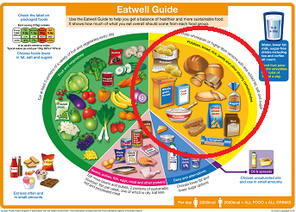
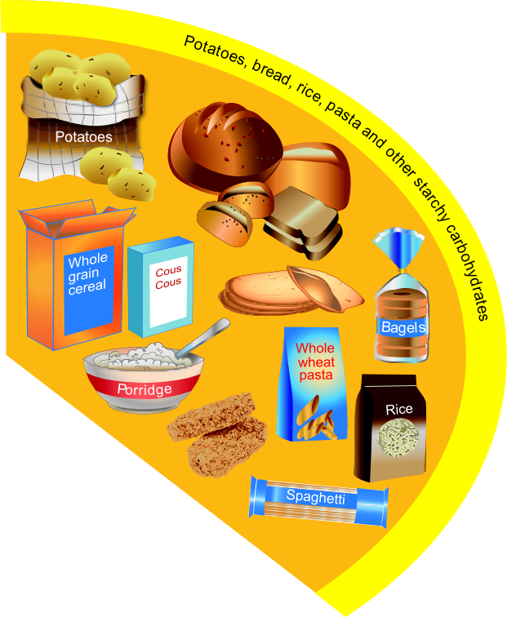
Carbohydrates for mental and physical endurance
Base meals on potatoes, bread, rice, pasta or other starchy carbohydrates; choosing wholegrain versions where possible.

Slide 20
Carbohydrates for mental and physical endurance
Glucose comes from the carbohydrates we eat
  Fruit and vegetables
  Cereals, bread, rice, pasta
Eating carbohydrate-containing, regular meals ensures you will have a steady blood glucose supply to the brain and to your muscles

Slide 21
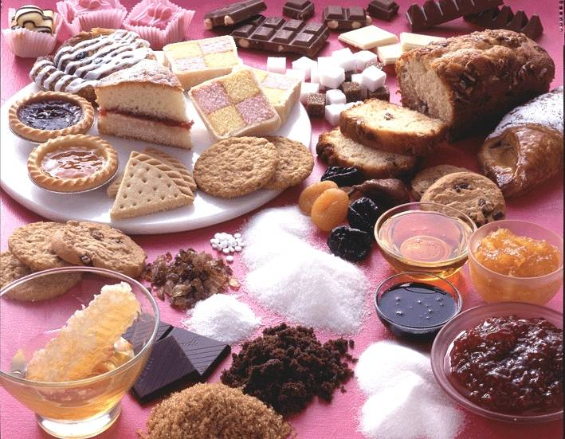
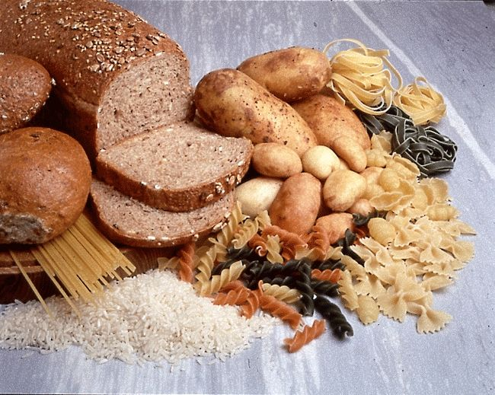
Food Sources of carbohydrate
But are all sources of carbohydrate equal?

Slide 22
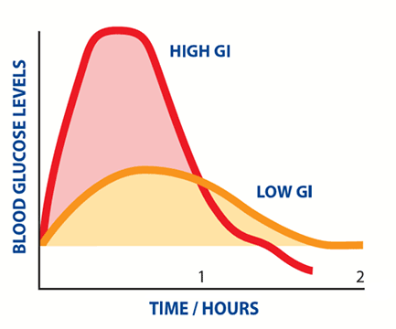
Choose the right carbohydrates
Carbohydrate containing foods digested at different rates
Best choice for steady blood sugar supply are low Glycaemic Index (GI) foods
  High GI foods e.g. white bread, sugary drinks, cakes, biscuits
  Absorbed quickly
  Quick, sharp rise in blood sugar followed by rapid fall
  Lower GI foods absorbed more slowly
  Steadier rise & fall in blood sugar
Notes:
References
BDA Food Fact Sheets
https://www.bda.uk.com/foodfacts/GIDiet.pdf
https://www.bda.uk.com/foodfacts/food_fact_sheet_information_sources/gi_infosources
References & Resources
BDA Food Fact Sheets
https://www.bda.uk.com/foodfacts/GIDiet.pdf
https://www.bda.uk.com/foodfacts/food_fact_sheet_information_sources/gi_infosources
www.bda.uk.com/foodfacts/Carbs.pdf
https://www.bda.uk.com/foodfacts/food_fact_sheet_information_sources/carbohydrates_information_sources
https://www.bda.uk.com/foodfacts/foodmood.pdf
https://www.bda.uk.com/foodfacts/food_fact_sheet_information_sources/foodmoodinfo

Slide 23
Small, healthy, swaps
Make your meals healthier by swapping ............... to these!
White toast with butter and marmalade Glass of orange juice | Scrambled eggs on granary toast A whole orange
Large white cob with cheese and ham Packet of crisps and can of cola | Wholemeal sandwich with cheese and salad An apple, a handful of nuts and can of diet cola
Lasagne with garlic bread | Spaghetti bolognaise with side salad

Slide 24
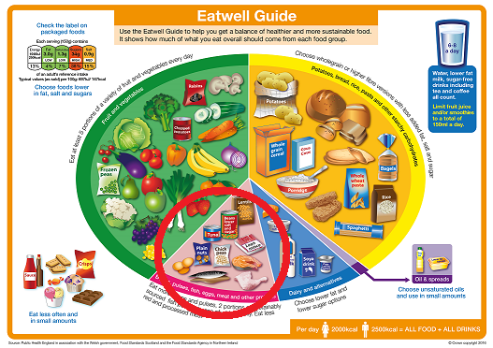
Protein for mental and physical strength
Eat some beans, pulses, fish, eggs, meat and other proteins (including 2 portions of fish every week, one of which should be oily).
Good source of iron, zinc, iodine and omega 3 fatty acids
May be protective in maintaining good memory¹ and prevention and treatment of depression²
Notes:
For van drivers in particular, with a lot of concentration

Slide 25
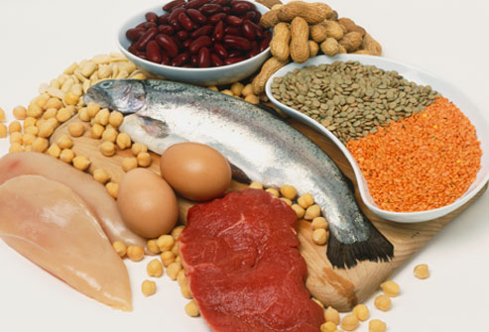
Choosing the right protein
Choose good sources e.g. lean meat, fish, eggs, pulses, nuts & seeds
Frequent intakes of processed meats & meat products can increase risk of heart disease and some cancers
Notes:
We’re not saying you should never choose these protein containing foods, but hopefully you are seeing that eating them regularly isn’t a good choice for people looking forward to a healthy retirement.

Slide 26
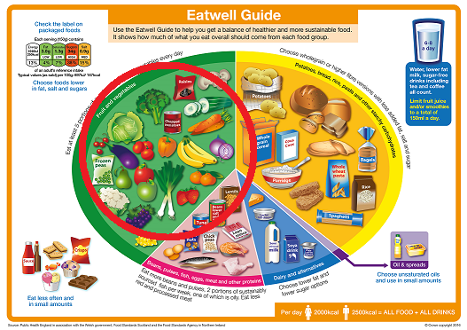
More foods for brain health
Whilst on shift:
37% of van drivers eat 1 portion of fruit or veg
24% eat 2 portions of fruit or veg
Eat at least 5 portions of a variety of fruit and vegetables every day.
Good source of polyphenols
Diets achieving the recommendation for fruits and vegetables have been associated with ↓ depression and anxiety¹
Notes:
Thinking back to the start of the presentation we saw that driving jobs are associated with anxiety and that intakes of fruit and veg (1 portion per shift) were low. Eating to recommended levels can support brain health – plus boost so many other health factors.
Suggested activity if there is time
Ask if participants think frozen/ canned & dried count
What about fruit juice/smoothies?
References & Resources
The Eat Well Guide
https://www.gov.uk/government/publications/the-eatwell-guide
BDA Food Fact Sheet
https://www.bda.uk.com/foodfacts/FruitVeg.pdf
https://www.bda.uk.com/foodfacts/food_fact_sheet_information_sources/fruitveginfo
1. Rucklidge and Mulder. 2016. Could nutrition help behaviours associated with personality disorders? A narrative review. Personality and Mental Health. 10: 3-11

Slide 27

Powerful Polyphenols
Aid ‘synaptic plasticity’ in the brain
Affect a broad range of brain mechanisms
Associated with higher cognitive function and better mood
Nature’s
anti-depressants
Abundant in colourful fruit, veg, herbs, spices, teas, coffee and wine
More than 8000 compounds identified
Include flavanoids & anthocyanins
Resveratrol in berries, grapes, red wine and peanuts
Chorogenic acid in plums, apples cherries
Curcumin in turmeric (curries), red/yellow onions, leaves
And many others in cloves, mint, thyme, basil, ginger

Slide 28
Keep well hydrated

Slide 29
Keep well hydrated
27% of van drivers drink 5-6 cups of fluid whilst on shift
19% drink 4-5 cups of fluid whilst on shift
A study found that drivers in simulator tests who were mildly dehydrated made double the errors of those who were properly hydrated. This was roughly the same number as someone who had consumed the upper legal limit of alcohol.

Slide 30

Effects of small amounts of fluid loss (dehydration)
Physical effects
  Reduction in strength
  Perception of effort is increased
  Tiredness and fatigue
Mental effects
  Poor concentration
  Reduced skill / accuracy
  Impedes decision making

Slide 31
Risks for dehydration at work
Fluid losses from:
  Air con or heaters in vans
  Hot environment
  Protective clothes
  Multi-drop deliveries building up a sweat
Notes:
Suggested activity:
Ask if any of these apply to participants
Ask if participants have noticed impairment of their mood when dehydrated
References
BDA (2015) White Paper :Supporting healthier working lives through dietitian-led wellness initiatives
http://www.bdaworkready.co.uk/

Slide 32
Risks for dehydration
Barriers to access
  Limited access to top up on drinks
  Long hours
  Time associated with toilet breaks
  Availability of facilities for toilet breaks
Notes:
Suggested activity:
Ask if any of these apply to participants
Ask if participants have noticed impairment of their mood when dehydrated
References
BDA (2015) White Paper :Supporting healthier working lives through dietitian-led wellness initiatives
http://www.bdaworkready.co.uk/

Slide 33
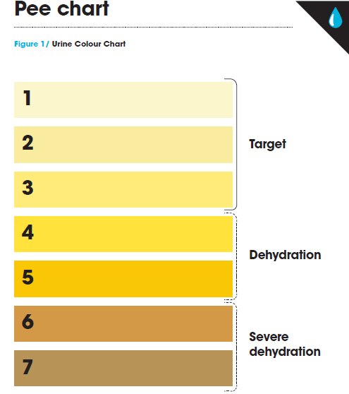
How to tell if you are dehydrated?
Thirst?
Urine colour?
Work Ready have hydration resources including:
Travel mugs
Pee charts
Work Ready hydration toolkit
Notes:
This urine chart was developed by leading hydration experts working with elite athletes to optimise performance. If van drivers are operating as industrial athletes, then fluid intake is a key consideration.

Slide 34
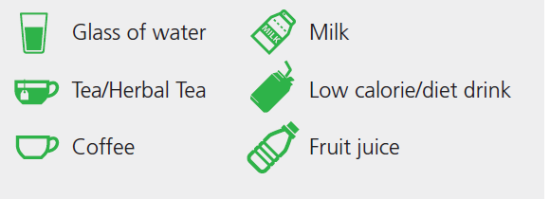
What counts?
Water – either tap or bottled is great.
Coffee & tea : including herbal tea
Low calorie/diet drinks: Regular soft drinks contain high amounts of sugar so look out for reduced-calorie options
Milk: skimmed or semi skimmed
Fruit juice/smoothie: a glass counts as one of the 5-a-day
Alcohol does not contribute to hydration

Slide 35

A word about caffeine
Coffee/tea/cola can contribute to fluid intake
  Caffeine intakes up to 400 mg/day not dehydrating
  Equivalent to 4-5 cups of coffee
↑ alertness & reduces sleepiness
May ↑ anxiety, irritability + sleep disturbances
Notes:
Caffeine can be used to boost performance, but with caution. This advice has been put together for long haul pilots who need to maintain concentration during a shift:
Tea and coffee is effective and additional supplements are not necessary
Many drinks may also contain high amounts of sugar as well as caffeine. This includes energy drinks, colas and some specialty teas and coffees.
Caffeine is most effective upon awakening. 2-3 small cups (200 ml) of tea or coffee in a 2-3 hour upon rising may be optimal.
Caffeine has its peak stimulatory effects about one hour after consumption.
Intake should diminish upon the hours leading up to sleep.
Individuals respond very differently to caffeine – some may get a powerful stimulatory effect whilst others may not

Slide 36

‘Men and women should drink no more than 2-3 alcoholic drinks 2-3 times as week’
And what about alcohol?
  14 units per week
  Women & men
  Avoid binge-drinking
  More alcohol free days

Slide 37
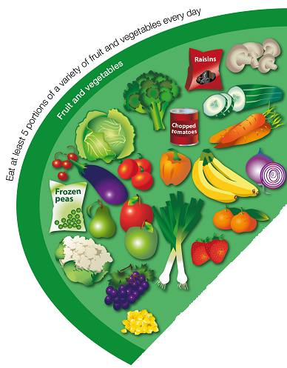
Snack Smart
75% UK adults snack at least once a day (10% snack 3 x a day)
Can be positive & nutritious :useful brain fuel & provide other nutrients
Key to healthy snacking = choices & portion sizes
Is there a food group you are not good at eating ?

Slide 38

Snack Smart
For portion control look for mini sizes
Avoid stress & hunger pangs
    Plan ahead for the day
    Keep healthy snacks to hand
Try to keep higher-fat/ higher-sugar cakes, biscuits, crisps & chocolate as occasional treats rather than your regular snacks
Notes:
Resources
BDA Food Fact Sheet www.bda.uk.com/foodfacts/healthysnacks.pdf
www.nhs.uk/Change4Life/Pages/healthy-snacks.aspx

Slide 39
Snack Smart
  Some ideas for the van:
Dried or fresh fruit, nuts & seeds
Crackers, oat or rice cakes or veggie sticks with cottage cheese or hummus
Scones/ malt loaf /teacakes
Lower sugar/ wholegrain cereal bar
Notes:
Resources
BDA Food Fact Sheet www.bda.uk.com/foodfacts/healthysnacks.pdf
www.nhs.uk/Change4Life/Pages/healthy-snacks.aspx

Slide 40

What else can help?
Physical activity
Social interaction
Sunlight & vitamin D
Mindful eating
Reducing smoking & alcohol
Getting enough sleep
... a lunch break can be a great chance to include some of these
Notes:
Notes
Acknowledgment that mood is influenced by factors other than diet. Taking a lunch break may not only boost nutrition it may help improve mood, well being and reduce stress especially if involving nature, sunlight, relaxation, social interaction and/or physical activity.
References
Buckley et al (2015) PHE & Active Working CIC Consensus Statement The sedentary office: an expert statement on the growing case for change towards better health and productivity. Br J Sports Med 49 :1357-62
http://bjsm.bmj.com/content/49/21/1357
de Bloom et al (2014) Exposure to nature versus relaxation during lunch breaks and recovery from work: development and design of an intervention study to improve workers’ health, well-being, work performance and creativity. BMC Public Health 14:488
http://www.ncbi.nlm.nih.gov/pmc/articles/PMC4039544/
Department of Health (2004) At Least Five a week: evidence on the impact of physical activity and its relationship to health Chapter 5.5 Physical activity, psychological well being and mental illness
http://webarchive.nationalarchives.gov.uk/20130107105354/http://www.dh.gov.uk/prod_consum_dh/groups/dh_digitalassets/@dh/@en/documents/digitalasset/dh_4080988.pdf
Moore et al (2015) Social Interaction and Collaboration among Oncology Nurses. Nurs Res Pract Article ID 248067
http://www.ncbi.nlm.nih.gov/pmc/articles/PMC4465712/
NHS Choices : Low mood and depression
http://www.nhs.uk/Conditions/stress-anxiety-depression/Pages/low-mood-and-depression.aspx
NHS Choices : Alcohol http://www.nhs.uk/Livewell/alcohol/Pages/Tipsoncuttingdown.aspx
NHS Choices : Mindfulness http://www.nhs.uk/Conditions/stress-anxiety-depression/Pages/mindfulness.aspx
Penckofer et al (2010) Vitamin D and Depression: where is all the sunshine? Issues in Mental Health Nursing 31: 385-393 http://www.nhs.uk/Conditions/stress-anxiety-depression/Pages/low-mood-and-depression.aspx
Vitamin D Council https://www.vitamindcouncil.org/health-conditions/depression/

Slide 41
What can employers and fleet managers do to support drivers?
Provision of information and support
Factor in time on shifts for meal/snack breaks and toilet stops
Protect meal break
Evaluate implementation efforts to show value of workplace nutrition programmes

Slide 42
We asked van drivers: what could help you to eat and drink more healthy at work?
Breaks
Cheaper healthier options in the café/vending machines
Availability
Refrigerated storage
Time
A mobile van that sells just healthy foods on sites
Less stress, more time
Planning the day ahead
Reminders
Notes:
These are just some of the recurring themes.

Slide 43
How we could help
A programme that is tailored to your organisation and staff
Education around meal prep
Food demos: meal prep, snacking, eating well for less
Nutrition consultations for drivers
Factsheets
Hydration resources as prompters on the road
Review of food provisions

Slide 44
Questions?
Notes:
There are BDA Food Fact Sheets on several related topics.
Alcohol
Breakfast
Carbohydrate
Depression & Diet
Food and Mood
Fluid
Fruit & Vegetables
Omega -3
Snacks
Healthy Eating
Packed Lunches
Vitamin D
You may want to provide links to recipes or other sources of information. If so you could add links to this slide.
You may want to add certificate of attendance if appropriate .

Slide 45
More information: bdaworkready.co.uk workready@bda.uk.com

