Slide 1
Reality Check: Brexit Mags Simpson Head of Policy - Scotland & Northern England FTA

Slide 2
Introduction - political update
Withdrawal Agreement agreed between EU and UK Government – not yet ratified by UK Parliament
UK General Election 12 December
No-Deal Brexit on 31 January 2020 still possible

Slide 3
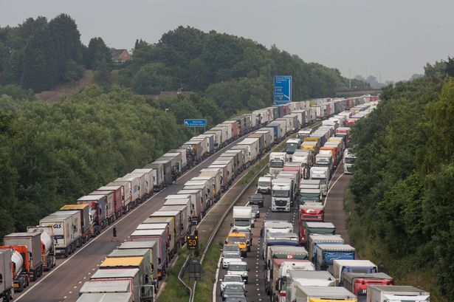
No Deal Brexit impact on domestic haulage – Operation Brock
Keep M20 open both directions
4 stages
HGVs over 7.5t NOT heading to ports
different requirements
proof of destination
Notes:
A No-Deal Brexit would have implications even for road haulage companies that only operate on the domestic market. Domestic operators need to be aware of the traffic management plan around the main ports, in particular Dover, even if they only serve the local market.
Highways England will implement measures to keep the M20 open in both directions in case of disruptions across the Channel (Operation Brock)
4 different stages depending on severity of disruptions
Drivers of goods vehicles over 7.5t NOT heading to the ports of Eurotunnel will need to follow a different set of instructions and may be asked to provide proof of their destination

Slide 4
No Deal Brexit impact on domestic haulage – Operation Brock
Operation Brock – Vehicles >7.5t NOT heading to the ports or Eurotunnel
Phase 1
Drivers using A20 use right-hand lane.
Phase 2
M20 contraflow system London-bound J8-9
Phase 3
For drivers NOT heading to the ports or Eurotunnel, phase 3 is identical to phase 2
Phase 4
As phase 2; but will not be able to use M26
50mph limit
May be stopped at traffic lights to prove destination
Notes:
Phase 1 - Drivers using the A20 can use the right-hand lane. They may be stopped at traffic lights to prove they are not heading to the ports
Phase 2 - On the M20 drivers will have to use a contraflow system on the London-bound carriageway between junctions 8 and 9
50mph limit
Phase 3 - Identical to phase 2 –the differences will only affect vehicles heading to the ports
Phase 4 - Identical to phase 2 except drivers will not be able to use the M26

Slide 5
No Deal Brexit impact – Fuel supply
Government did not share planning assumptions for fuel supply
Yellowhammer: possible disruptions to distribution in London and SE
Local shortages possible; panic buying
No suggestion of cessation of fuel supply; reduced supply possible
FTA advice: do not to engage in panic buying; comply with regulation about storage of fuel
Notes:
The press widely reported about a leaked Government document describing the worst case scenarios in a number of areas. The Government eventually published an official, shorter version of its so-called ‘Yellowhammer report’ highlighting reasonable worst case planning assumptions.
FTA reacted vigorously to the Government’s failure to share their planning assumptions on fuel supply in due time
Government’s reasonable worst case planning assumptions –published in September- envisage disruptions to fuel distribution in London and the South-East if Dartford crossing is blocked
Yellowhammer suggests local shortages possible in other parts of the country because of panic buying
No suggestion of cessation of fuel supply; reduced supply possible on a localised basis
FTA advises members not to engage in panic buying –which would contribute to and worsen the problem- and to comply with regulation about storage of fuel

Slide 6
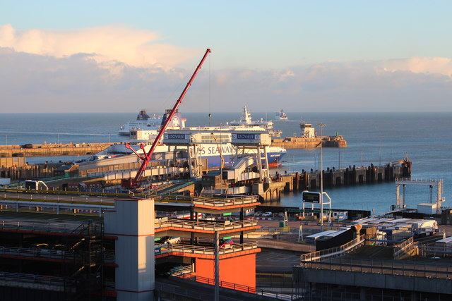
No-Deal Brexit impact on domestic haulage – Collecting EU goods from UK ports
Hauliers will need proof of customs formalities
Hauliers should notify importer that goods have arrived.
Stamped carnets should be provided to the trader
More information on FTA’s website or in DfT reference guide for hauliers
Notes:
Although customs formalities and other border procedures are primarily the responsibility of traders, it is crucial that all actors of the supply chain communicate effectively to ensure that the required paperwork is available when checks will be carried out.
Hauliers collecting goods from UK ports to deliver them to their final destination in the UK will need proof of customs formalities
Hauliers should notify the importer that goods have arrived. Stamped carnets and copies of other documentation should be provided to the trader

Slide 7
No-Deal Brexit impact on international haulage
International hauliers: continued access to EU market
UK Community Licence no longer recognised
Most UK-EU journeys will not need permits to 31 December 2019
Some journeys to non-EU countries or between EU countries may require permits
More information on transport, customs and border requirements for hauliers and drivers available in DfT reference guide
Notes:
In addition to this, international hauliers will be facing new requirements.
International hauliers need to ensure access to the EU market is secured –depending on their business model- as UK Community Licence will no longer be recognised
Most UK-EU journeys will be possible without specific permits until 31 December 2019 –FTA is campaigning for an extension, possibly until end of July 2020. The European Commission proposed such an extension but it still requires the approval of Member States and Members of the European Parliament. Final decision is expected in the fourth week of October.
Some journeys to non-EU countries or between EU countries may require permits
More information on transport, customs and border requirements for hauliers and drivers available in DfT reference guide

Slide 8
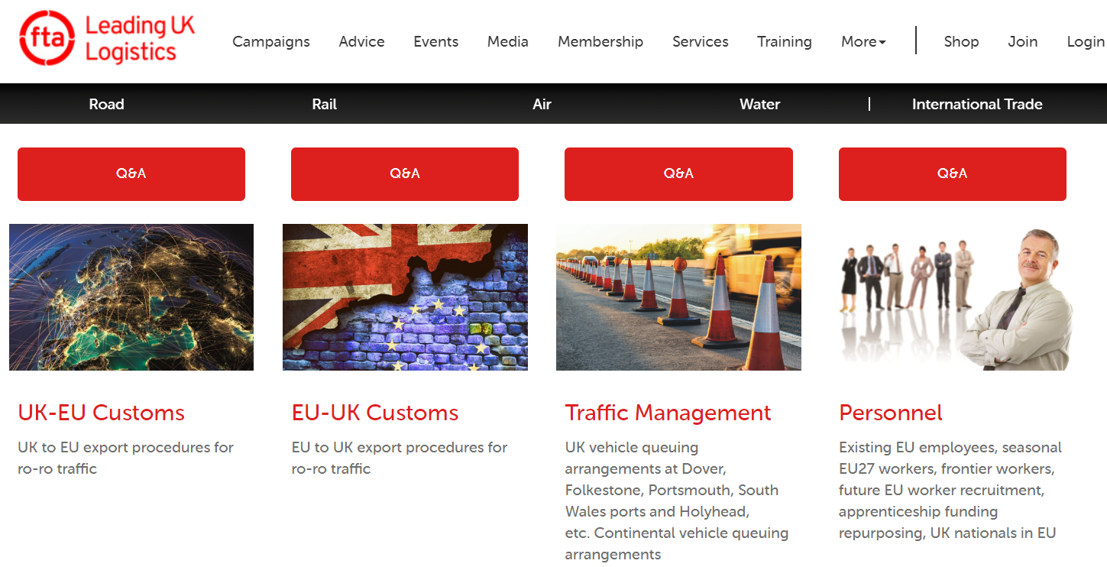
More information https://fta.co.uk/campaigns/brexit-help

Slide 9
How FTA can help you:
BREXIT INFORMATION SERVICE
TRAINING
Essential Information Service
All you need to know about the most relevant Brexit developments in the form of email digests.
The service is free to FTA members.
Expert Subscription Service
More detailed advice, tips and best practice information, briefing notes, checklists, compliance guides and webinars, tailored to your type of operation.
Bespoke Consultancy Service
Have FTA consultants
come on-site to talk
about your bespoke
needs.
Half-day training workshops for hauliers
End-to-end requirements (new road haulage procedures, documentation and responsibilities arising in a No-Deal Brexit)
fta.co.uk/brexit-service
Notes:
Make the most of your membership through Freight Councils, eNews, events and services.
Read from slide

Slide 10
FTA Skills Working Group
Increasing Driver Shortage
Alternative funding – separate to apprenticeships
Attracting Talent – Think Logistics
Jamie Hepburn – Minister for Business
Mags Simpson msimpson@fta.co.uk and Sally Gilson sgilson@fta.co.uk
Notes:
As a slight aside – but closely linked to potential impact of Brexit and future immigration policies……..Skills
Scotland’s economy very much dependent on EU workers and we have had members telling us the driver shortage is getting worse
Not just about skills shortage- also about looking for funding and attracting talent
Funding – does not need to be about apprenticeships – the door is slightly ajar for this conversation right now because of Brexit and Immigration changes
Scot Gov is ready to listen and better understand the challenges that our industry is facing
FTA are involved in an existing Skills Group but we need more members around the table. This needs to be lead by industry with workable solutions and ideas not simply a grumble…this is what's wrong…..this is how we can train more youngsters…and this is how much help we need……
If you are interested in getting involved please come and find me at coffee break

