Slide 2
Reality Check: Brexit
James Firth
Head of Road Freight Regulation Policy
FTA

Slide 3

Introduction – political update
Queen’s Speech 14 October
Legislation passed to stop No Deal
No-Deal Brexit on 31 October still possible
Notes:
Legislation passed by Parliament to stop No Deal was given royal assent
However, a No-Deal Brexit on 31 October is still possible unless:
A withdrawal agreement is adopted and ratified by the UK and the EU before that date –thus securing a transition period
Or: UK Government requests an extension and the EU grants it

Slide 4

Introduction - political update
Government still planning for Brexit on 31 October 2019
Prime Minister will not request extension
Little time left for negotiation
31 October No-Deal still possible
Notes:
Government’s central planning assumption is still Brexit on 31 October 2019 –with or without a deal
Prime Minister made it clear he will not request an extension
Prime Minister made an alternative proposal to solve the Irish border issue and replace the controversial backstop. However, very little time left for a negotiation breakthrough with the EU and the Irish Government already made clear that the proposed plan was not acceptable.
No-Deal Brexit on 31 October is still a very tangible prospect and the default legal outcome.
Therefore FTA advises members to keep planning for No Deal. We appreciate it is uncomfortable for the most affected companies to make significant investments and changes to their processes in spite of the uncertainty but the logistics industry needs to plan for the worst and hope for the best.

Slide 5
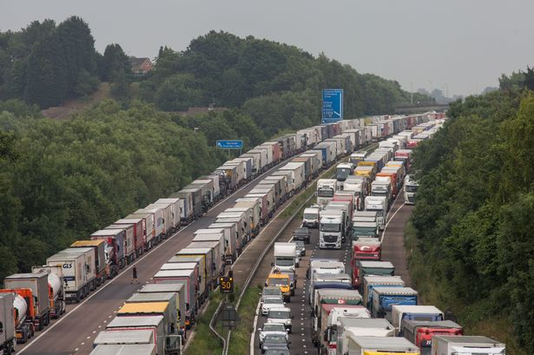
No Deal Brexit impact on domestic haulage – Operation Brock
  Keep M20 open both directions
  4 stages
  HGVs over 7.5t NOT heading to ports
    different requirements
    proof of destination
Notes:
A No-Deal Brexit would have implications even for road haulage companies that only operate on the domestic market. Domestic operators need to be aware of the traffic management plan around the main ports, in particular Dover, even if they only serve the local market.
Highways England will implement measures to keep the M20 open in both directions in case of disruptions across the Channel (Operation Brock)
4 different stages depending on severity of disruptions
Drivers of goods vehicles over 7.5t NOT heading to the ports of Eurotunnel will need to follow a different set of instructions and may be asked to provide proof of their destination

Slide 6
No Deal Brexit impact on domestic haulage – Operation Brock
Operation Brock – Vehicles >7.5t NOT heading to the ports or Eurotunnel
Phase 1
Drivers using A20 use right-hand lane.
Phase 2
M20 contraflow system London-bound J8-9
Phase 3
For drivers NOT heading to the ports or Eurotunnel, phase 3 is identical to phase 2
Phase 4
As phase 2; but will not be able to use M26
50mph limit
May be stopped at traffic lights to prove destination
Notes:
Phase 1 - Drivers using the A20 can use the right-hand lane. They may be stopped at traffic lights to prove they are not heading to the ports
Phase 2 - On the M20 drivers will have to use a contraflow system on the London-bound carriageway between junctions 8 and 9
50mph limit
Phase 3 - Identical to phase 2 –the differences will only affect vehicles heading to the ports
Phase 4 - Identical to phase 2 except drivers will not be able to use the M26

Slide 7
No Deal Brexit impact – Fuel supply
  Government did not share planning assumptions for fuel supply
  Yellowhammer: possible disruptions to distribution in London and SE
  Local shortages possible; panic buying
  No suggestion of cessation of fuel supply; reduced supply possible
  FTA advice: do not to engage in panic buying; comply with regulation about storage of fuel
Notes:
The press widely reported about a leaked Government document describing the worst case scenarios in a number of areas. The Government eventually published an official, shorter version of its so-called ‘Yellowhammer report’ highlighting reasonable worst case planning assumptions.
FTA reacted vigorously to the Government’s failure to share their planning assumptions on fuel supply in due time
Government’s reasonable worst case planning assumptions –published in September- envisage disruptions to fuel distribution in London and the South-East if Dartford crossing is blocked
Yellowhammer suggests local shortages possible in other parts of the country because of panic buying
No suggestion of cessation of fuel supply; reduced supply possible on a localised basis
FTA advises members not to engage in panic buying –which would contribute to and worsen the problem- and to comply with regulation about storage of fuel

Slide 8
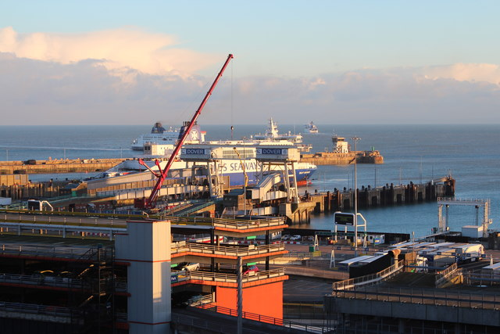
No-Deal Brexit impact on domestic haulage – Collecting EU goods from UK ports
  Hauliers will need proof of customs formalities
  Hauliers should notify importer that goods have arrived.
  Stamped carnets should be provided to the trader
More information on FTA’s website or in DfT reference guide for hauliers
Notes:
Although customs formalities and other border procedures are primarily the responsibility of traders, it is crucial that all actors of the supply chain communicate effectively to ensure that the required paperwork is available when checks will be carried out.
Hauliers collecting goods from UK ports to deliver them to their final destination in the UK will need proof of customs formalities
Hauliers should notify the importer that goods have arrived. Stamped carnets and copies of other documentation should be provided to the trader

Slide 9
No-Deal Brexit impact on international haulage
International hauliers: continued access to EU market
UK Community Licence no longer recognised
Most UK-EU journeys will not need permits to 31 December 2019
Some journeys to non-EU countries or between EU countries may require permits
More information on transport, customs and border requirements for hauliers and drivers available in DfT reference guide
Notes:
In addition to this, international hauliers will be facing new requirements.
International hauliers need to ensure access to the EU market is secured –depending on their business model- as UK Community Licence will no longer be recognised
Most UK-EU journeys will be possible without specific permits until 31 December 2019 –FTA is campaigning for an extension, possibly until end of July 2020. The European Commission proposed such an extension but it still requires the approval of Member States and Members of the European Parliament. Final decision is expected in the fourth week of October.
Some journeys to non-EU countries or between EU countries may require permits
More information on transport, customs and border requirements for hauliers and drivers available in DfT reference guide

Slide 10
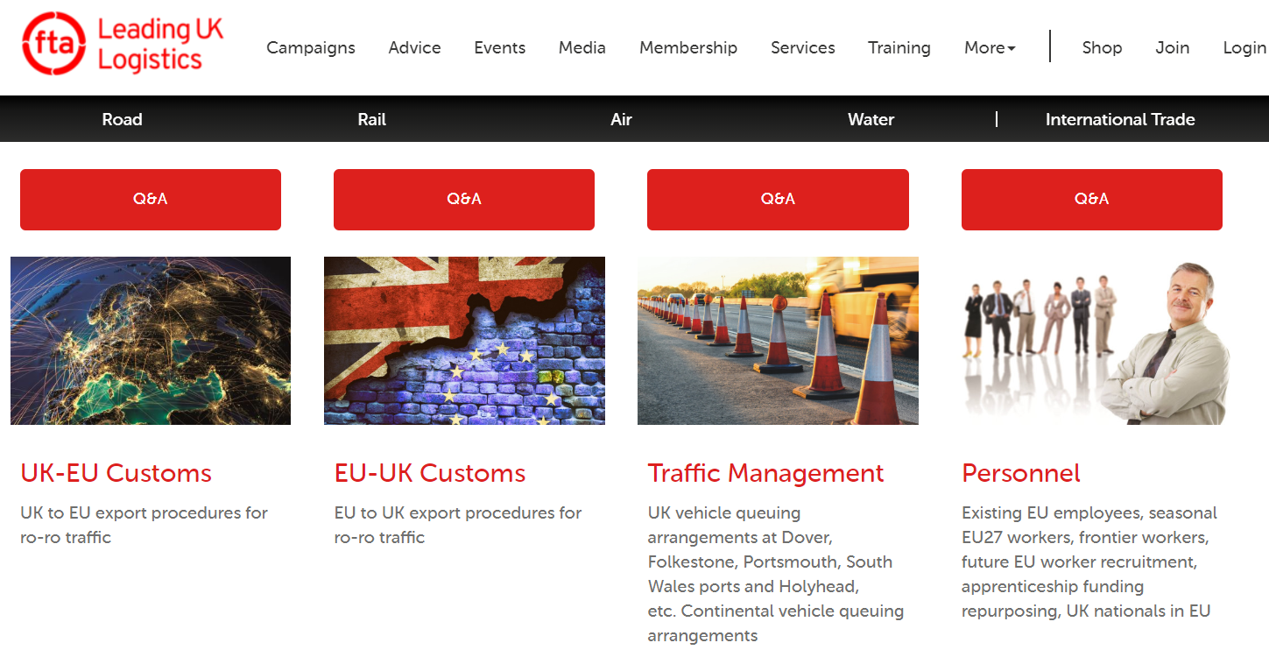
More information https://fta.co.uk/campaigns/brexit-help

Slide 11
How FTA can help you:
BREXIT INFORMATION SERVICE
TRAINING
Essential Information Service
All you need to know about the most relevant Brexit developments in the form of email digests.
The service is free to FTA members.
Expert Subscription Service
More detailed advice, tips and best practice information, briefing notes, checklists, compliance guides and webinars, tailored to your type of operation.
Bespoke Consultancy Service
Have FTA consultants
come on-site to talk
about your bespoke
needs.
Half-day training workshops for hauliers
End-to-end requirements (new road haulage procedures, documentation and responsibilities arising in a No-Deal Brexit)
fta.co.uk/brexit-service
Notes:
Make the most of your membership through Freight Councils, eNews, events and services.
Read from slide

