Slide 1


Getting Logistics Ready for Brexit
NB: The slides reflect our understanding as at the date of the conference and may no longer be accurate as the situation changes
19th December 2018

Slide 2
Chairman’s Welcome & Introductions:
“No Deal is Still a Risk”
James Hookham
Deputy Chief Executive
FTA

Slide 3
Overview & Conference Structure
Pauline Bastidon
Head of European Policy & Brexit
FTA

Slide 4


What we know
UK & EU negotiators reached an agreement on 14 November
Agreement is made of a withdrawal agreement (binding) & a political declaration on outline of future relationship
Both UK Gvt & EU-27 leaders adopted the two texts on 25 November
UK HoC needs to ratify the texts – vote postponed to January
European Parliament will need to ratify them too (after HoC)

Slide 5
What we know
1
Withdrawal arrangements: most pressing matters for an orderly withdrawal (citizens, financial settlement, Ireland) – Adopted but not Ratified
2
Transitional measures: limited in time – Contingent on withdrawal agreement ratification
3
Comprehensive free trade agreement with the EU: concluded post Brexit
4
Framework for the future UK/EU relationship: preparatory discussions – Outline of future relationship adopted by UK & EU – but not respective parliaments yet

Slide 6
What we know
The UK intends to leave the EU on 29 March 2019, 11pm BST
The transition period is not a guarantee
Any transition would end at the latest in 2022
The UK Government intends to leave the Single Market & Customs Union
In a no deal situation, tariffs will apply
Border delays & disruptions are likely in a no deal scenario
New customs & regulatory obligations will arise in the event of no deal

Slide 7
What we know
Air freight will be able to continue operating at least until end 2019
International road haulage & rail freight are dependent on agreements being concluded & could face severe restrictions in a no deal scenario
The UK Government has pledged to protect the rights of EU citizens currently in the UK, but post-Brexit immigration rules are likely to be more restrictive

Slide 8
Withdrawal agreement
Status quo until end of December 2020 (incl. international agreements) – could be extended by 1 or 2 years at the UK’s request
  Would apply unless/until superseded by a subsequent agreement ensuring there is no hard border
  UK and EU in a ‘combined customs territory’ – no tariffs between UK and EU – EU external tariff applies to RoW goods
  Union Customs Code and parts of the Single Market apply to NI
Transition period
Irish backstop

Slide 9
Withdrawal agreement
Provides for status-quo like transition until at least 2021
Managed departure from the EU
No hard border on the island of Ireland
No tariffs / checks on rules of origin no matter what – UK-wide
Legal guarantee for UK workers
Opportunity to remove frictions through future relationship

Slide 10
Future relationship
No tariffs or quotas
No checks on Rules of Origin
AEO mutual recognition agreement
Other aspects to be negotiated
Reduced rate of physical sanitary & phytosanitary checks likely (but full documentary/identity checks)
Pledge to avoid need for hard border in Ireland through future relationship suggests further facilitations
Customs
Regulatory

Slide 11
Future relationship
Visa-free travel for short-term visits
… but would not cover agency workers
Comprehensive air transport agreement (market access, aviation safety & security, air traffic management, competition)
‘Comparable market’ access for road haulage with strong regulatory alignment obligations
Bi-lateral arrangements for cross-border rail
Cooperation on maritime safety & security
Staff Mobility
Transport

Slide 12
Next steps
19 December: EU ‘no deal’ guidance
19 December: UK Immigration White Paper
Before 21 January: UK House of Commons ‘meaningful vote’
If agreement is ratified by HoC: European Parliament vote
There is a tangible threat of no deal

Slide 13
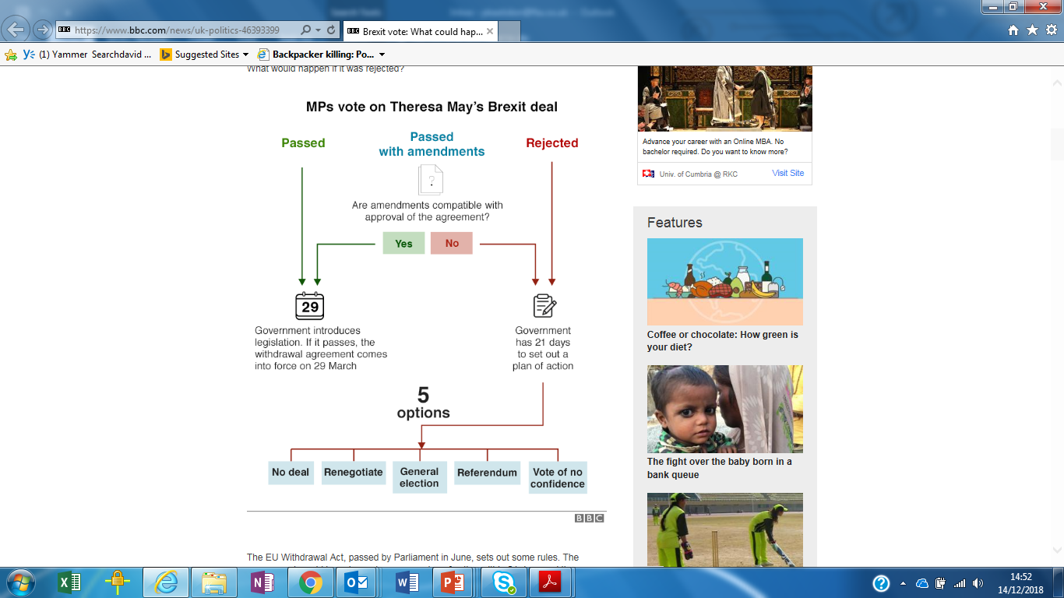
Next steps – UK Parliament vote

Slide 14
Brexit scenarios
Brexit is cancelled - because of a second UK Referendum and/or a change of Government = NO BREXIT
Brexit is minimal - because new free trade agreement provides for close relationship & minimal frictions = SOFT BREXIT
Brexit is tough - because hard borders are introduced at the end of the Transitional Period = HARD BREXIT
Brexit is chaotic - because No Withdrawal Agreement is signed and trade and transport revert to 3rd country rules on 29 March 2019 = NO DEAL BREXIT

Slide 15
Brexit scenarios
No deal
Soft Brexit
Limited changes at end of transition period
Reduced or no border checks & formalities
No Brexit
Changes at the end of transition period
Full transport access
Maximum level of trade facilitation
No changes
Changes on 29/03/19, 23:00
Full customs & border controls
Hard Brexit
Full trade formalities
Tariffs
Possible transport restrictions (road & rail)
Full customs & potentially reduced regulatory controls
Limited trade facilitation / customs simplification measures
Transport?
No border controls beyond existing ones
No transport restrictions

Slide 16
Impact of no-deal Brexit – key challenges for logistics
New admin formalities & red tape (costs)
Border delays
Transport (market access)
Access to skills
Brexit challenges

Slide 17
Mini-deals in the event of no deal?
Road haulage arrangements to maintain connectivity & avoid the need for permits
Aviation arrangements to keep planes flying and air cargo moving
Recognition of the UK as ‘approved 3rd country’ for SPS
No SPS checks at the borders
Urgent decision on status of Irish border
Bi-lateral agreements necessary to maintain Getlink shuttle services & international rail freight services through Channel Tunnel
Waiver from the need to produce safety & security declarations
Mutual recognition of AEO accreditations
Continued access to EU VAT system

Slide 18
Panel discussion
‘No Deal’ Planning for UK-EU Imports & Exports:
Customs procedures
John Lucy, Manager - International Transport & Trade Procedures, FTA
Alex Veitch, Head of Global Policy, FTA
Pauline Bastidon, Head of European Policy & Brexit, FTA

Slide 19
CUSTOMS PROCESSES FOR UK RO RO OPERATIONS IN EVENT OF D1ND MARCH 2019:
John Lucy, Manager - International Transport & Trade Procedures, FTA

Slide 20
D1ND RO RO IMPORTS BASIC LEGAL RESPONSIBILITY + PROCESS #1
IMPORTER / TRADER (or representative):
Before loading makes Pre Departure Customs Declaration TO HMRC, includes relevant documents to support movement + truck / trailer number = creates Master Reference Number (MRN) which must be provided to Haulier
Arrival at UK port- updates HMRC confirming UK arrival (+ MRN + EORI numbers), possible time lapse allowing this to be done after actual arrival? at which point duty + VAT becomes payable,
HAULIER
Driver accompanied submits Safety & Security information (Entry Summary Declaration ENS) at least two hours before arrival at UK port, or one hour for Eurotunnel.
Driver must have either the MRN as evidence of that a full or simplified frontier has been made OR the EORI number of the importer if the importer has used the entry in the records simplified procedure

Slide 21
D1ND RO RO IMPORTS BASIC LEGAL RESPONSIBILITY + PROCESS #2
Ferry / Train Operator
Accompanied- the operator must have a reasonable belief that a customs but NOT safety & security declarations have been made, this will probably be done through a change in their contractual terms & conditions (tick box on booking?)
Unaccompanied – the operator must submit safety & security declaration for unaccompanied trailers and are liable if not completed, to be done within same time limits as accompanied and will require exactly the same level of data from haulier / importer!
Export Declarations- will require a combined document for customs & S&S on an Export Summary Declaration to HMRC before goods reach port, the response will be; P2P, send additional documents or make vehicle & goods available at a Designated Export Place (DEP) for inspection

Slide 22
eCMR
One standard - One way of working
Consignor
Carrier
Consignee
Paper reduction
Management, control and more efficient organization of logistical chain
Instant digital access to all CMR’s
Realtime proof of delivery
ETA insight: Pick-up and delivery times
Reduce costs & failures
Management by exception
Tighter planning, faster invoicing
Improve efficiency (stay in truck)
Better service – higher customer satisfaction
Reduced administration: No more time consuming handwritten or printed paper consignment notes
Faster payment
Fewer telephone inquiries
Safe and correct method for signing
Paper reduction
Secure and legally correct signature
Damage, defects and delays are reported quickly
No longer necessary to scan and manually archive consignment notes
ETA insight: Better planning thanks to insight into delivery times
Fewer telephone inquiries

Slide 23
Making Customs Simpl(er)
I want to… | …what can I use to save time and/or money?
Regularly trade goods which will be carried by road across a customs border, to or from a trusted buyer or seller | CTC Authorised Consignor or Consignee
Occasionally transport goods across a customs border | TIR Carnet
Reduce the customs paperwork required due to regularly importing large quantities of the same types of product | Customs Freight Simplified Procedures
Import unfinished goods; process them; and re-export them | Inward Processing
Export unfinished goods; have them processed outside the customs territory them, then import them for sale | Outward Processing
Bundle together several customs authorisations without having to run through the whole application process for each one | AEO C
Improve cash flow by delaying payment of customs duty for around a month after goods enter the UK | Deferment Account
Save money on the cost of import by getting a reduction on an Actual Debt guarantee used in a deferment account | AEO C
Get faster access through borders for my goods due to my high quality security track record on my facility (only at countries with recognition agreements) | AEO S
Store my goods for as long as I like without paying customs duty so that I can decide what to do with them (re-export; sell on domestic market; move in transit) | Customs Warehouse
Store my goods for up to 90 days if the paperwork is delayed at the border | Temporary Storage

Slide 24
Panel discussion
‘No Deal’ Planning for
UK-EU Imports & Exports:
Conformity checks & inspections
Sarah Laouadi, European Policy Manager, FTA
Pauline Bastidon, Head of European Policy & Brexit, FTA
John Lucy, Manager - International Transport & Trade Procedures, FTA

Slide 25

Sanitary and phystosanitary (SPS) checks
Documentary checks
Identity checks
Physical checks

Slide 26
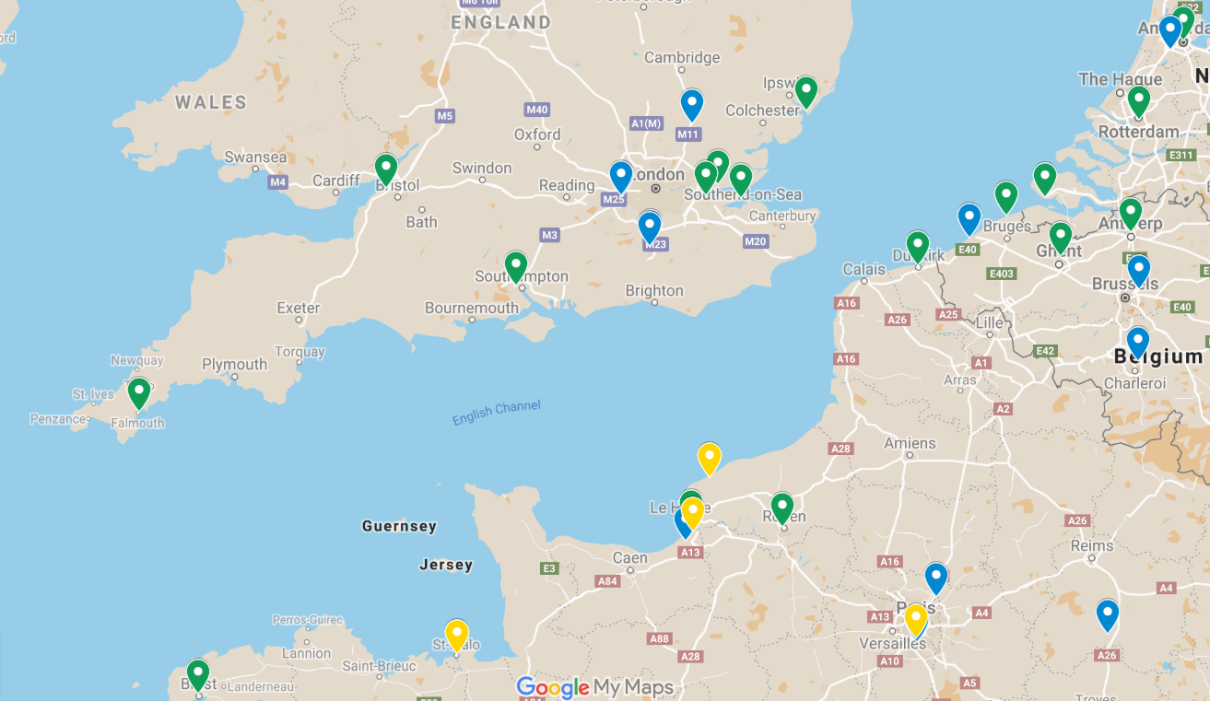
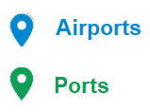

EXISTING BORDER INSPECTION POSTS
(animal-based products)
EXISTING DESIGNATED POINTS OF ENTRY – FR only
(plant-based products)

Slide 27
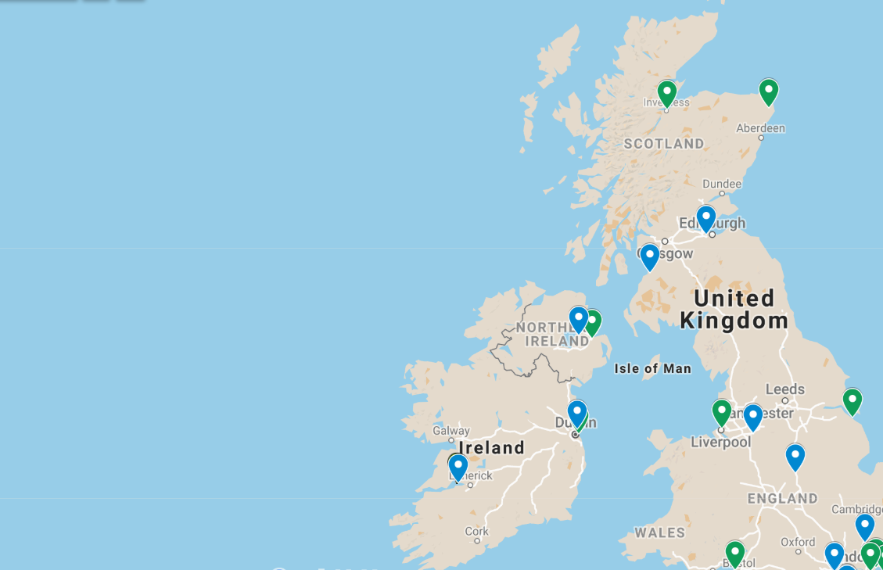
EXISTING BORDER INSPECTION POSTS

Slide 28
Transport options are constrained by availability of BIPs
Location
Type of products
BIP
Opening hours
Capacity

Slide 29
COFFEE

Slide 30
Panel discussion
‘No Deal’ Planning For International Goods Vehicle Operators & Drivers
Sarah Laouadi, European Policy Manager, FTA
Ian Gallagher, Head of Compliance Information, FTA
John Lucy, Manager - International Transport & Trade Procedures, FTA
Seamus Leheny, Policy Manager – Northern Ireland, FTA
Heidi Skinner, Policy and Public Affairs Manager, FTA

Slide 31
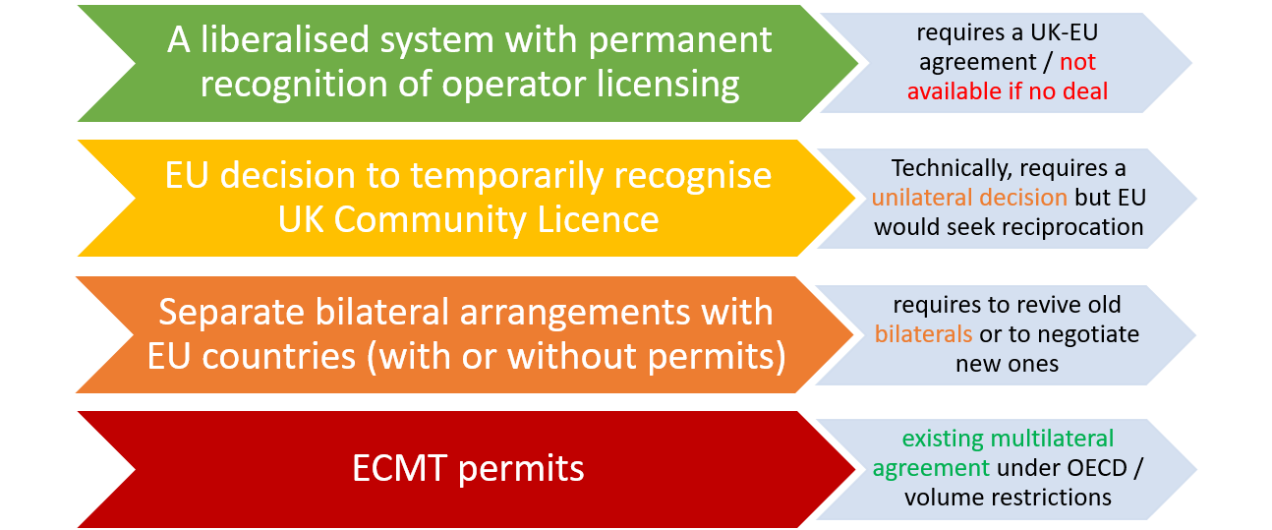
Road haulage options – depending on negotiations outcome

Slide 32
Do I need ECMT permits?
HGVs
ECMT permit required
Vans
ECMT permit required in Italy
Own account
ECMT permit required in many countries
International removals
ECMT authorisation required
+ a number of sector-specific exemptions (which may not be valid in all EU countries)

Slide 33
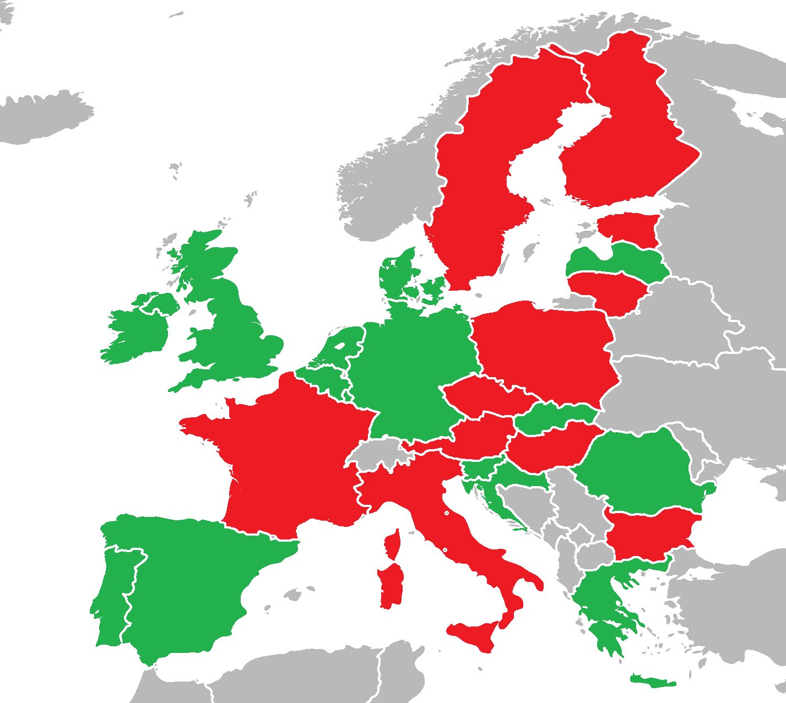
Own-account exemption
Permit not required for own-account transport
ECMT permit (or bilateral permit) required for own-account transport

Slide 34
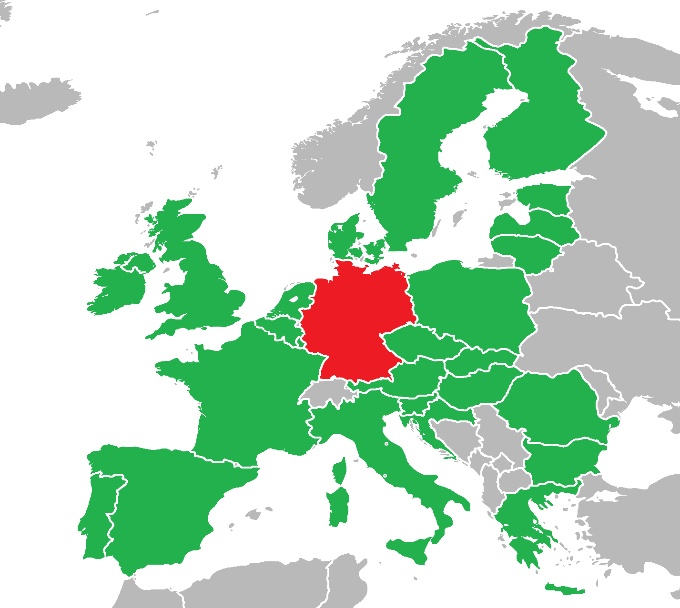
Exemption for transport of works and objects of art for fairs and exhibitions*
Permit not required
ECMT permit (or bilateral permit) required
*exemption is valid only if goods are not for sale

Slide 35
Exemption for accessories and animals to/from theatrical, musical, film, sports or circus performances, fairs or fetes, and those intended for radio recordings or for film or TV production*
Permit not required
ECMT permit (or bilateral permit) required
*exemption is valid only if goods are not for sale

Slide 36
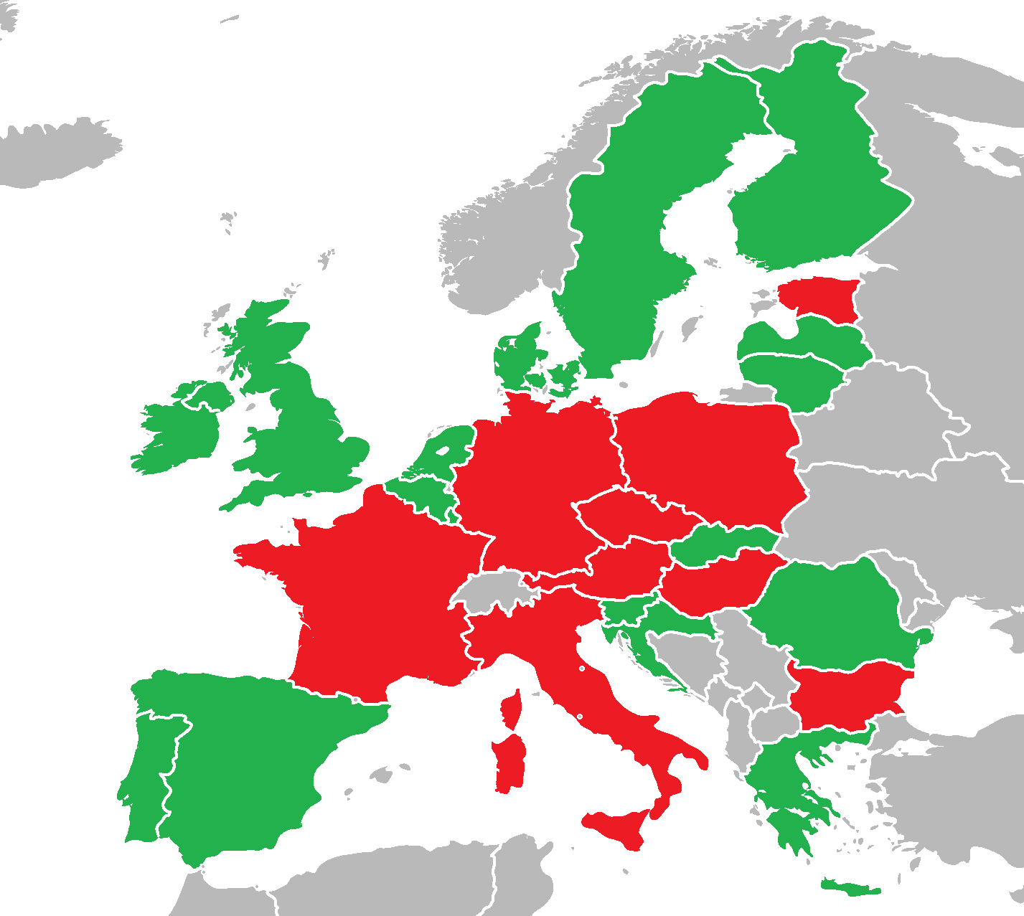
Transport of livestock in specialised vehicles
Permit not required
ECMT permit (or bilateral permit) required

Slide 37
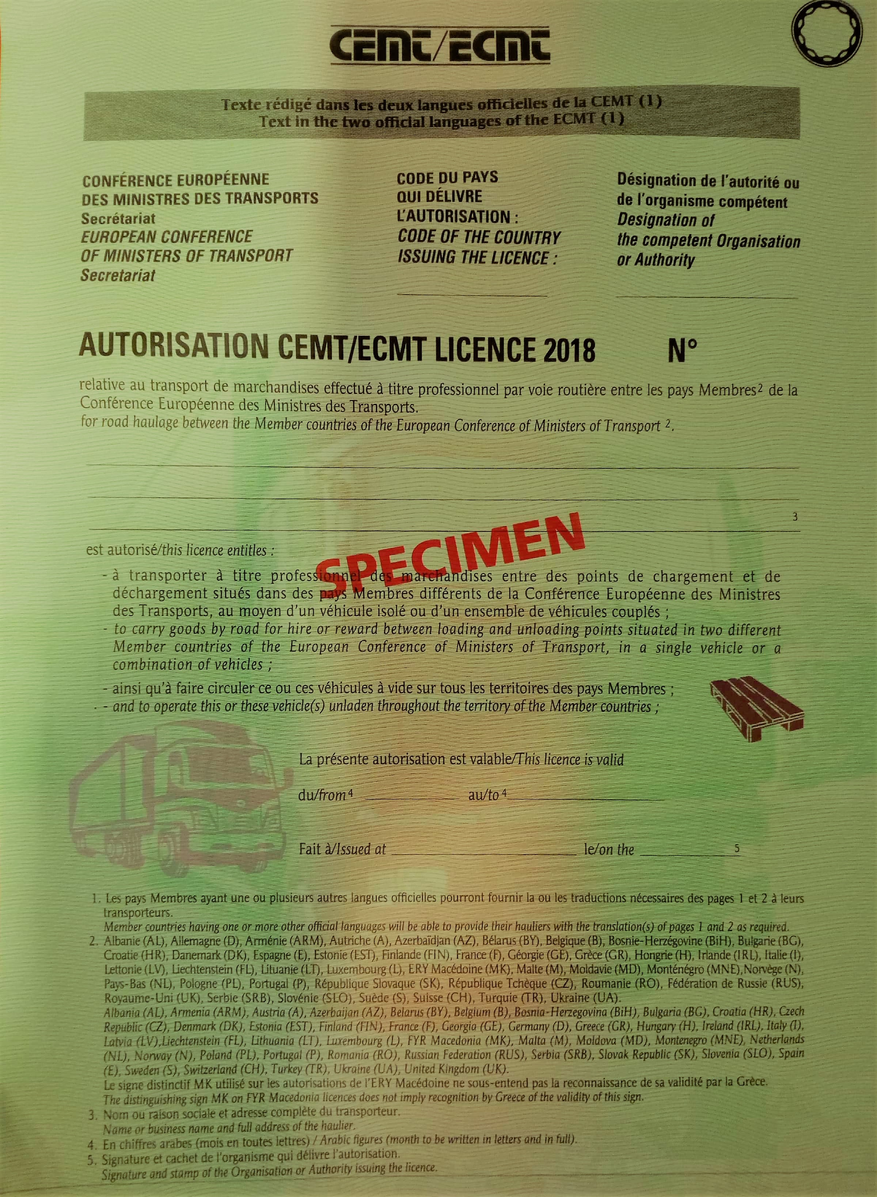
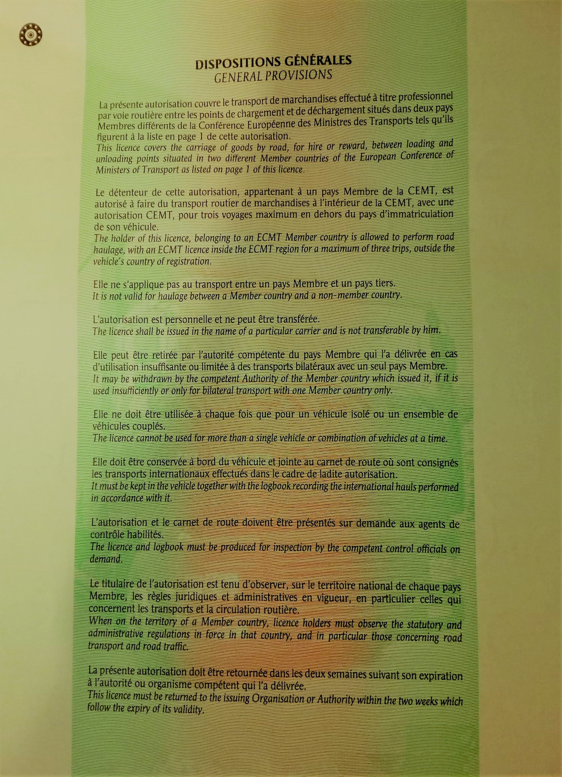
Annual ECMT permit (or ‘ECMT licence’)

Slide 38
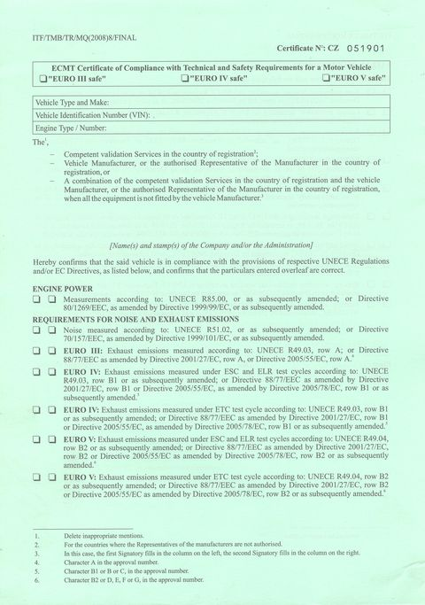
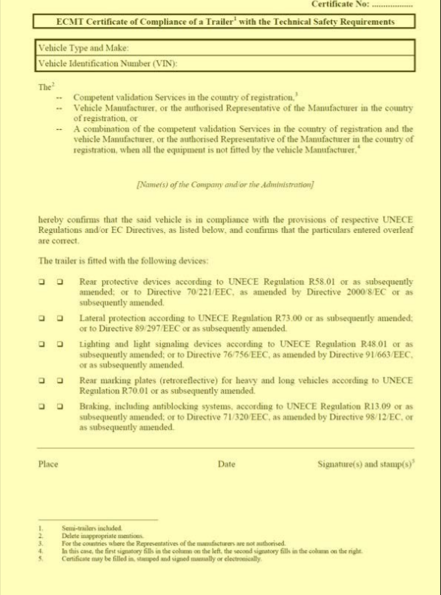
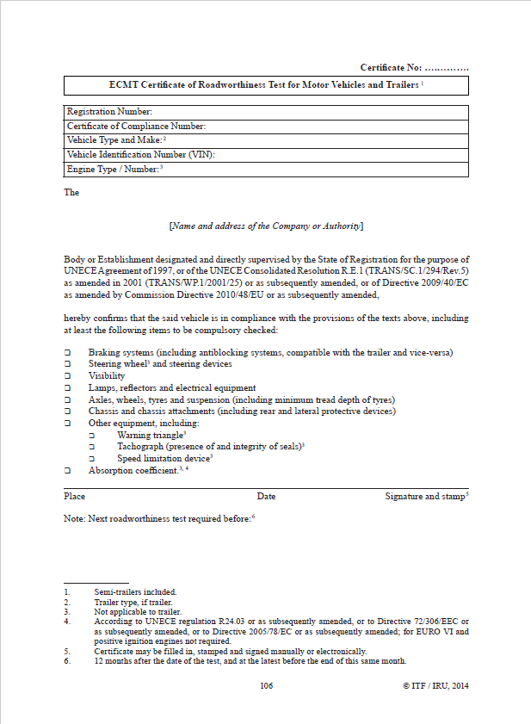
ECMT accompanying documents
Certificate of compliance (motor vehicle)
Certificate of compliance (trailer)
Roadworthiness certificate (motor vehicle and trailer)

Slide 39

The Trailer Registration Briefing Note is available from the MAC

Slide 40
2 types of International Driving Permits
Legal basis | Available | Valid from | Valid for driving in | Validity period
1949 Geneva convention | Now | Day of issue, or up to 3 months in advance | Cyprus, Ireland, Malta and Spain | 12 months
1968 Vienna Convention | From February 2019 | Only valid from 28 March 2019, or day of issue if later | All other EU countries, Norway and Switzerland | 3 years
Source: Department for Transport

Slide 41
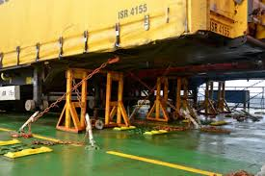
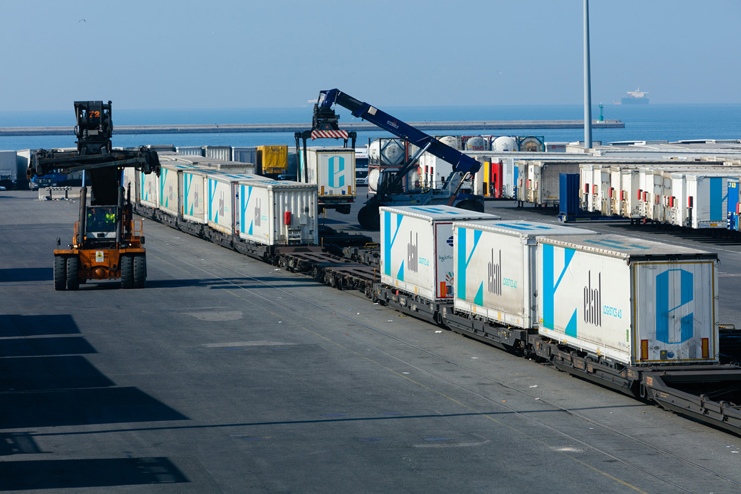
UNACCOMPANIED TRAILER CONSIDERATIONS

Slide 42
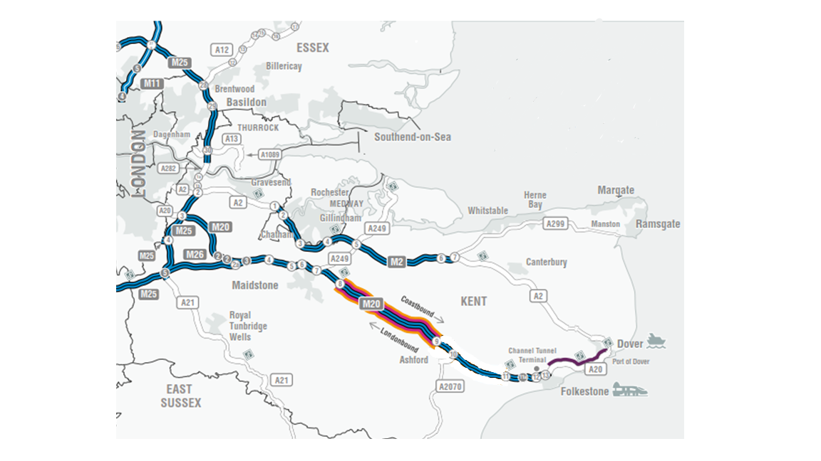

Slide 43
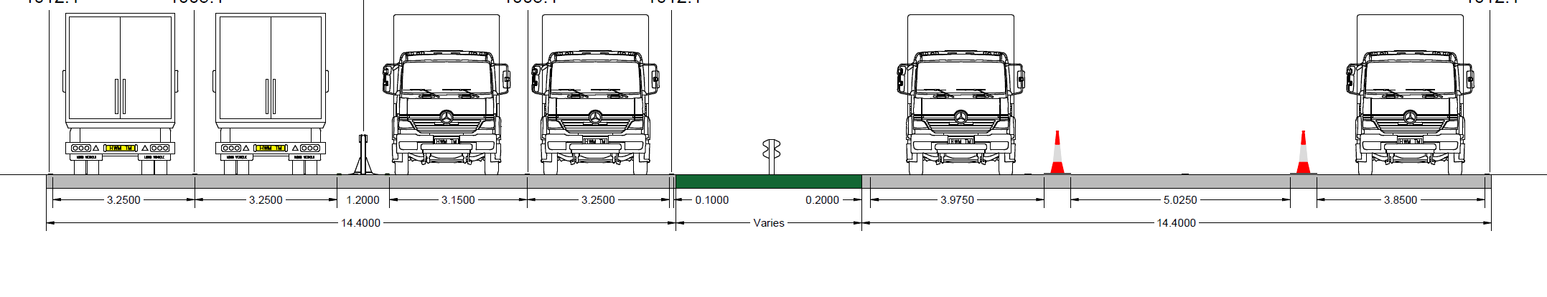
M20 J8-9
all London-bound vehicles
coast-bound cars and non port HGVs
port bound freight only

Slide 44
Panel discussion
‘No Deal’ Planning for Air, Sea & Rail Transport
Alex Veitch, Head of Global Policy, FTA
Pauline Bastidon, Head of European Policy & Brexit, FTA

Slide 45
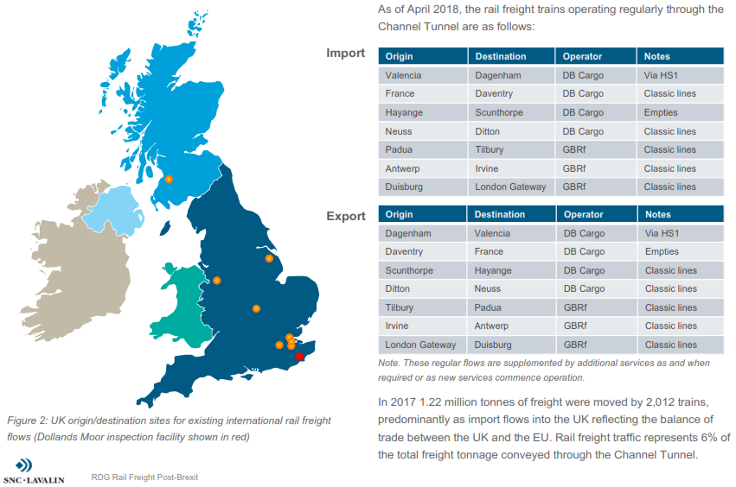
International Rail Freight – origins and destinations

Slide 46
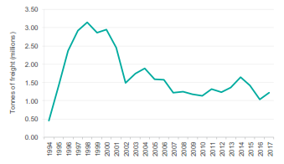
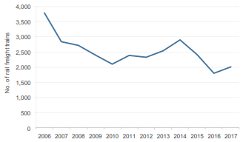
International Rail Freight - Trends
After reaching a peak in the late ‘90s rail freight through the Channel Tunnel has approximately halved.
The number of rail freight trains operating through the Channel Tunnel declined from 2,800 in 2007 to just over 2,000 in 2017.
Source: Rail Delivery Group

Slide 47
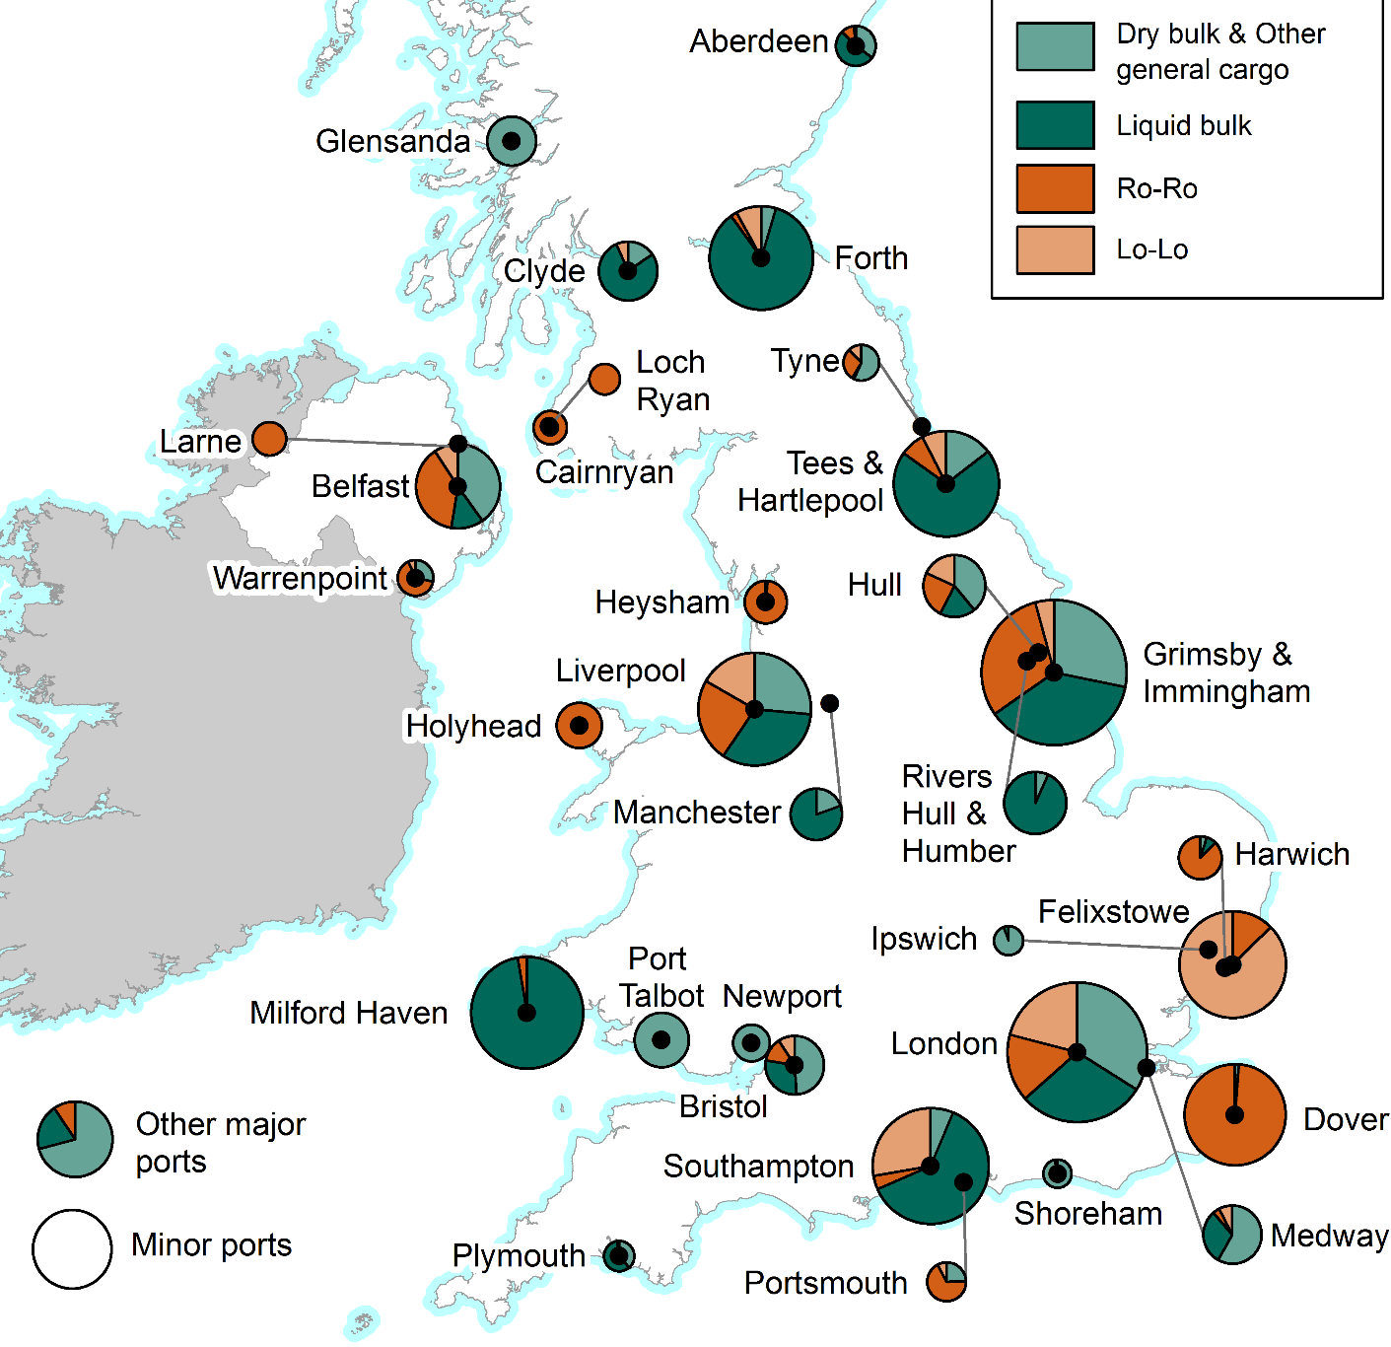
UK major ports* by cargo, 2017 (*>2mt)
Top 10 Ro Ro Ports 2017 (thousand tonnes)
Dover | 25,931
Grimsby & Immingham | 16,431
London | 7,812
Liverpool | 7,751
Belfast | 6,936
Holyhead | 5,219
Heysham | 4,567
Harwich | 4,156
Felixstowe | 3,644
Cairnryan | 2,847
Top 10 Lo Lo Ports 2017 (thousand tonnes)
Felixstowe | 25,346
London | 10,448
Southampton | 9,560
Liverpool | 5,424
Grimsby & Immingham | 2,281
Forth | 2,208
Tees & Hartlepool | 2,160
Hull | 1,773
Belfast | 1,694
Bristol | 807

Slide 48
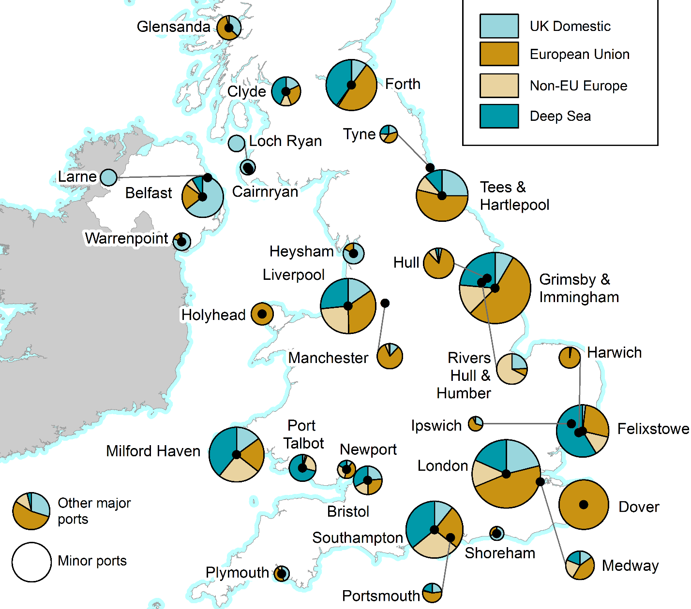
UK major ports by route, 2017
Top 20 EU route ports (all cargo types)
Grimsby & Immingham | 29,096
Dover | 25,956
London | 23,791
Tees & Hartlepool | 15,238
Forth | 13,438
Liverpool | 11,205
Southampton | 8,600
Hull | 8,336
Felixstowe | 7,820
Milford Haven | 6,589
Manchester | 5,555
Holyhead | 5,230
Harwich | 4,618
Orkney | 4,047
Sullom Voe | 3,792
Belfast | 3,773
Medway | 3,768
Glensanda | 3,621
Clyde | 2,340
Bristol | 2,289

Slide 49
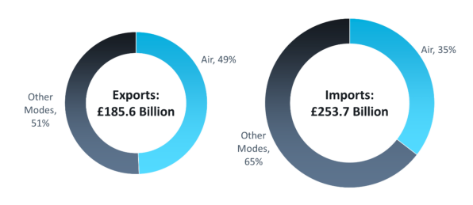
Air Freight – imports and exports

Slide 50
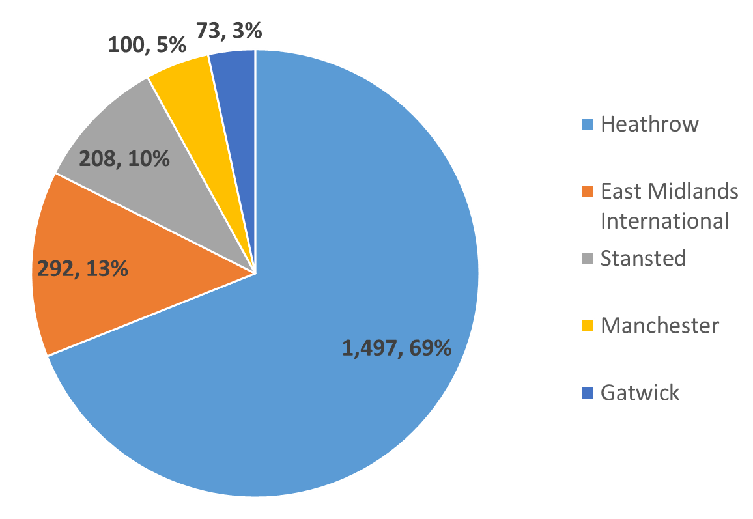
Total Air Freight handled, 2015 (thousand tonnes)

Slide 51
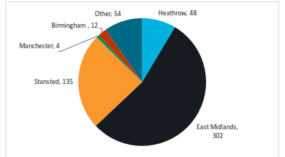
Air Freight: Integrator freight volumes, 1,000 tonnes (2017)

Slide 52
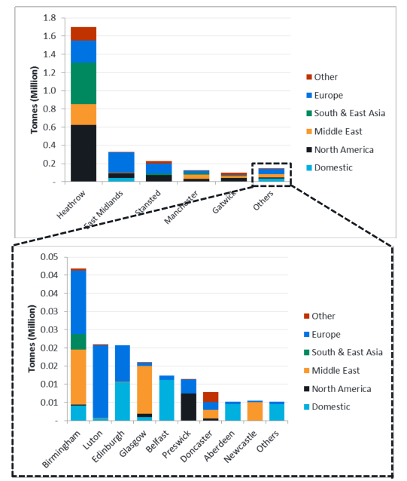
Destination of UK freight volumes
Across all airports, North America was the largest market (accounting for 32% of volume), followed by Europe (25%, 18% of which was to the EU) and South and East Asia (19%).
Heathrow, and to a lesser extent Gatwick, handled predominately North American and Asian freight, benefitting from extensive passenger networks.
The large European share of volume at East Midlands
reflects the airport’s role within its integrators’ networks. Similarly, at Stansted, much of thefreight volume is on European and North American routes.

Slide 53
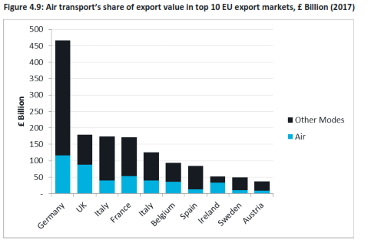
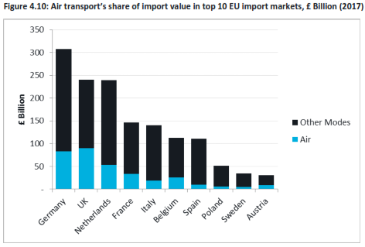
UK ships a large proportion of non-EU exports by air (49%)
The UK ships a greater proportion of its extra-EU exports by air than most other European economies. Although Germany is by far the largest exporter to non-EU countries, only 25% of its goods by value are transported by air, whereas the UK, which is second largest total export market, ships a far higher proportion (49% by value) by air.

Slide 54
LUNCH

Slide 55
Panel discussion
‘No Deal’ Trade & Transport with, and on, the Island of Ireland
Seamus Leheny, Policy Manager – Northern Ireland, FTA
John Lucy, Manager - International Transport & Trade Procedures, FTA
Aidan Flynn, General Manager, FTA Ireland
Sally Gilson, Head of Skills, FTA

Slide 56


Slide 57
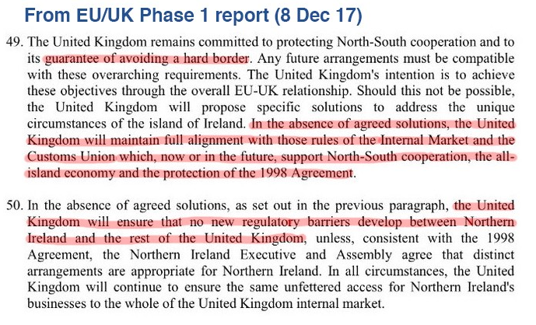

Slide 58
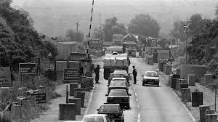
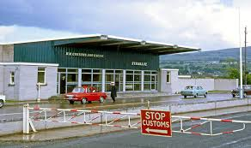
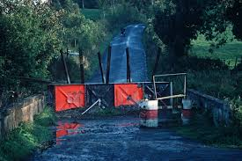
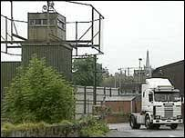

Slide 59
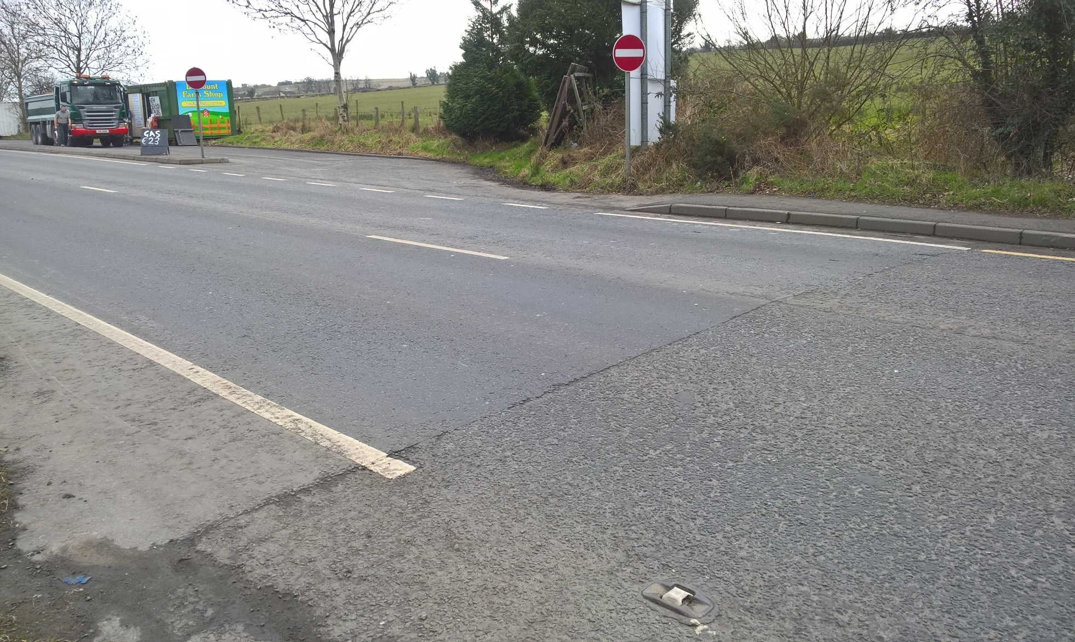

Slide 60
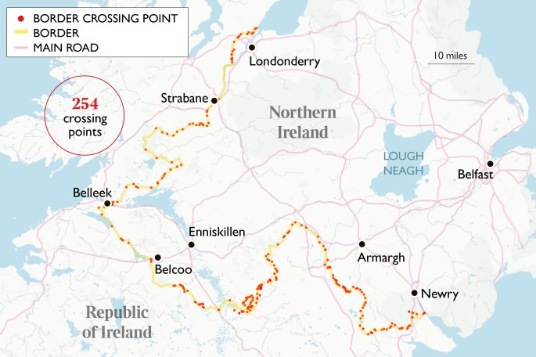

Slide 61
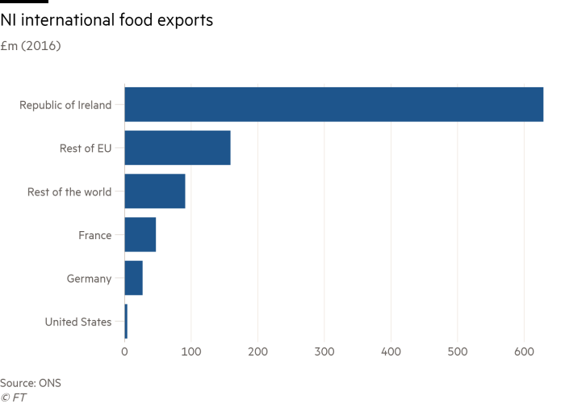
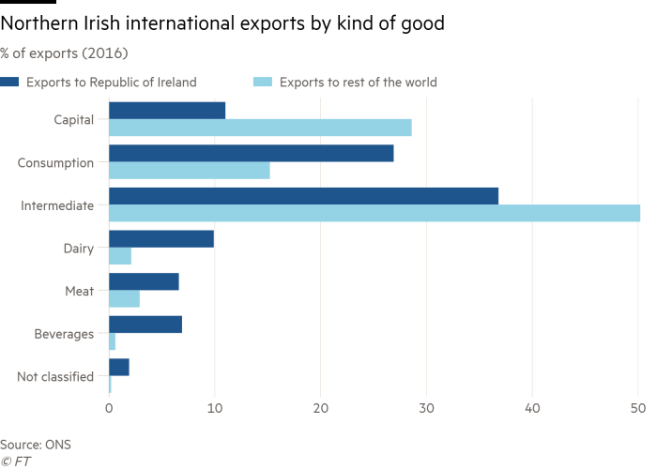

Slide 62
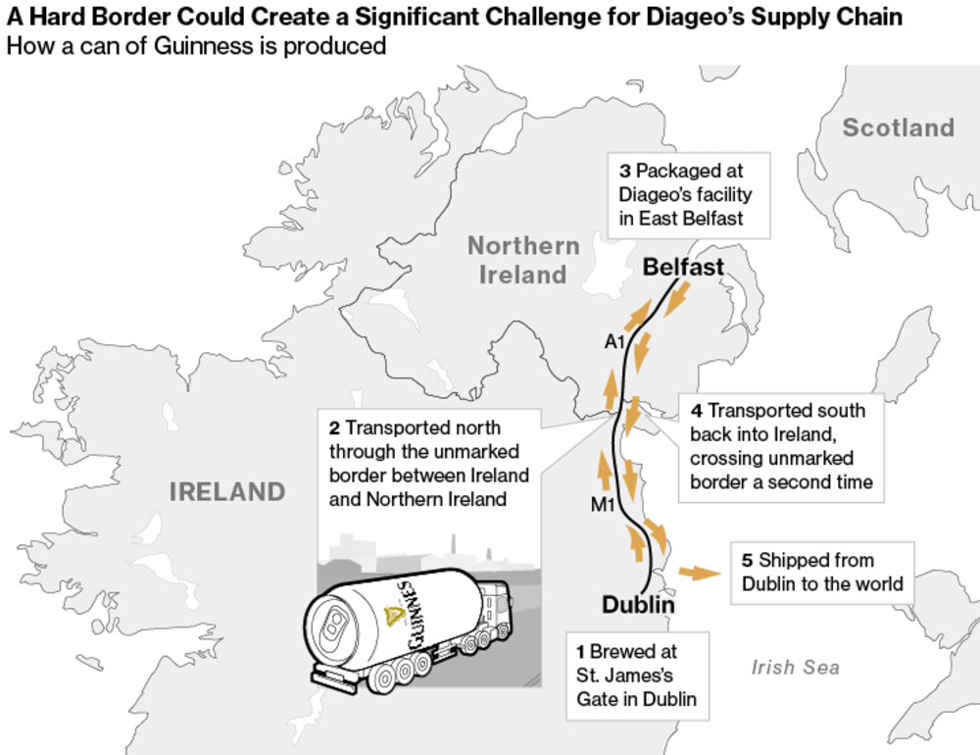

Slide 63
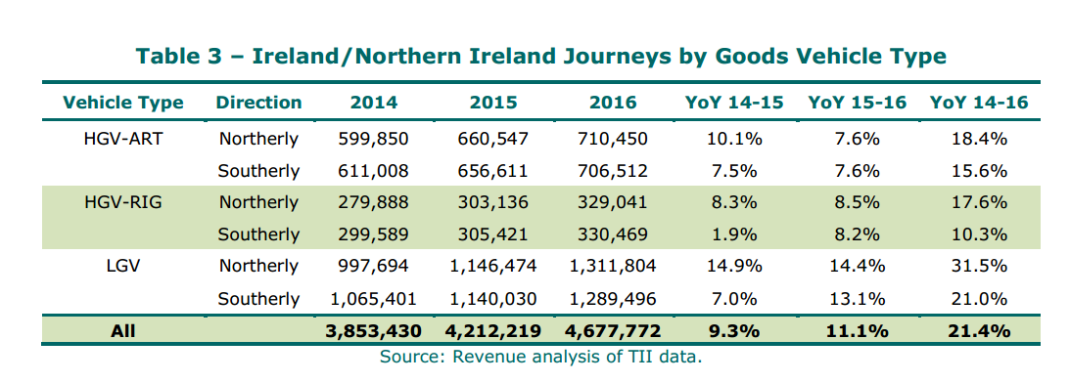

Slide 64
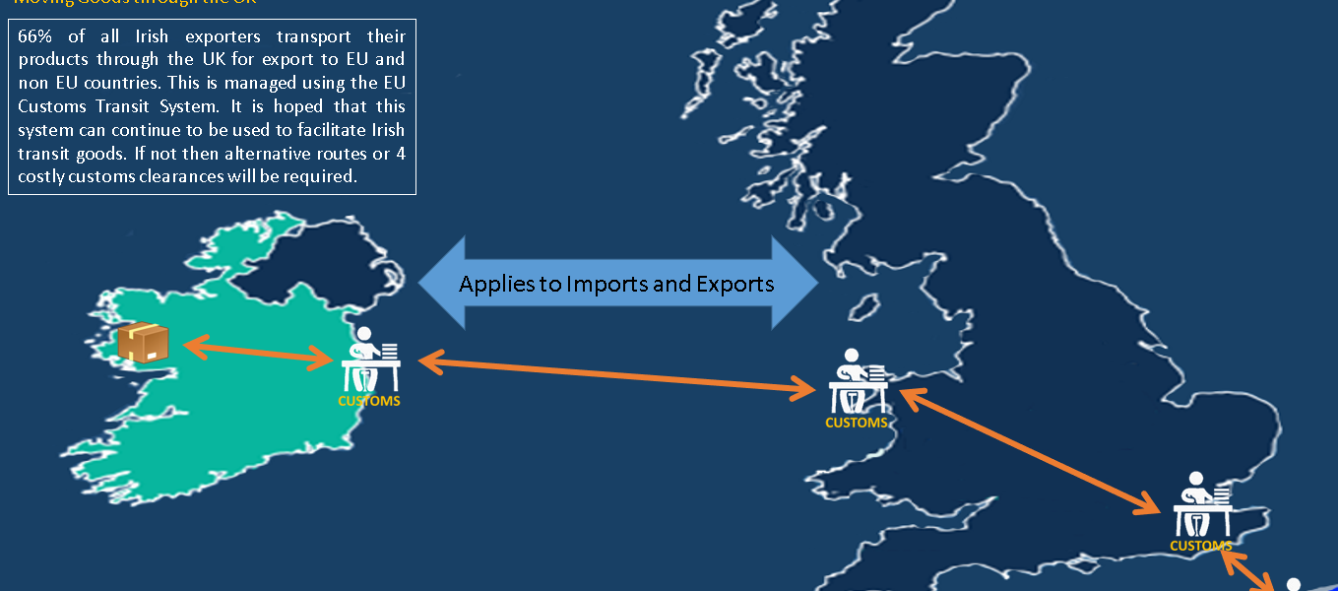
LANDBRIDGE TRANSIT ROI – EU – ROI

Slide 65
IMPLICATIONS FOR LANDBRIDGE TRADE IF NO TRANSIT AGREEMENT
SPEED, 20 HOURS BY RO RO , 40+ BY DIRECT FERRY, 60 + LO LO
FREQUENCY, MULTIPLE OPTIONS PER DAY
PORT OPTIONS, 80% VIA DUBLIN
150 K TRUCKS PER YEAR, 3 MIILION TONNES
MOST AT RISK INDUSTRIES: AGRI PRODUCTS, SEAFOODS & AUTOMOTIVE
PERISHABLES, LIVE ANIMALS, JIT SUPPLY CHAINS
ANY ALTERNATIVE REQUIRES REMAPPING MULTIPLE INDUSTRIES SUPPLY CHAINS AND MAY SIMPLY BE UNSTAINABLE FOR SECTORS

Slide 66
The UK’s Future Immigration Policy
Sally Gilson
Head of Skills
FTA

Slide 67
Logistics and EEA Workers
13% 43,000
19% 113,000
25% 19,000

Slide 68
What we know
Settled Status
5 years or more continuous residency
Pre-Settled Status
Under 5 years continuous residency
Post 31st March 2019
Free movement will continue throughout the transition period - 31/12/20
Applications open fully from March 2019
Apply for pre-settled status until 5 years completed
Applications can be made for Pre-Settled Status
Irish citizens
Irish citizens can continue to work and live in UK as part of the Common Travel Area

Slide 69
Current System for Recruiting Non EU Workers
Main options for entry non EU;
Tier 2 System – RQF 6 and above, min salary £30k, max 1,700 visas per month
Youth Mobility Scheme – 8 countries, 18-30 year olds, min of £1,870 savings and 1,000 people per country
Shortage Occupation List – As per Tier 2, to qualify for SOL must be RQF level of 6 and above (Currently seeking a call for evidence)

Slide 70
Migration Advisory Committee
Focus on higher skilled
No preference for EU citizens
Abolish cap on number of migrants under Tier 2
Extend Tier 2 to RQF level 3 or above
Retain minimum salary of £30,000 for Tier 2
Avoid lower skilled sectoral schemes besides agriculture
Extend Youth Mobility Scheme if extra lower skilled workers required

Slide 71
How the logistics sector would fair under recommendations
90% of logistics workers are below RQF level 2
88% earn below £30k
Minimum £30,000 salary restrictive – especially for Northern Ireland where average wages are lower
No provision for seasonal workers beyond Youth Mobility Scheme
White paper for immigration due by November
Government recognise need for lower skilled workers in some sectors and a system likely to be devised

Slide 72
No Deal EU Citizens in UK
The UK Govt guarantees that EU citizens resident in UK by 29th March 2019 will have right to stay and entitled to benefits and services
Settle Scheme will continue to run in case of no deal
After 1 January 2021 can no longer guarantee that National Identity card will be valid to enter UK
Frontier workers – will protect the right of those that live in other state but travel regularly to and from UK because they are employed or self-employed. Many of this cohort will spend enough time in UK to qualify for settled status
Other Frontier workers will be able to obtain a separate UK immigration status which will allow them to continue frontier working in the UK after exit*
Professional qualifications will continue to be recognised as long as achieved by 29 March 2019

Slide 73
No Deal – UK Nationals in EU and EFTA
UK cannot act unilaterally to protect rights of UK nationals in EU – withdrawal agreement only way to guarantee
Continue to call on EU and member states to uphold commitments to citizens and protect rights of UK nationals including benefits and services
UK Nationals that return due to no deal would have access to NHS
Further detail will come re bringing EU or Non EU family members back home with them
Still in discussions to protect past social security contributions and reciprocal healthcare
UK seeking arrangements with EFTA states – EFTA states confirmed UK nationals living in those states will be able to stay

Slide 74
How can we train new staff
Brexit will create further skills gaps through skills shortages and new regulations/ procedures
Freight Forwarders and Customs Experts – can utilise apprenticeships and additional money from Government in the form of customs training grants
HGV Drivers – Apprenticeships currently only funded route, occasionally DWP training programmes but money limited

Slide 75
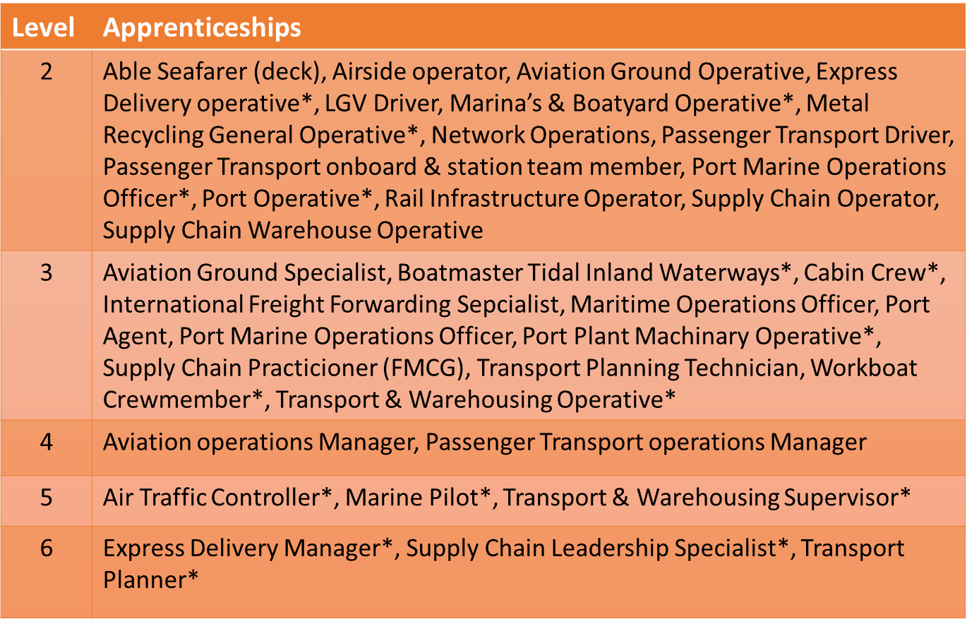
Logistics apprenticeships

Slide 76
Customs Training and IT Grants
Government announced a one off investment of £8million for customs training and IT improvements to support businesses through Brexit
There is £2 million available to provide training grants which will provide funding for up to 50% of the cost of training staff
There is £3 million available to support investment in IT improvements that increase the automation and productivity of completing customs declarations (NB. This grant is only applicable to customs intermediaries)
Applications will close on 5th April 2019 or earlier if funding allocated

Slide 77
What is FTA campaigning for
Continued access to lower skilled workers
Amendment to Shortage Occupation List and Future Immigration White Paper to reduce salary and qualification restrictions
Mechanism for employers to check rights to work for EU citizens
Assurances for frontier workers
Unused Apprenticeship Levy funds to be utilised for emergency Brexit training
Ultimately convert to Training Levy to include all vocational training

Slide 78
Panel discussion
People Issues:
Status of EU Employees under ‘No Deal’
Sally Gilson, Head of Skills, FTA
David Yazdi, Director, Solicitor and Co-founder, HY
Pauline Bastidon, Head of European Policy & Brexit, FTA
Aidan Flynn, General Manager, FTA Ireland

Slide 79
COFFEE

Slide 80
Top things you can do now to de-risk Brexit:
FTA Speakers nominate their best advice to Members to de-risk Brexit, given the current situation
Sarah Laouadi, European Policy Manager, FTA
Heidi Skinner, Policy and Public Affairs Manager, FTA
Pauline Bastidon, Head of European Policy & Brexit, FTA
John Lucy, Manager - International Transport & Trade Procedures, FTA
David Yazdi, Director, Solicitor and Co-founder, HY
Sally Gilson, Head of Skills, FTA
Ian Gallagher, Head of Compliance Information, FTA
Alex Veitch, Head of Global Policy, FTA
Aidan Flynn, General Manager, FTA Ireland
Seamus Leheny, Policy Manager – Northern Ireland, FTA
James Hookham, Deputy Chief Executive, FTA

Slide 81
Top tips to de-risk your Brexit
Sarah Laouadi: Apply for ECMT road haulage permits but don’t forget to check if some of your operations can benefit from a permit exemption.
Heidi Skinner: If your freight is traveling through Kent after we leave the EU please allow more time for delays. Without more knowledge about the controls and checks at the EU borders it is difficult to know exactly how long delays maybe but they should be factored in.
Pauline Bastidon: Most border delays arise from non-Border checks, so plan carefully goods subject to non-Customs checks.
John Lucy: If you haven’t done already start talking to freight forwarders who can do your customs and safety and security declarations and ensure you have compatible IT systems
David Yazdi: Consider staff communications regarding the status of EU27 workers carefully, monitor staff behaviour and reinforce diversity policies to avoid discrimination/harassment cases on grounds of race.
Sally Gilson: Work on your talent management programmes now, if you need help FTA consultancy will be able to assist!
Ian Gallagher: Check whether hire companies have registered any trailers they hire to you before you take them out of the UK.
Alex Veitch: Find a Customs facilitation or easement that works for your supply chain and make the most of cost and time savings available.
Aidan Flynn: Watch out for announcement by Irish Customs on their arrangements for processing and clearing inbound shipments from Britain, including from the Mainland via the land-bridge.
Seamus Leheny: Review your distribution strategies for the Island of Ireland and select the point of landing carefully depending on the eventual Brexit scenario.
Chairman’s reminder: Join FTA to stay informed on Brexit developments, or if you are already a Member join in, and make the most of your membership through Freight Councils, eNews, events and services.

Slide 82
Chairman’s closing session
James Hookham
Deputy Chief Executive
FTA

Slide 83
Getting Logistics Ready for Brexit
NB: The slides reflect our understanding as at the date of the conference and may no longer be accurate as the situation changes
19th December 2018

