Slide 1
Logistics UK’s ‘Route to Net Zero’ webinar​
10 November 2021: COP26 Transport Day

Slide 2
Webinar housekeeping
We are recording the webinar today, so to ensure continuity, attendees will be muted, but if you have a question, please use the questions panel to ask questions as we go through the webinar.
This can be done by the process shown here;
We are monitoring the questions box and will answer questions at the end if we have time or by email after the event if we don’t.
Please also use the questions box to flag up any technical issues such as sound and image quality; we will do our best to resolve them.

Slide 3
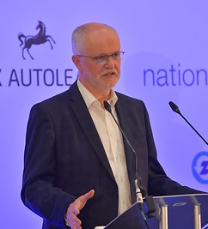
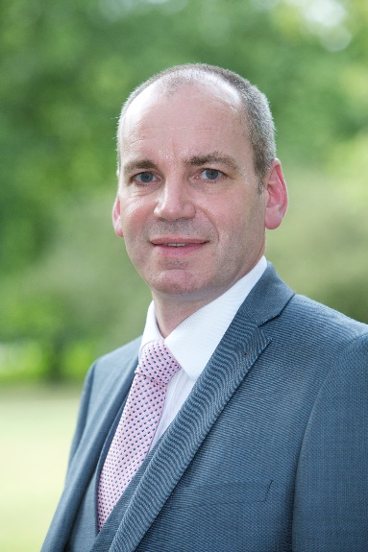
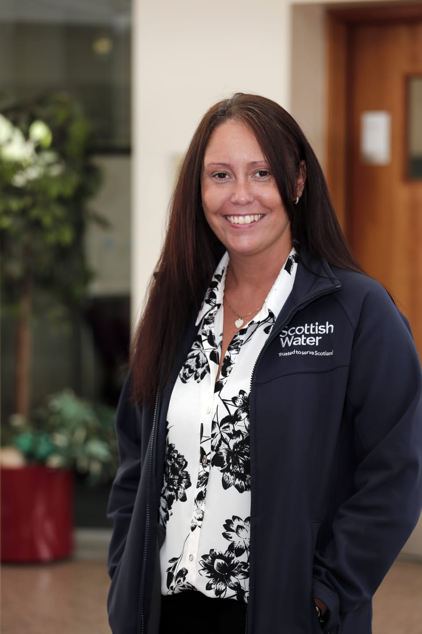
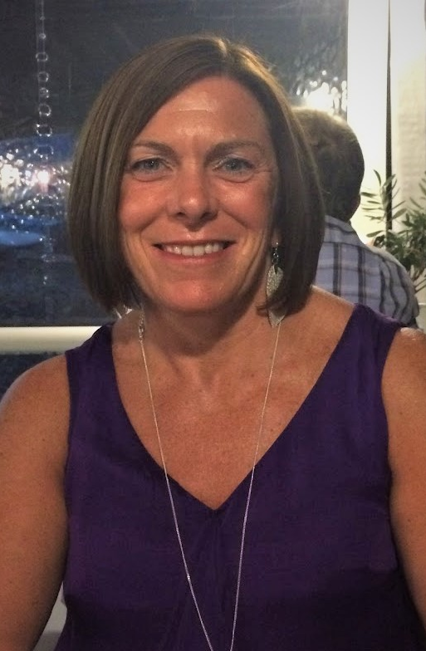
Welcome
David Wells, Chief Executive, Logistics UK
Andy Eastlake, CEO, Zemo Partnership
Elaine Pringle, Fleet Manager, Scottish Water
Jackie Hewson, Alternative Fuels Implementation Manager – Transport, John Lewis Partnership
Michelle Gardner, Head of Public Policy, Logistics UK

Slide 4
Route to Net Zero manifesto
Tackling climate change is top of the political agenda - today is "transport day" at COP26
World leaders are currently discussing binding commitments on how to tackle transport emissions across the globe
Logistics UK’s decarbonisation manifesto provides:
Road map to decarbonise logistics across all transport modes
Measures industry needs from government and other stakeholders to make this a reality

Slide 5
Route to Net Zero commitment
Logistics UK is asking its members to sign up to its Route to Net Zero commitment and pledge to reduce their greenhouse gas emissions as quickly and effectively as possible on the pathway to net zero.
Visit logistics.org.uk/environment/netzero for more information and to submit your application.
Route to Net Zero members John Lewis Partnership and Scottish Water are joining us this morning to talk about the steps they have taken so far to decarbonise, and their plans going forward.

Slide 6
The journey so far

Slide 7
The journey so far

Slide 8
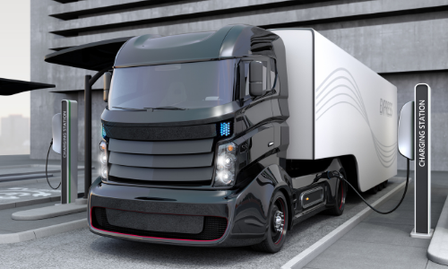
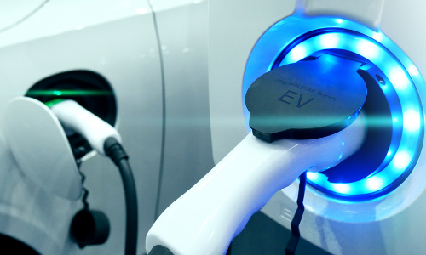
Road freight
Uptake of battery electric vans is growing among members but adequate supporting infrastructure and power supply funding remain challenges
The picture for HGVs is more uncertain, with battery electric, electric road systems, and hydrogen all being explored
While long-term HGV solutions are being developed, there are still many steps logistics businesses can take now to decarbonise their operations

Slide 9
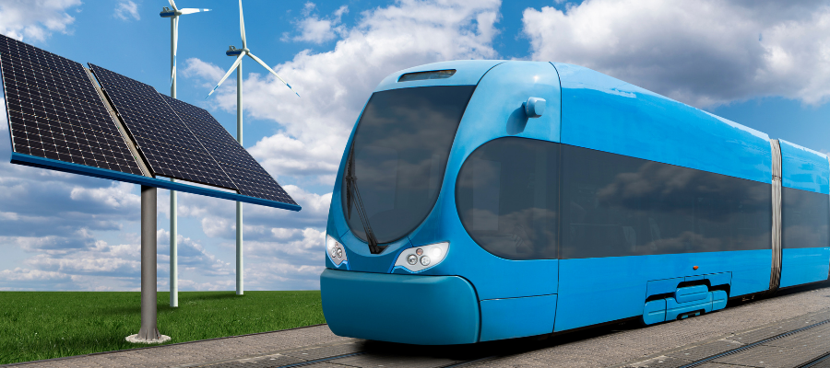
Multimodal
Modal shift to rail or water can help to remove vehicles off the road and reduce emissions
Logistics UK supports the Government’s rail freight growth target, along with its pledge to pursue infill electrification
Logistics UK supports recent announcements from the Government on developing Sustainable Aviation Fuels and Zero Emission flights
The UK must become a global hub for low-emission aviation

Slide 10
Collaboration and the power of Partnership on The Route to Net Zero
Andy Eastlake - CEO, Zemo Partnership

Slide 11
Zemo Partnership working with Logistics UK
Previously LowCVP (2003-2021).
An independent, non-profit partnership that brings together government, industry and a wide range of expert stakeholders in the field of low and zero-emission mobility.
The Partnership plays a key role in helping the UK Government to deliver its zero carbon transport strategy, with the objective of ensuring that the UK takes a leading role in the global shift towards clean, low & zero carbon transport.
Government & Public Bodies
Environmental
& Academia
Fuel Suppliers
Finance & Leasing
Energy Infrastructure
Fleet Operators
Technology
Suppliers
Automotive
Manufacturers

Slide 12
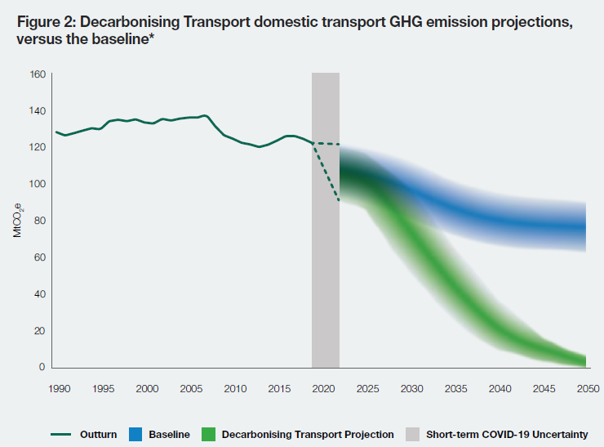
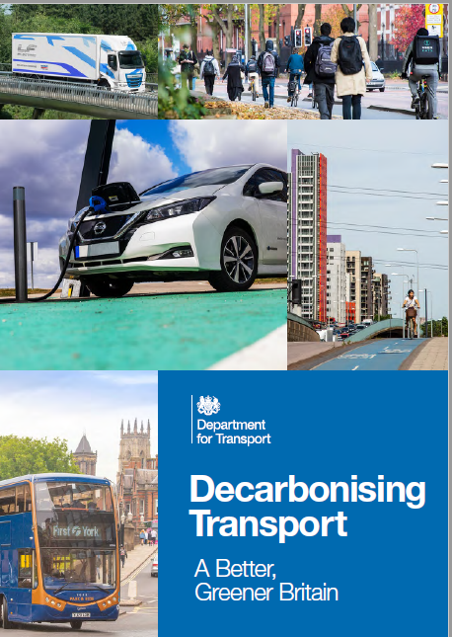
Scale of the challenge

Slide 13
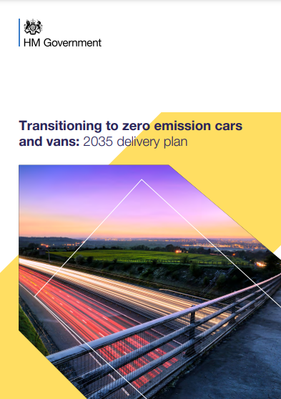
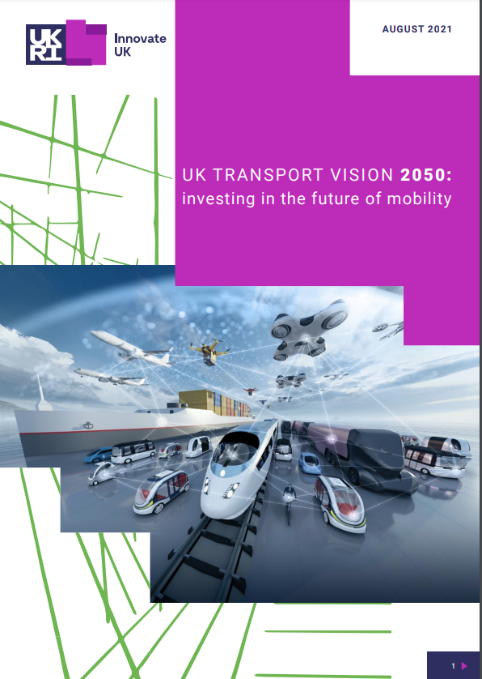
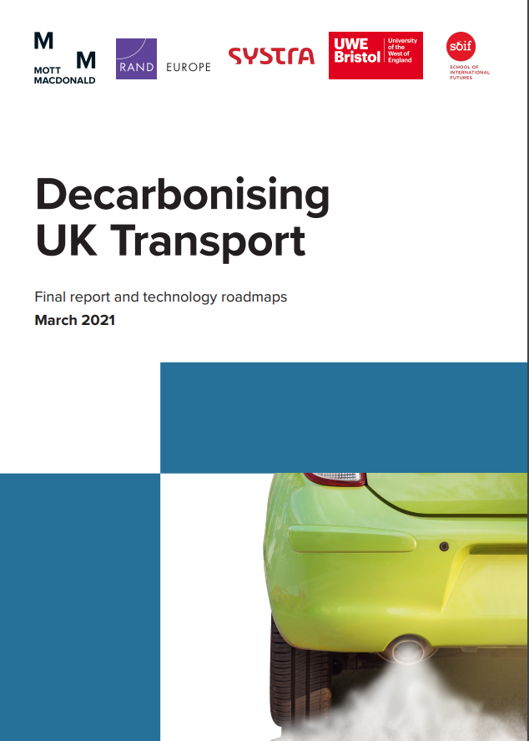
Making sense of the Plan (s)

Slide 14
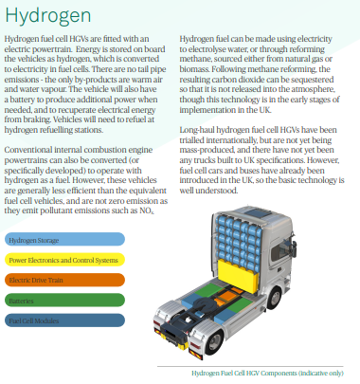
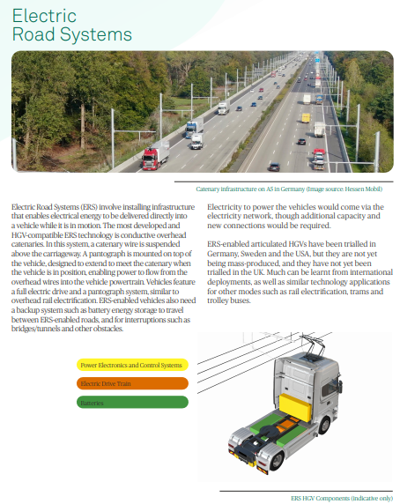
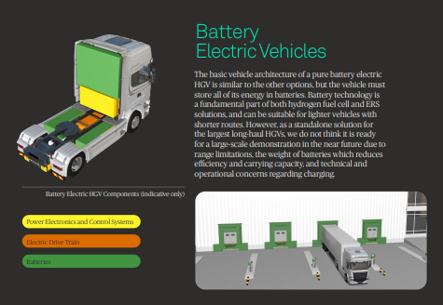
Shaping and supporting the research Zero Emission Road Freight (ZERF) trial options
Many common components so UK supply chain focus too

Slide 15
Take the quick wins ……. Quickly
96% of the total GHG impact from conventional Diesel HGVs, is from fuel used in operation
Easy wins today and tomorrow
Reducing fuel used –
Aero, Tyres, Driving style
Using renewable fuels –
Biodiesel, HVO
Using Gas truck with renewable methane
While we develop a clearer picture of the future of zero (tailpipe) emission HGVs

Slide 16
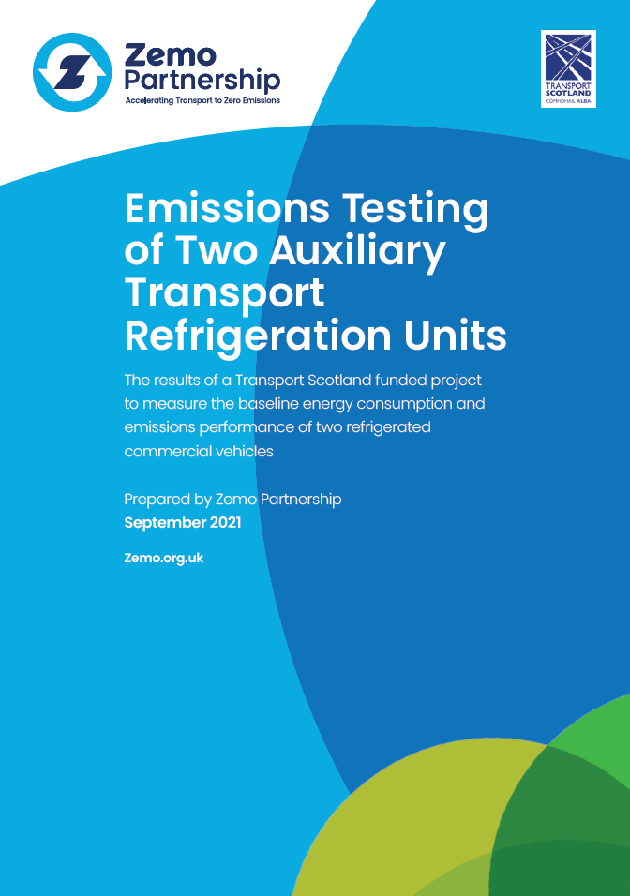
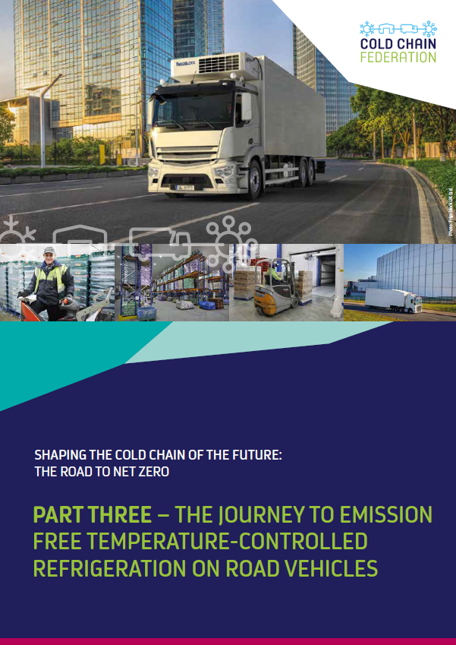
Don’t forget Ancillaries, Transport Refrigeration Units
Report published in September
Industry workshop (with Cold Chain Federation) Tuesday 26th October, 2:30-4:30pm
Develop consensus around next steps
Disseminate Zemo and CCF reports
Raise awareness of alternative technologies

Slide 17
Supporting the commitment with actions… for government , industry and users
Development of the Plug-in Van & Truck Grant scheme and standards
Renewable fuel policy proposals to government
Renewable fuel assurance scheme for suppliers and operators
Electrification of Fleets at depots – energy and infrastructure
Technology assessment and accreditation for fuel and carbon savings
Consultation support on ICE phase out plans
Hydrogen well to tank and well to wheel studies
Actions for new vehicle sectors (Powered Light vehicles)
None of us can decarbonize alone, but together……. In partnership….

Slide 18
Don’t forget Ancillaries, Transport Refrigeration Units
Report published in September
Industry workshop (with Cold Chain Federation) Tuesday 26th October, 2:30-4:30pm
Develop consensus around next steps
Disseminate Zemo and CCF reports
Raise awareness of alternative technologies

Slide 19
Scottish Water
Route to Net Zero Fleet
Elaine Pringle
Fleet Manager

Slide 20
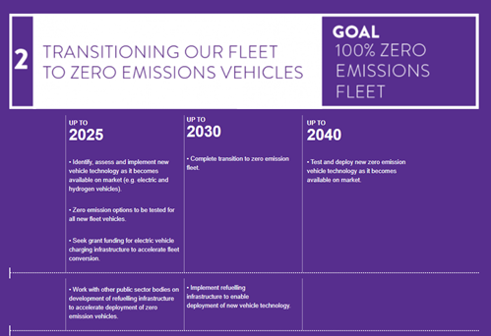
Fleet Net Zero Ambitions and Objectives
Scottish Government: Programme for Scotland
Public sector fleets will phase out the need for:
Petrol or diesel cars by 2025
New petrol or diesel light commercial vehicles from 2025
New petrol or diesel commercial vehicles from 2030
Scottish Water Net Zero Emissions Routemap
Up to 2025: Identify, assess and implement new zero emission vehicle technology as it becomes available
Up to 2030: Transition to zero emission fleet
Water Industry Commission for Scotland
Scottish Water should want to be more than 40% of the way towards its 2040 net zero emissions by 2027 given that the last steps towards net zero are likely to be the most difficult
20

Slide 21
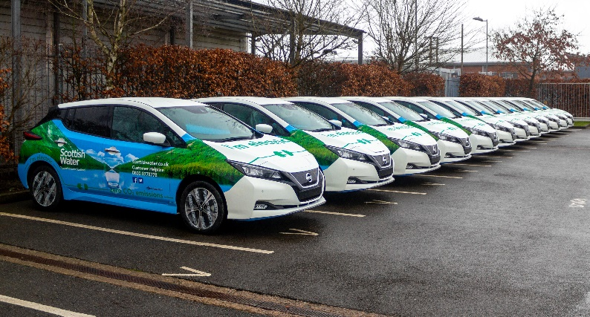
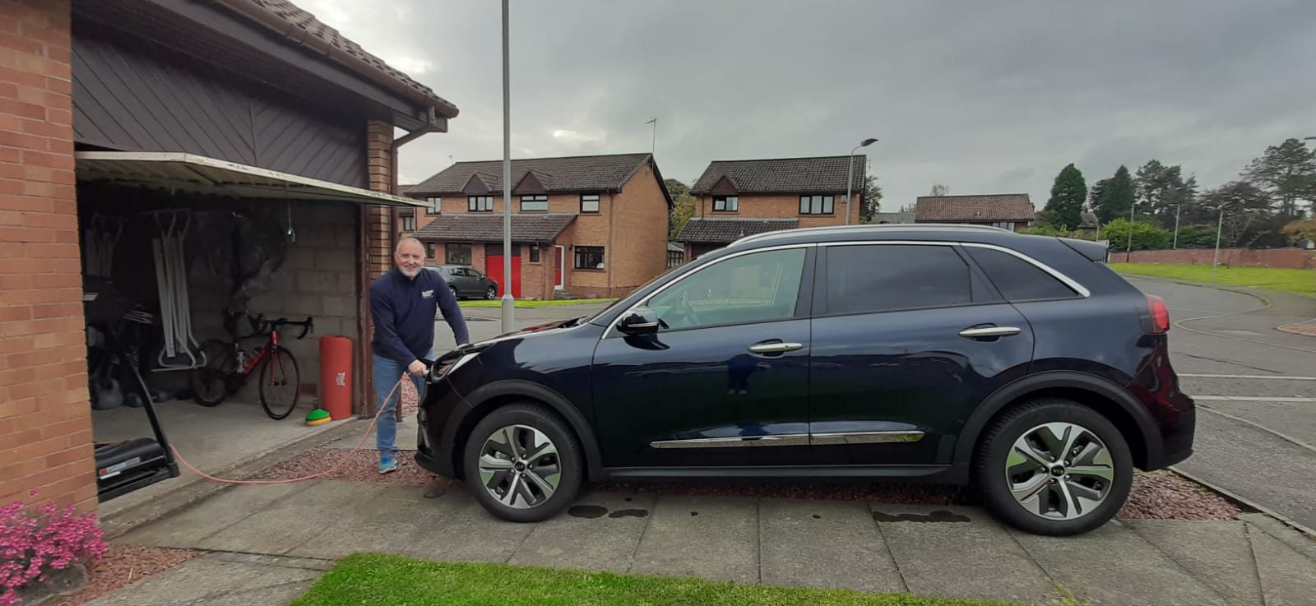
Scottish Water Business Miles
Pool cars
We have transitioned our pool cars to electric vehicles (EV)
Lease Cars
Introduced an EV only lease car policy
Move to a Total Cost of Ownership (TCO) model
>30% of our lease cars are now EV
Grey Fleet / Personal Car Drivers
Developing options to introduce a Salary Sacrifice scheme to make EVs more
accessible to all employees
21

Slide 22
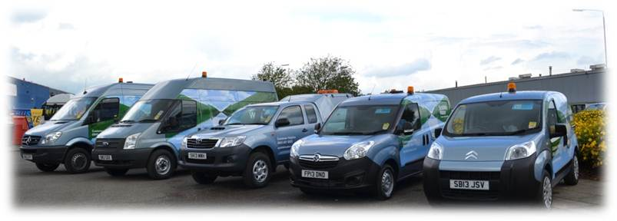
Commercial Fleet Review
Vehicle Technology
Cenex completed a market scan and provided us with options and impacts of replacing our diesel vehicles with EV or low emission vehicles
Operational Criteria
Criteria was applied based on known operational constraints, including current daily mileage, payload and towing capability, compatibility with on-board equipment / power required and the charging or refuelling infrastructure available or viable to install
Suitability Assessment
Based on current vehicle technology and operational criteria, EVs in the small and medium van segments are viable options
Infrastructure Requirements
To enable transition into EVs, it is likely that we will require a blended approach between workplace and home charging
22

Slide 23
Commercial Fleet – Transition to Electric Vehicles
Approach
We will transition to EVs when it is economic (lowest total cost of ownership) and operationally practicable to do so
Economic
Small and medium vans: c.£10k more expensive to purchase, but reduction in fuel costs will see payback within the asset lifecycle, making it the lowest total cost of ownership
Operational Constraints
There are a number of operational constraints to be considered before replacing a diesel van with an EV
We will not replace a diesel van with an EV if it will not enable operational teams to do their job – we do not want any impact on service to our customers
Vehicle Technology
Range
Payload / Towing capability
Compatibility with on-board equipment
Length of time taken to charge
Infrastructure
Availability of public infrastructure
Availability of workplace charging
Opportunity to install home charging
Operational Constraints
Infrastructure
Requirement to take vehicle home for business purposes
Standby
Direct to site working arrangements
Maintenance
Availability of garage and supplier network to service and maintenance EVs
23

Slide 24
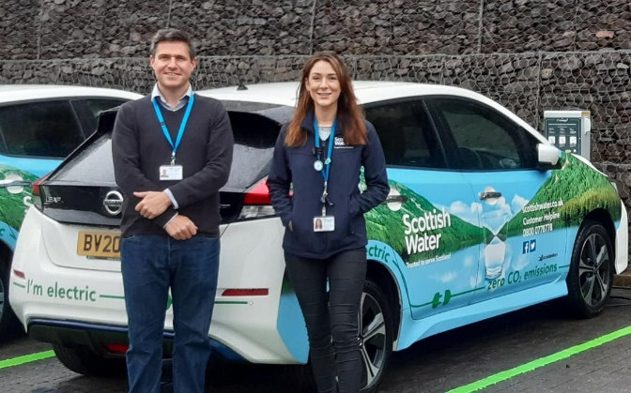
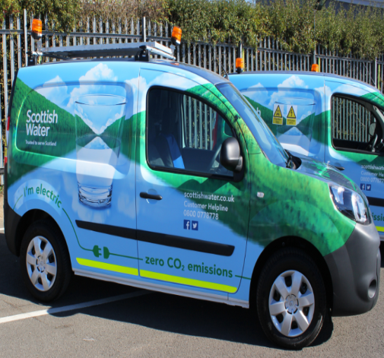
Commercial Fleet – Transition to Electric Vehicles
EV Transition Project Team
Engaging operational teams
Installation of supporting infrastructure and mechanism for home charging
Market scan and trials of emerging alternative fuel technology including hydrogen, biomethane and biodiesel
Transition Plan
Trials so far include: Renault Kangoo vans, one with hydrogen fuel cell range extender, electric mini excavator
20 Nissan e-NV200
We will replace up to 600 of our small and medium vans with EVs over the next 5 years
24

Slide 29
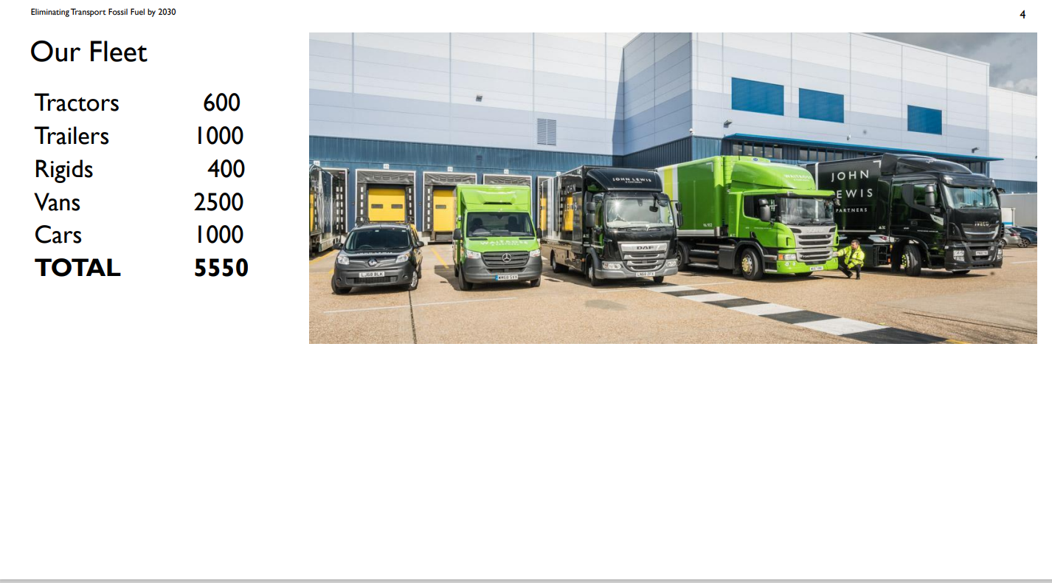

Slide 32
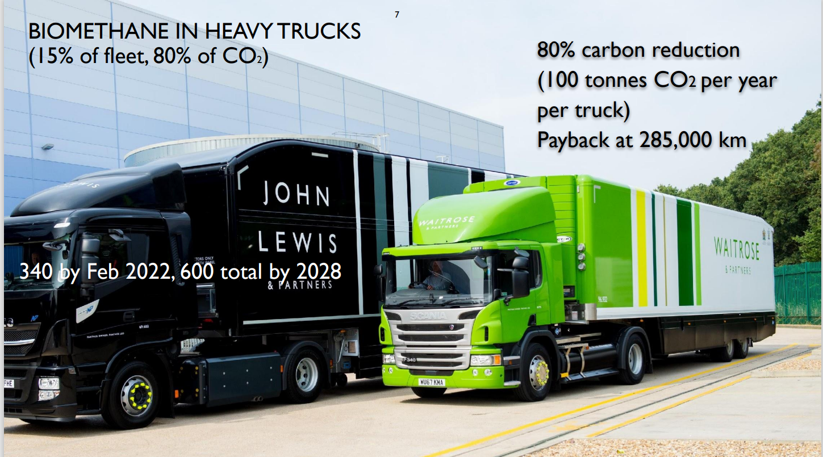

Slide 36
ANY QUESTIONS?

Slide 37
Thank you
Please visit www.logistics.org.uk/environment
for more information on Logistics UK’s decarbonisation work, including details on how to join the Route to Net Zero commitment

